Slide 1
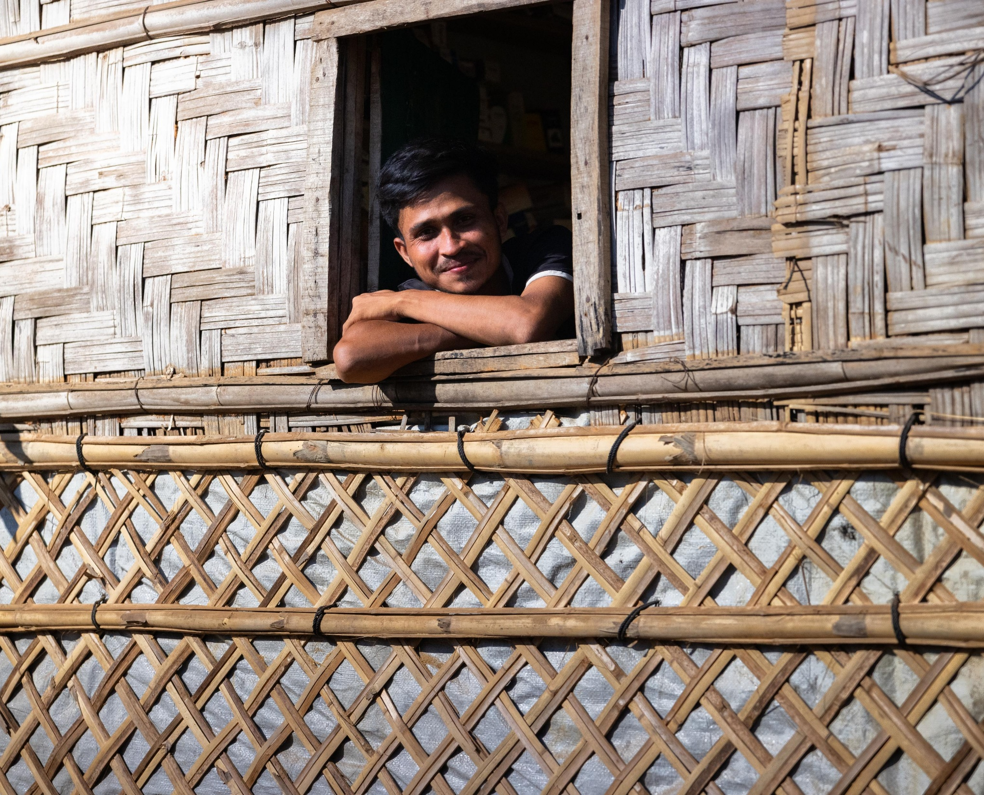


Slide 2
UNHCR
UNHCR is the only United Nations agency with a mandate for the protection of refugees at the global level. UNHCR’s Statute, which was adopted by the General Assembly in 1950, defines UNHCR’s functions as:
providing international protection to refugees; and
assisting governments in finding durable solutions for them.
Further, UNHCR’s Executive Committee and the UN General Assembly have authorised involvement with other groups. These include:
former refugees who have returned to their homeland (returnees);
internally displaced people; and
persons who are stateless or whose nationality is disputed.

Slide 3
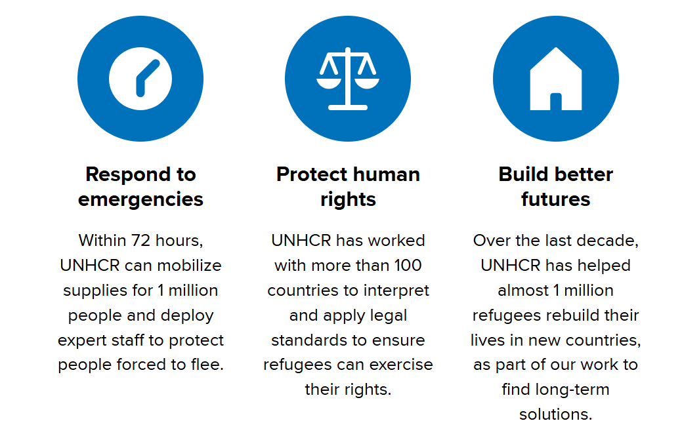
What we do
Education
Access to safety
Access to safety
Settlements & Shelter
Livelihoods
Long term solutions
CBI
Coordinating assistance
WASH
Protection
Ending statelessness
Advice on mixed movements
Advocacy
Notes:
Access to safety
Making sure refugees can reach safety and are not pushed back across a border is central to our work. People forced to flee must not be expelled or returned to situations where their life and freedom are at risk. This is the prohibition against refoulement, enshrined in the 1951 Refugee Convention.
If we expect people might be fleeing across a border, our roving teams are out in vehicles in all kinds of terrain, sometimes 24 hours a day to help ensure refugees can reach safety. We monitor whether governments and armed groups are preventing refugees from entering a safe area. When necessary, we advocate with authorities and alert the media. We also try to make sure that people who do cross a border have a realistic chance to have their refugee status recognized.
Protection
Protection underpins all UNHCR activities aimed at ensuring the rights of refugees, displaced and stateless people are recognized.
We promote accession to the 1951 Refugee Convention which outlines the international standards of treatment for refugees. We also support States to register displaced people and provide them with documentation, and support refugee status determination, which is the administrative process that decides if a person seeking international protection is considered a refugee under international, regional or national law.
Advocacy
We advocate for and work with governments to change laws and practices to better protect displaced people, creating change on national, regional and global levels. This helps ensure refugees, asylum-seekers and other forcibly displaced persons can access support and services, get documents, go to school, work and exercise other rights.
Bringing about positive changes on national, regional and global levels can take years, but we accomplish it with the help of lawyers, judges, civil society organizations, politicians and students.
Ending statelessness
We also work to secure nationality for people who are stateless by advocating for change in laws and practices. One of the most important ways to achieve this is through nationality laws that allow children to become citizens of the country where they were born if they would otherwise be stateless. Birth registration is also critical. Likewise, we make sure people do not lose their nationality through changes to laws, when new states emerge or when there are changes to national borders.
Building Futures
UNHCR helps them to rebuild their lives through access to education and work. This also helps displaced people to regain a sense of purpose and become part of the communities where they live.
At the same time, we work with governments and the international community to find long-term solutions so refugees can find a place to call home. This can include support to integrate into the country where they have sought refuge, repatriation to their home country (when safe to do so), or resettlement in a third country.

Slide 4
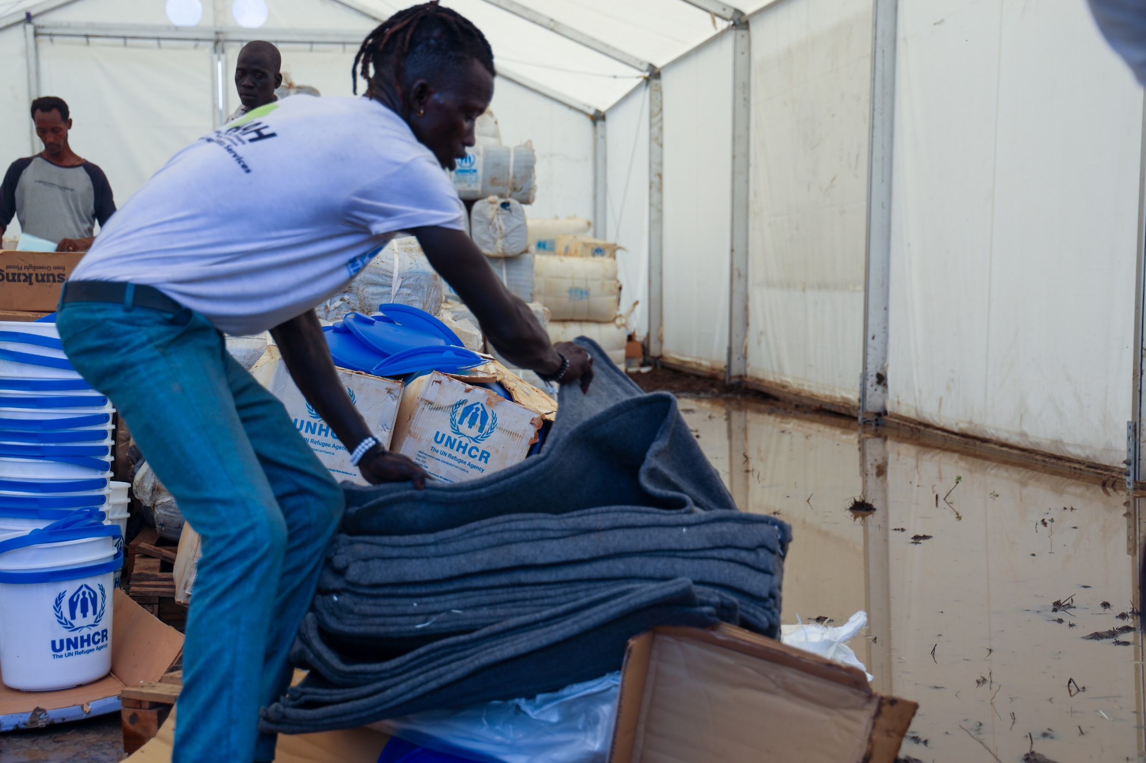
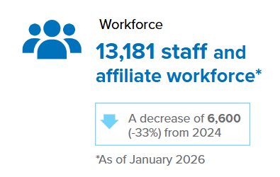
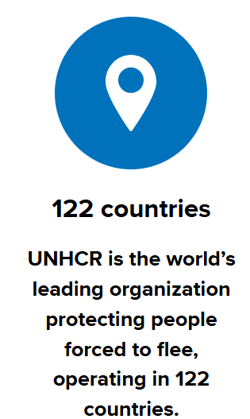

Global Presence
Notes:
122 countries and territories and 382 office locations

Slide 5
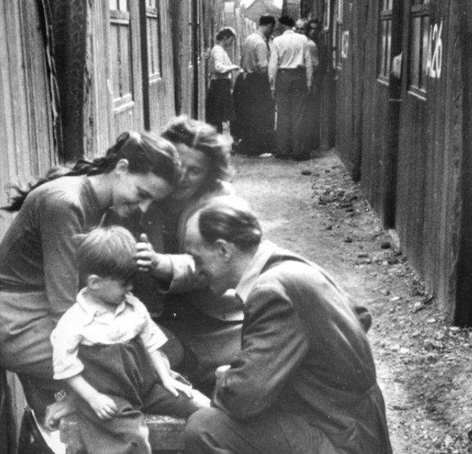
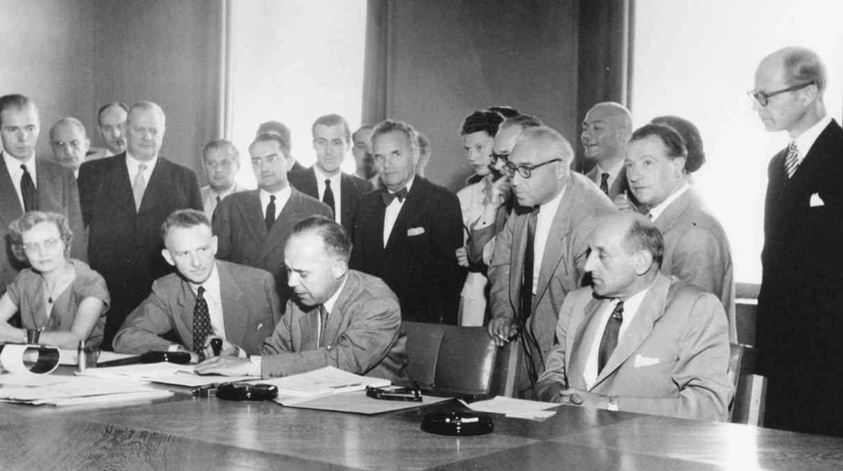
75th Anniversary of the Refugee Convention
Refugees from Eastern Europe pictured in a camp in Germany after the Second World War
Signing of the Refugee Convention

Slide 6
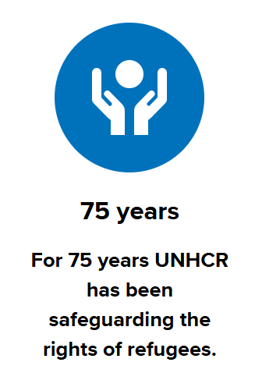
The 1951 Convention provides the internationally recognized definition of a refugee and outlines the legal protection, rights and assistance a refugee is entitled to receive.
UNHCR serves as the ‘guardian’ of these documents. We also help governments translate them into national laws to ensure refugees are protected and can exercise their rights.
The core principle of the 1951 Convention is non-refoulement, which asserts that a refugee should not be returned to a country where they face serious threats to their life or freedom.
A Lifesaving Tool.
Rules That Bring Order in a Changing World.
Protection Is Our First Line of Defence.
Notes:
From the ashes of the Second World War came a promise: that people forced to flee war, violence and persecution would not be left without protection, but met with safety. Seventy‑five years on, that promise matters more than ever — and it must be upheld.
A Lifesaving Tool, Not Just a Treaty. The Refugee Convention is more than a legal document. It is a practical, lifesaving tool — helping ensure that people fleeing war and persecution can find safety and are not sent back to danger.
It also recognises something essential: no country can manage displacement alone. Protection works best when countries work together, sharing responsibility and supporting one another.
Rules That Bring Order in a Changing World. Global displacement is rising, and the world is more complex than ever. The Refugee Convention provides a clear, agreed framework — setting out who qualifies for protection and the standards that apply.
It remains flexible and relevant today providing countries the tools to manage asylum systems in an orderly and predictable way, while maintaining control of their borders and systems.
What matters is how it is implemented in practice — with effective systems, fair decisions, and international cooperation.
A Tradition the UK Can Be Proud Of. The United Kingdom helped shape the Refugee Convention and has long played a leading role in offering protection to people forced to flee.
That tradition continues today — through asylum, resettlement schemes, community sponsorship, and longstanding partnerships with countries hosting the vast majority of the world’s refugees. It reflects the best of the UK: fairness, compassion, and a willingness to work with others to find practical solutions.
Protection Is Our First Line of Defence. There is no substitute for the Refugee Convention. It remains as vital today as it was 75 years ago — not only to protect individuals, but to help prevent instability, reduce disorder, and support global security.
Strong protection systems, alongside safe pathways and international cooperation, are the best way to manage displacement in a way that is fair, controlled and sustainable.
Ultimately, the Convention is more than a framework for others — it is a safeguard for all of us. At any time, any of us could need its protection.

Slide 7
Total forcibly displaced: 117.8 million at end of 2025
Global Trends
68.7 million internally displaced people
27 million refugees under UNHCR's mandate
6 million
Palestinian refugees under UNRWA's mandate
4.5 million people estimated to be stateless. The true number is likely to be much higher as many stateless populations are unregistered
7.2 million other people in need of international protection
One in every 70 people, or 1.4 per cent of the entire world’s population, is now forcibly displaced
9 million asylum-seekers
Notes:
The total number of forcibly displaced people (117.8 million) encompasses refugees, asylum-seekers, other people in need of international protection and internally displaced people. It includes refugees and other displaced people not covered by UNHCR’s mandate and excludes other categories such as returnees and non-displaced stateless people.
The category “Other people in need of international protection” was first introduced in mid-2022 reporting and refers to people who are outside their country or territory of origin, typically because they have been forcibly displaced across international borders, who have not been reported under other categories (asylum-seekers, refugees, people in refugee-like situations) but who likely need international protection, including protection against forced return, as well as access to basic services on a temporary or longer-term basis.“
Other people in need of international protection are included in the global forced displacement total.
Venezuelans previously designated as “Venezuelans displaced abroad” are included in this new category. This change has been made retroactively in UNHCR’s statistics since 2018 and the term Venezuelans displaced abroad will no longer be used.

Slide 8
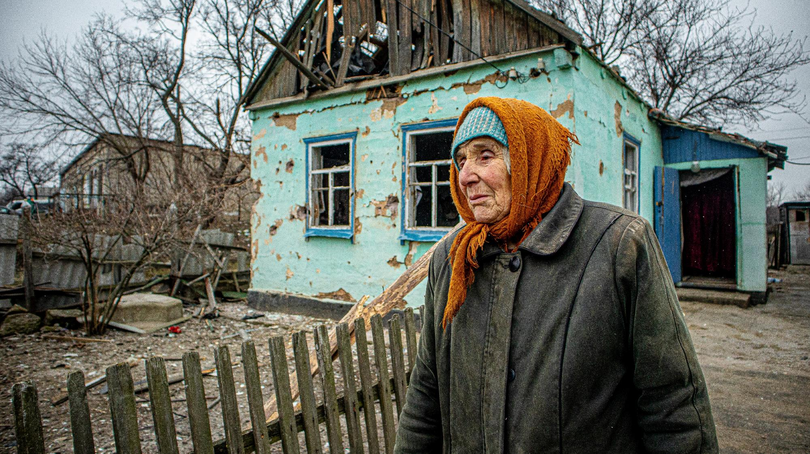
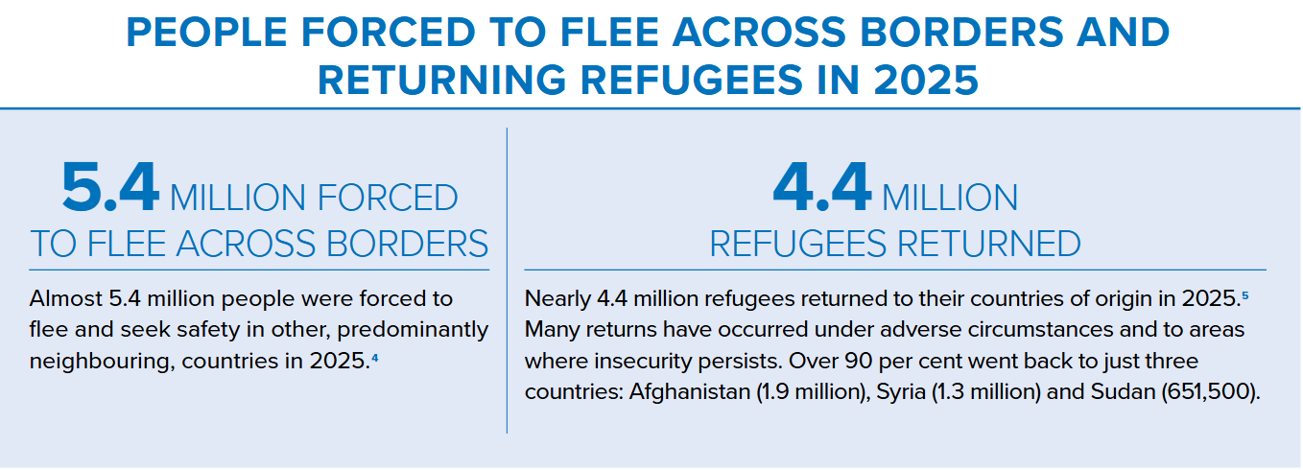

Slide 9
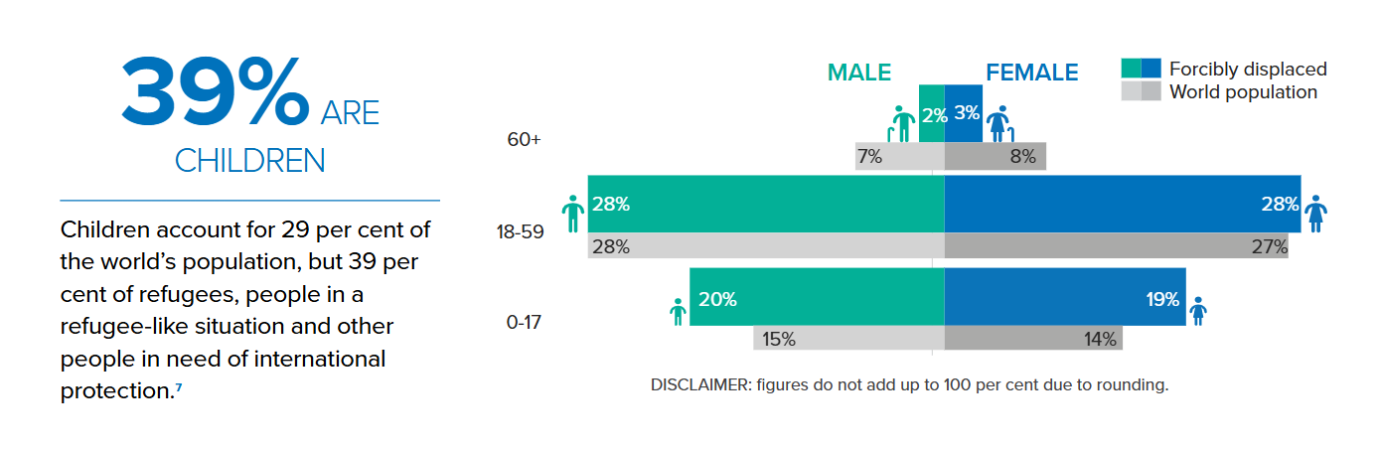
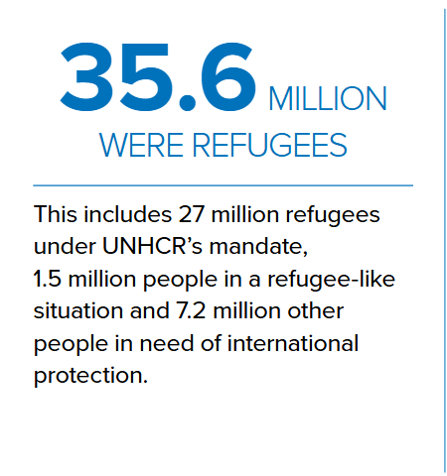
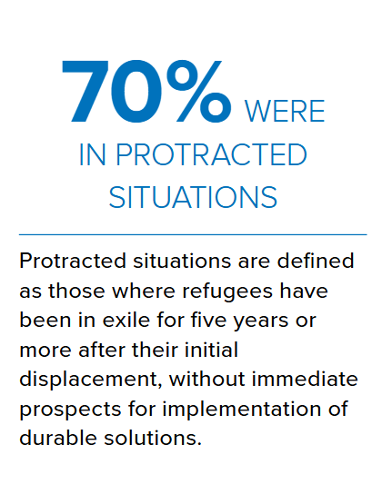

Slide 10
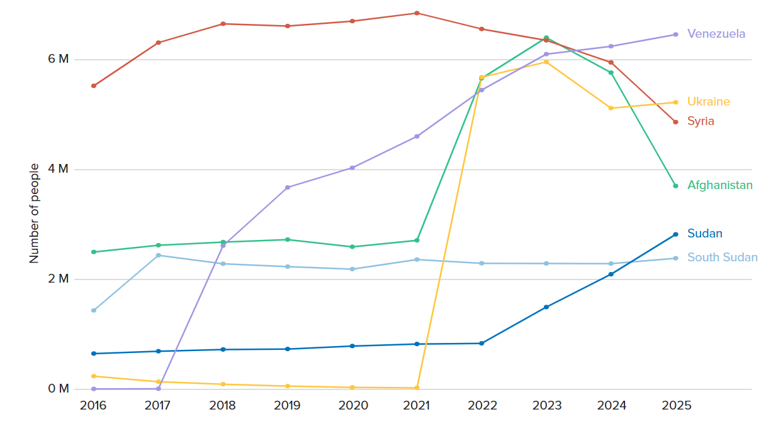
Where do refugees come from?
Notes:
More than seven in ten refugees and other people in need of international protection originated from the
same six countries in 2025 as in 2024:
Afghanistan, South Sudan, Sudan, Syria, Ukraine and Venezuela.
The number of Afghan and Syrian refugees fell, while
increases were observed in the reported statistics
for refugees from South Sudan, Sudan, Ukraine
and Venezuela,

Slide 11
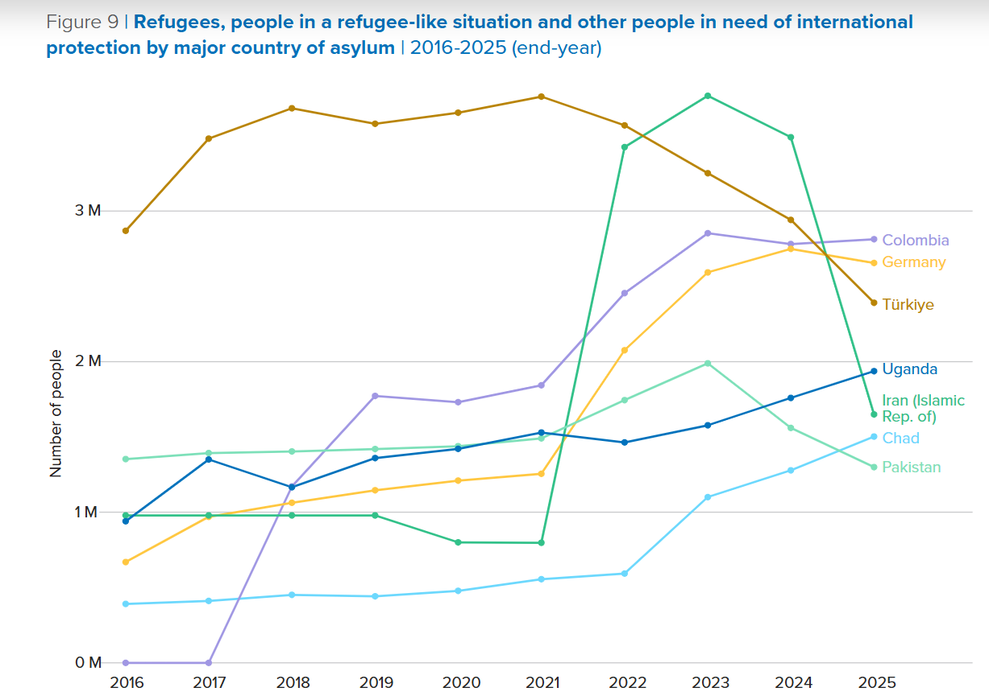
Where are refugees hosted?

Slide 12
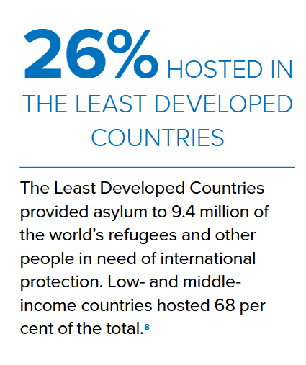
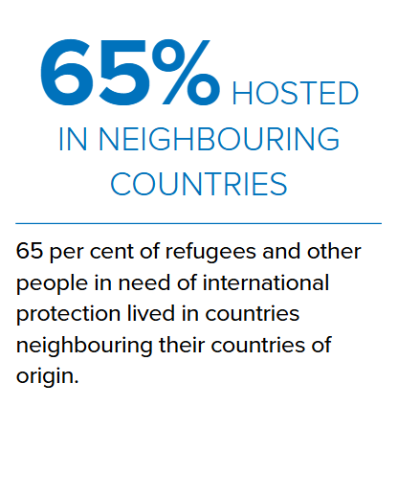
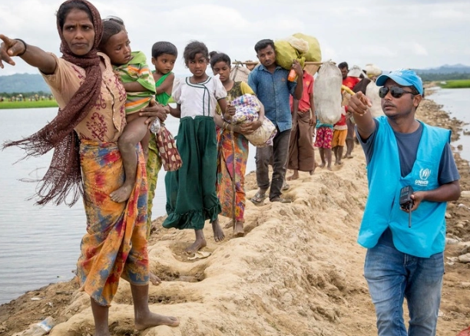
Notes:
Low-income countries continued to host a disproportionately large share of the world’s displaced people, in terms of their population and the resources available to them.
These countries represent 8 per cent of the global population and only 0.3 per cent
of global domestic product, yet they hosted 18 per cent of refugees. This included
very large refugee populations in Chad, the Democratic Republic of the Congo, South
Sudan, Sudan and Uganda. The share of refugees hosted in lower-middle-income
countries, including Bangladesh, Lebanon and Pakistan, remained at 17 per cent by
end-2025. The percentage of refugees hosted in upper-middle-income countries
decreased to 33 per cent from 37 per cent at end-2024, mainly due to the decrease
of refugees or other people in need of international protection in the Islamic Republic
of Iran. Other upper-middle-income countries hosting large number of refugees are
Türkiye, Colombia and Peru. High-income countries, which account for most of the
global wealth, hosted 29 per cent of refugees at end-2025. This was 2 per cent more
than at end-2024.
The Least Developed Countries consist of 44 countries, including Bangladesh, Chad, the Democratic Republic of the Congo, Ethiopia, Rwanda, South Sudan, Sudan, Uganda, the United Republic of Tanzania and Yemen. Together, they account for 1.4 per cent of global gross domestic product, yet they were responsible for hosting nearly 26 per cent of all refugees worldwide.9At the end of 2025, the number of refugees in Least Developed Countries stood at 9.4 million, 12 per cent more than at end-2024 (8.4 million).

Slide 13

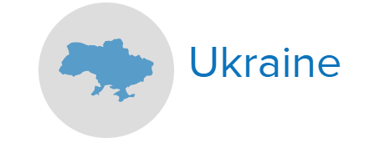
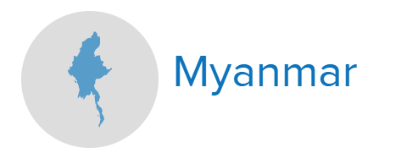
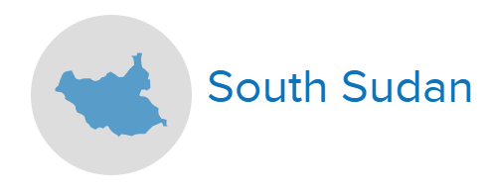

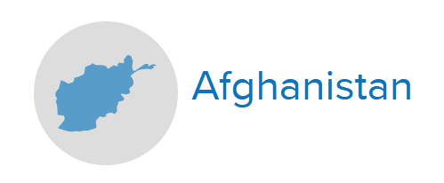



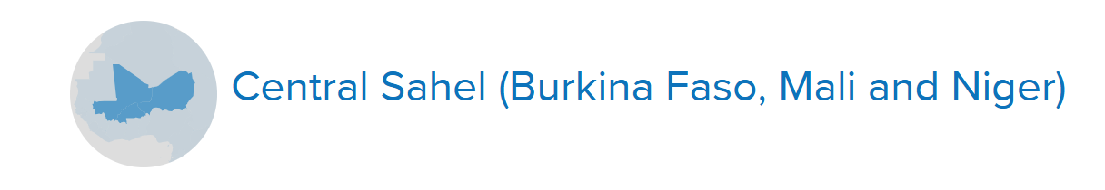
Key displacement situations
Notes:
Sudan
Largest displacement situation globally.
Fighting between the SAF, the RSF and allied armed groups intensified in Darfur and Kordofan states.
Repeated attacks against civilians.
Famine was confirmed in El Fasher and Kadugli towns while the risk of famine has also been reported for 20 areas.
Pockets of relative stability emerged in other parts of Sudan, largely in the east and in the capital Khartoum.
Sudanese refugees and asylum-seekers globally surged by 35 per cent (mostly in Chad)
Ukraine
Conflict started in 2022
Civilian population and civilian infrastructure were repeatedly affected or targeted by an escalation in deadly aerial attacks in 2025
Almost 5.3 million Ukrainian refugees remained displaced globally in 106 countries
DRC
Worsening security and humanitarian conditions, particularly in South and North Kivu and Ituri Provinces.
Peace agreement signed in June 2025 and the agreement in November 2025 between the Congolese authorities and the non-state armed group M23, still have to translate into real improvements on the ground for the civilian population.
Repeated reports of attacks against civilians and other human rights violations, including conflict-related sexual violence, have been attributed to all parties to the conflict, including M23 and other militias.
Myanmar
Complex and protracted humanitarian crisis in Myanmar continued in 2025, with armed conflict and ongoing clashes.
As of end-2025, 3.6 million people were internally displaced. A further 1.6 million were refugees or asylum-seekers of whom 289,500 have been displaced since February 2021
6,500 have attempted to find safety and protection via dangerous sea routes. 890 were reported dead or missing in 2024, making this the deadliest route globally in 2025.

Slide 14
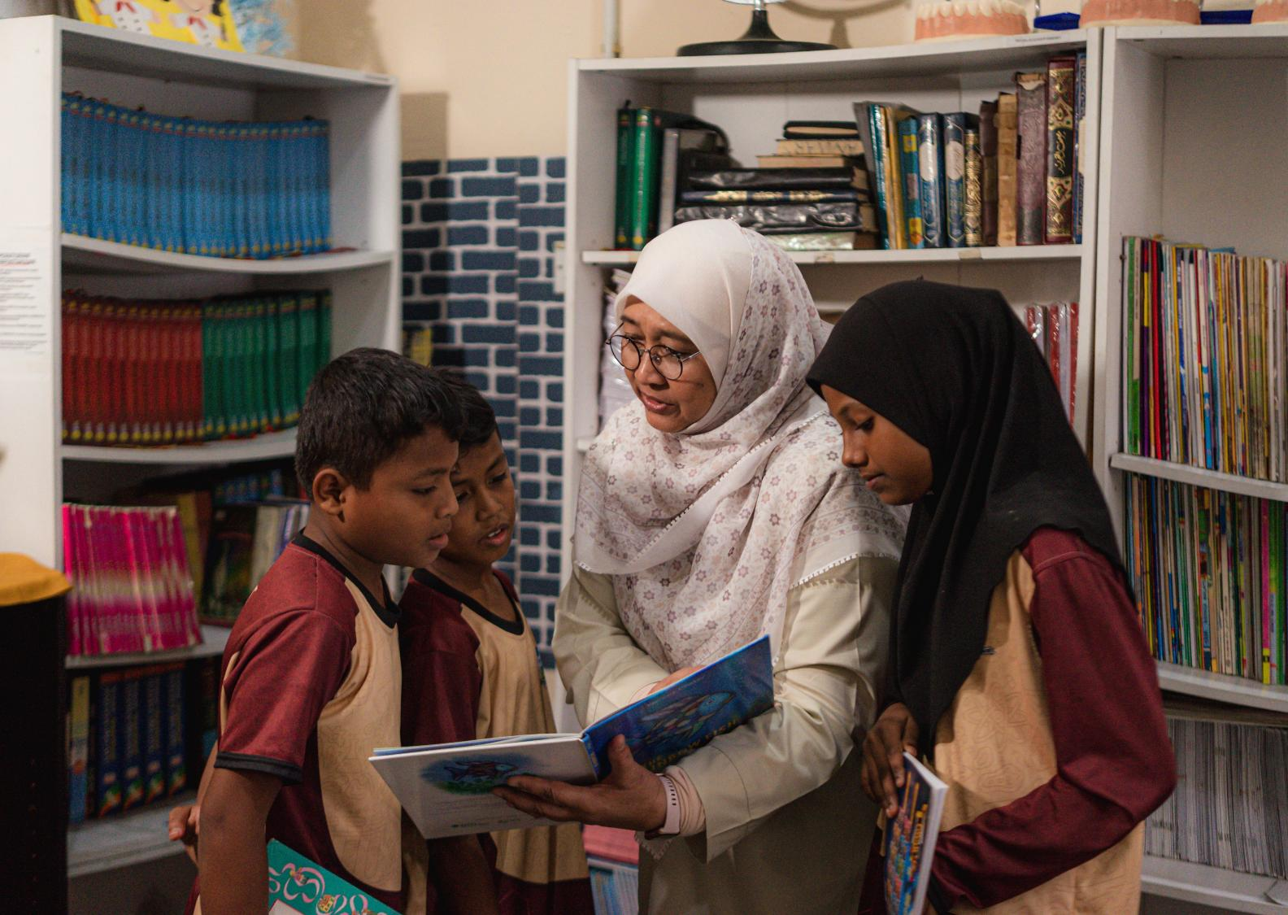
Durable Solutions
Voluntary repatriation, in which refugees return in safety and with dignity to their country of origin and re-avail themselves of national protection.
Local integration, in which refugees legally, economically and socially integrate in the host country, availing themselves of the national protection of the host government.
Resettlement - the selection and transfer of refugees from a State in which they have sought protection to a third State that has agreed to admit them ‐ as refugees ‐ with permanent residence status.

Slide 15
UK's forcibly displaced population in 2025
726,220
total population that UNHCR protects or assists
THE UK
4,480
stateless persons who have been recognised as refugees or who sought asylum
581,000
refugees and people in refugee like situations
481
stateless individuals recognised through the UK's stateless determination procedure
144,747
asylum-seekers
48,758 asylum-seekers (relating to 35,744 cases) at the end of March 2026

Slide 16
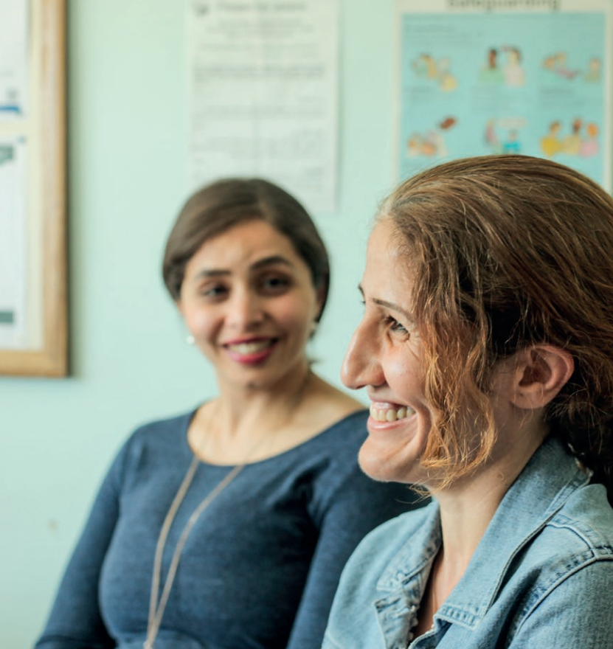
How refugees arrive in the UK
Through regular or irregular migration:
To claim asylum in the UK, a person must be in the UK.
Asylum-seekers may have:
  entered the UK on a visa and then claimed asylum on arrival or at a later time.
  entered the UK irregularly and then claimed asylum on arrival or at a later time.
  been trafficked to the UK and then claimed asylum on arrival or at a later time.
UK Government is responsible for registering and determining asylum applications.
Through resettlement
Through a safe and legal route (not all are for recognised refugees)
Notes:
Refugees may experience traumatic events in their countries of origin which may be what causes them to flee. Before being forced to flee, refugees may experience imprisonment, torture, loss of property, malnutrition, physical assault, extreme fear, rape and loss of livelihood.
During flight, refugees may be separated from family members, witness torture, and/or lose close family members or friends and endure harsh environmental conditions.
On their journey, refugees can experience extremely traumatic events.
Some refugees may live in other countries of asylum before coming to the UK. In these countries they may also find themselves facing serious protection risks as well as a lack of integration prospects.

Slide 17
Key considerations for those supporting refugees
Some asylum-seekers and newly-recognised refugees often face mental health issues once in the UK as a result of:
  Lack of access to work
  Separation from family
  Experiences in detention
  Social isolation
  Experiences of exploitation

Slide 18
Key considerations for those supporting refugees
Women
Studies on refugee integration in the UK have highlighted some of the issues that refugee and asylum-seeking women may face:
  Lack of affordable childcare;
  Safety (including domestic violence and harassment);
  Social isolation;
  Difficulties accessing female medical GP; and
  Gender discrimination in the labour market.
UASC
Often disoriented, frightened, hungry and exhausted on arrival.
Delays and disruption in access to education.
Many may need mental health support..

Slide 19
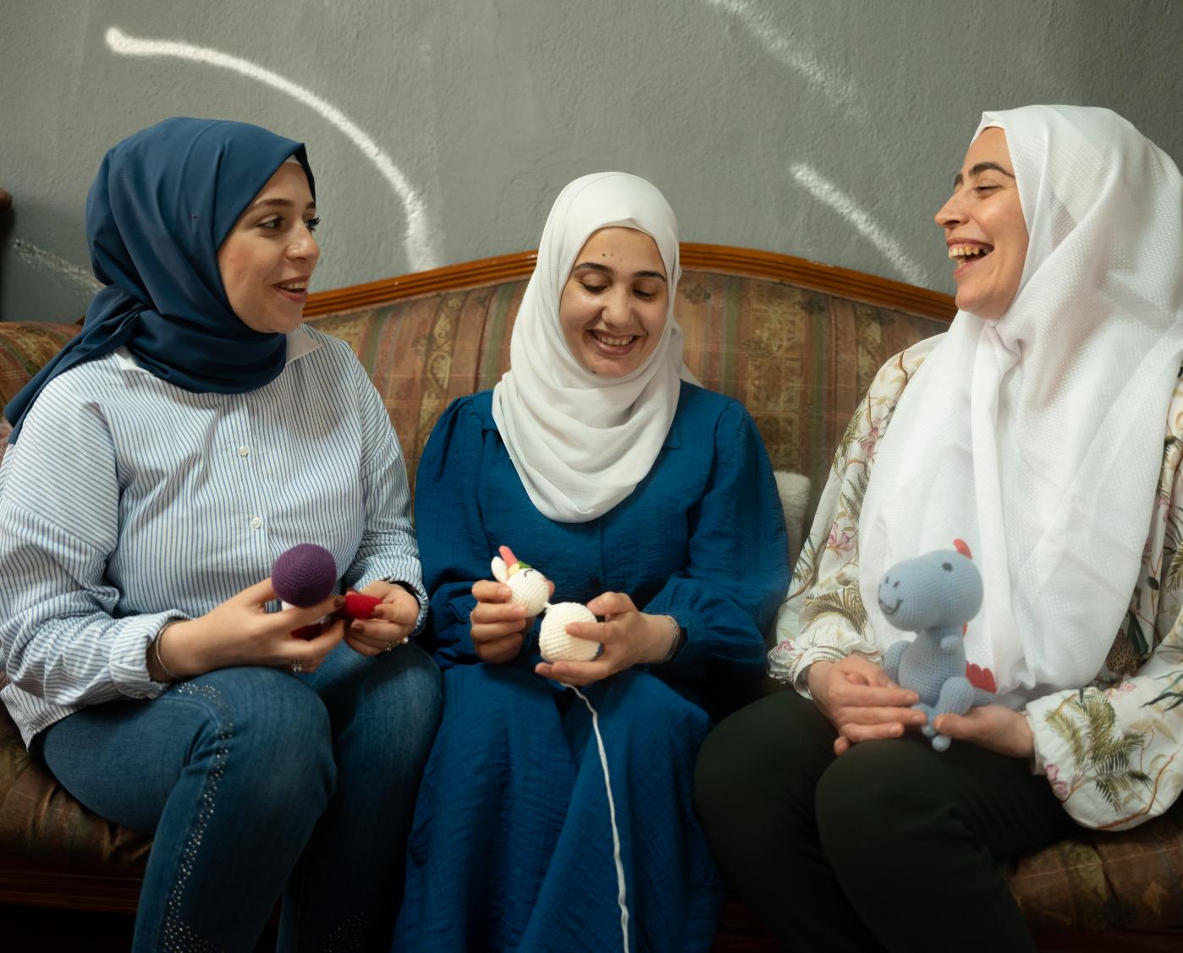
Refugee Week
Courage
Courage is lived every day by millions forced to flee
Courage is part of the UK’s long tradition of offering protection
Notes:
Courage is lived every day by millions forced to flee
Around 1 in every 70 people globally was forcibly displaced at the end of 2025 (117.8 million), many navigating fear, loss and uncertainty. This is nearly twice as many as were forcibly displaced a decade ago. Courage is not only in the moment someone is forced to flee, but continues in daily acts – navigating the asylum system, learning a new language, finding work, supporting a family far from home. Refugee Week invites us to recognise these everyday forms of courage and to connect them to our own lives – understanding that resilience and hope are shared human experiences.
Courage is part of the UK’s long tradition of offering protection
The UK helped shape the Refugee Convention 75 years ago, showing global leadership rooted in fairness and compassion. That tradition continues today through asylum, resettlement schemes, community sponsorship and partnerships with countries hosting most of the world’s refugees. This is about having the courage to live up to that legacy, working with others to find practical solutions and to keep the promise of protection alive.

Slide 20
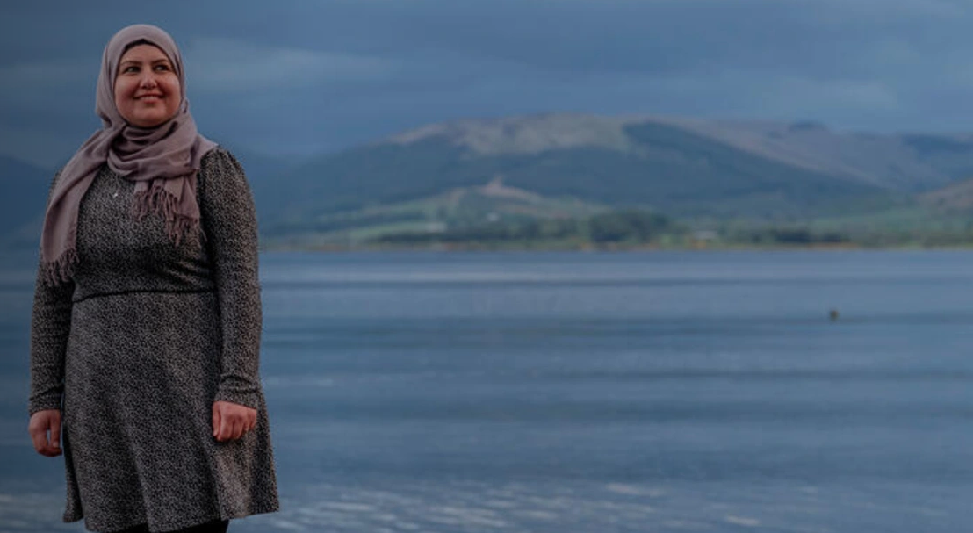
Thank you

