Slide 1
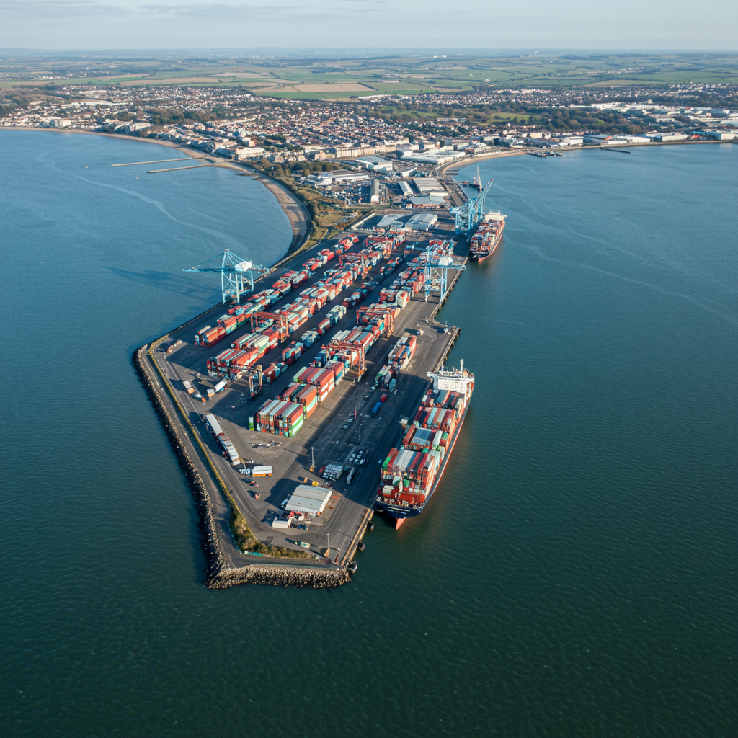

Coastal Navigators Network (CNN)
Update: October 2025

Slide 2







Case for Change
Problem Definition / Coastal-Specific
Coastal communities face unique challenges in health and social care recruitment and retention that impacts on health care delivery.
Geography
“Half-compass" effect, limiting access to jobs, education, and training, impacting both employers and residents
High costs from the “hamster wheel” of recruitment
Geography
“Half-compass" effect, limiting access to jobs, education, and training, impacting both employers and residents.
High costs from the “hamster wheel” of recruitment
Demand
Higher numbers of retirees and people with complex conditions drive demand, partly due to affordable but poor-quality housing
Demand
Higher numbers of retirees and people with complex conditions drive demand, partly due to affordable but poor-quality housing
Health and socials care model unsustainable- leading to higher demand inland
Health and socials care model unsustainable- leading to higher demand inland
Recruitment
High service-user ratios and unclear career pathways make it hard to attract and retain health and care professionals
Recruitment
High service-user ratios and unclear career pathways make it hard to attract and retain health and care professionals

Slide 3
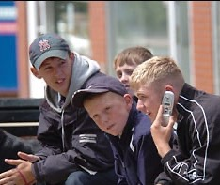
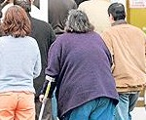
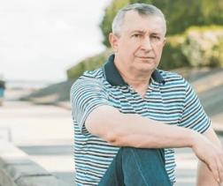
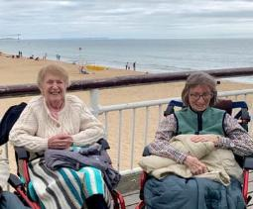
Why the CNN has been formed
Intergenerational
16-24 Yr Olds
24-35 Yr Olds
35-49 Yr olds
65+
Largest increase in economic inactivity in the latest quarter
The largest relative increases in economic inactivity due to poor health
Other health problem or disability has increased by 24%
41% higher proportion of older adults in coastal than non-coastal regions

Slide 4

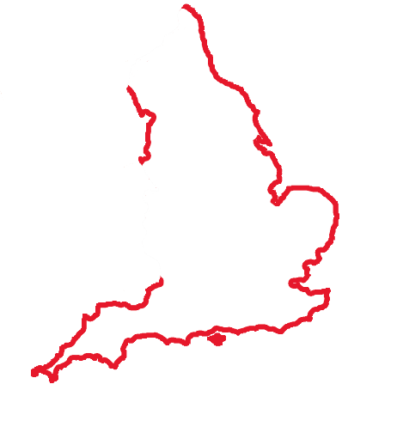

Why the CNN has been formed
Coastal communities are small, but collectively are a large and significant priority national population group (18.5%) the near equivalent of the entire North West and North East regions combined
~ 10.4 million (approx. 18.5% of England’s population)
North West (7.42m) + North East (2.65m) = ~10.07 million

Slide 5
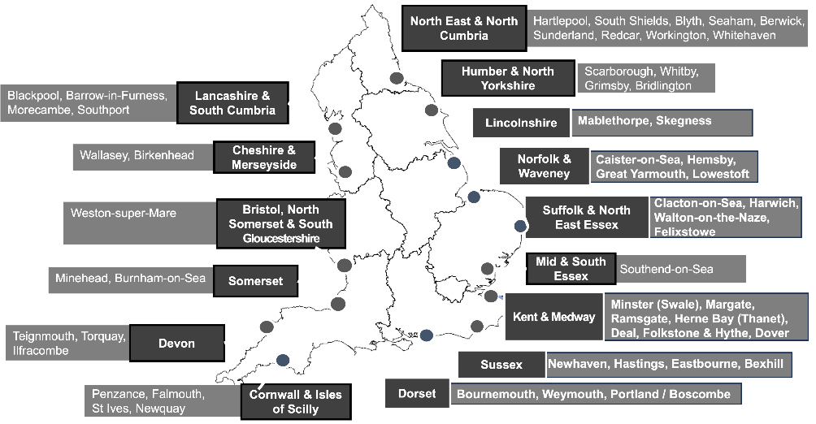
55 Priority coastal communities

Slide 6
Coastal employment gap in the 55 towns
= 2.2 million people; of these:
254,000
500,000
1 million
11% have never worked / are long-term unemployed
Never worked/Long Term Unemployed
22% have no qualifications
No qualifications
45.9% are economically
inactive
Economically inactive

Slide 7
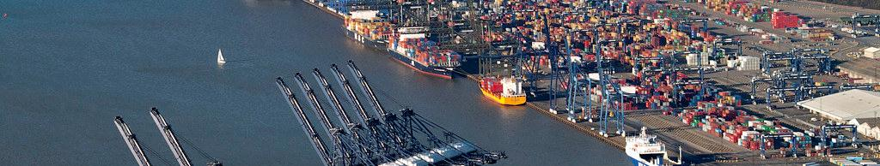
The Case for Urgent Action
45.9%
>50%
£9.88B
Economic Inactivity
Long-term Sickness
Annual Cost
Working-age adults in coastal towns — more than double
the national average
Coastal residents inactive due to health conditions, compared to 36.2% nationally
Estimated total cost in lost productivity
The analysis of data for the 55 coastal towns shows the scale of coastal economic inactivity and the financial impact of lost productivity due to long-term sickness amongst coastal residents who are not working.

Slide 8
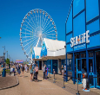

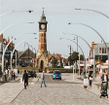


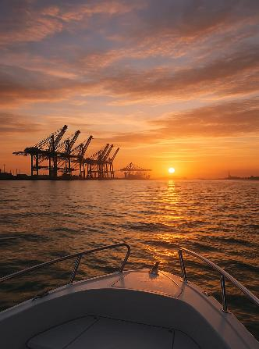
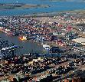
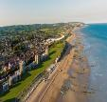

Case Study Focus
Felixstowe: Young People, Drugs, and Crime
“There’s no employment focus. No decent pathway young people can believe in or see themselves in. They’re discounting themselves before they’ve even started.”

Slide 9
Case Study Focus
Return on Investment
Integrated Neighbourhood Team
Patients recorded with alcohol and substance abuse: 3,716
Finance and activity measures
Young People aged 0 – 19 = (4,525)
PPPY – Total = £2,489 |  | 10% Reduction | 20% Reduction
 |  | Years 1 - 2 | Years 3 - 5
Acute elective | £600 | £540 | £480
Acute Non-elective | £787 | £709 | £630
GP Encounters | £332 | £299 | £266
Community | £183 | £165 | £147
Mental Health | £249 | £224 | £199
Social Care | £337 | £303 | £270
 |  | £2,240 PPPY | £1,992 PPPY
Total for population £9.3 million |  | Total cost saving year 5 £1.8 million
Alcohol and substance use
= 64 (1.4%)
Activity spend: £106,497 In total = 1.2%
£1,664 PPPY
Target:
Reduction of 50%
Cost Savings =
£53,248 Per year

Slide 10








Case Study Focus
Thanet: Suicide Prevention Strategy
Key Partners
Boscombe & Portland:
Area Profile
3rd
highest rate of completed suicide in the ICB
75%
of completed suicides in Kent and Medway are males
Areas of Focus
Older Males
Health inequalities dashboard
£22.5m
Employers
Priority needs assessment
cost of lost employment productivity Thanet
DWP & CVSE
Employment support
Opportunity:
To reduce the suicide risk amongst older males though earlier targeted interventions that also address unemployment/ redeployment

Slide 11
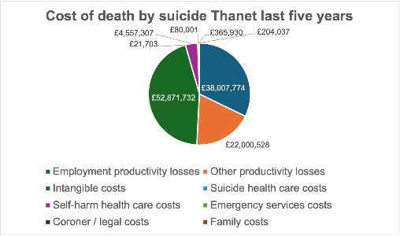
Case Study Focus
Thanet: Suicide Prevention Strategy
Cost of completed suicides for all 55 coastal towns
Employment productivity losses | £83,054,025
Other productivity losses | £48,075,227
Intangible costs | £115,534,524
Suicide health care costs | £47,424
Self-harm health care costs | £9,958,560
Emergency services costs | £174,818
Coroner / legal costs | £799,626
Family costs | £445,859
Total = £258.6 million per year
Opportunity:
To reduce the suicide risk amongst older males though earlier targeted interventions that also address unemployment/ redeployment

Slide 12

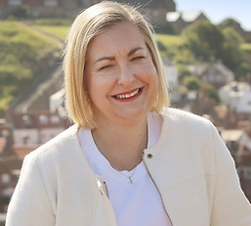
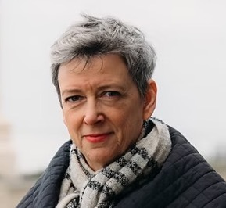
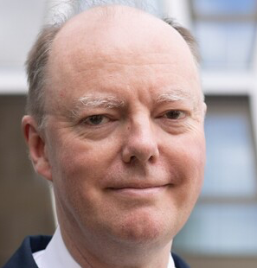
The Power of the Network
“We are keen to champion the solutions outlined in this prospectus at the highest level”
Co-Chairs of the APPG for Coastal ,
Polly Billington MP,
East Thanet
Alison Hume MP, Scarbrough and Whitby
“In Thanet we see how Real Time Suicide Surveillance data is being used to support a hyper-local response to reducing deaths by suicide…. . We need to act across agencies and sectors in ways that combine primary and secondary prevention with social interventions”
Professor Sir Chris Whitty CMO for England, CNN Prospectus

Slide 13
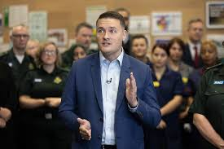
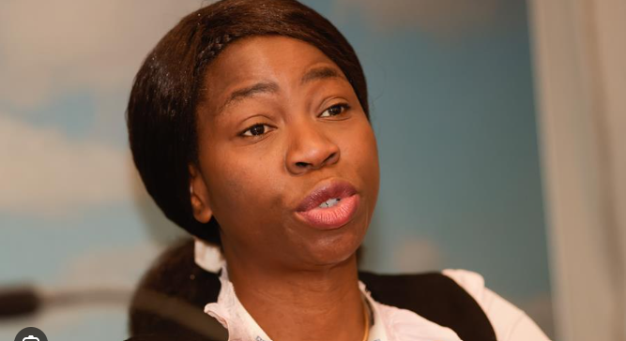
The Power of the Network
“This will be a decade-long project of improvement, and we will start in ..coastal communities”
Secretary of State for Health and Social Care, 25th June
“The CNN has had a key role to play in amplifying this agenda, so thank you”
Prof Bola Owolabi
Director of Health Inequalities, NHSE

Slide 14





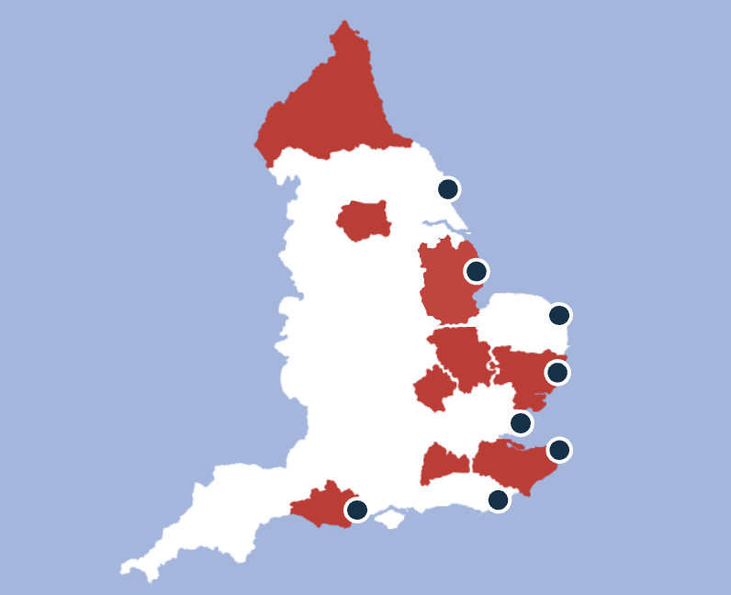


The Coastal Navigators’ Network
National Level
Co-Investment & Partnership Working
Place Partners
Coastal Industry
Taskforce
Notes:
CNN is a combination of place partnerships industry task force and cross departmental government task force

Slide 15
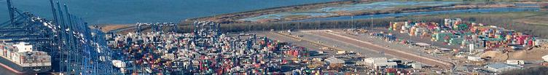


Coastal Navigators’ Network: Foundational Locations
Lincolnshire
Skegness
Norfolk & Waveney
Great Yarmouth
Suffolk & North East Essex
Felixstowe
Portland / Boscombe
Dorset
Kent & Medway
Thanet
Sussex
Bexhill

Slide 16
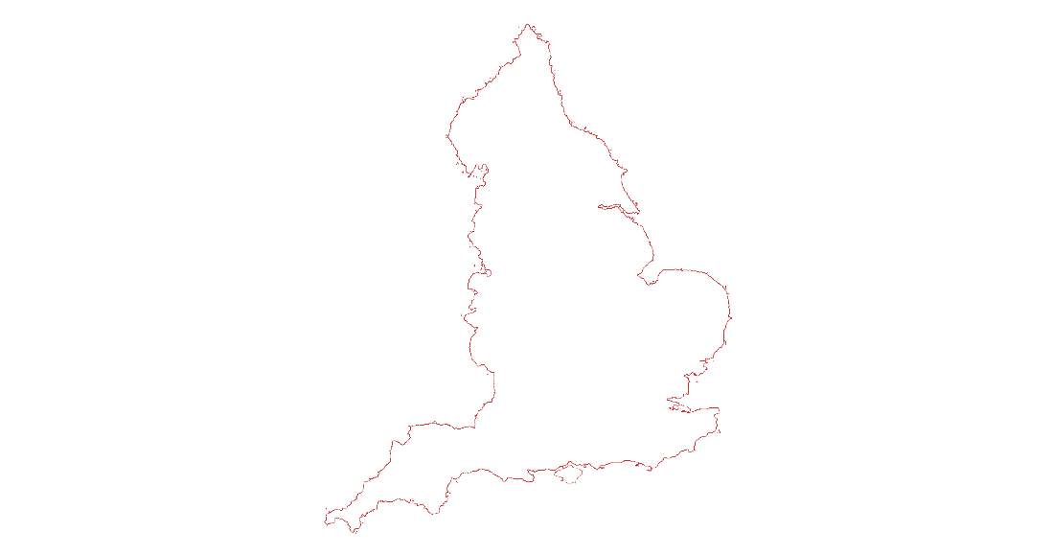
Coastal Navigators’ Network Locations - Year Two
Workington
Bridlington
Whitehaven
Skegness
Millom
Great Yarmouth
Barrow
Felixstowe
Fleetwood
Southend-on-Sea
Burnham-on-Sea & Highbridge
Canvey Island
Ilfracombe
Isle of Sheppey
Torquay
Thanet

Slide 17
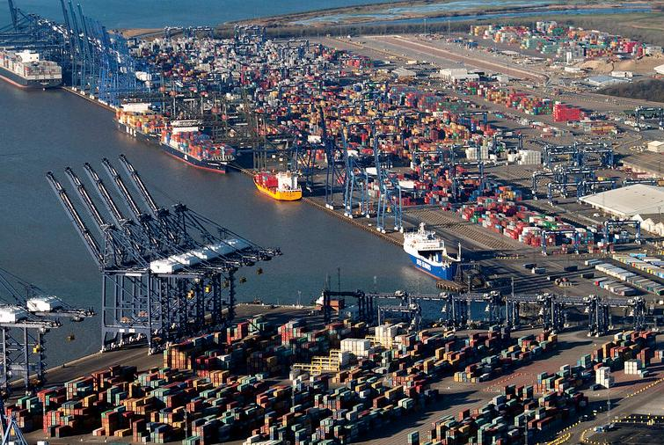
Location
Priority Challenges
Goal
Key Project
Barrow
Economic inactivity / housing pressure
Diversified employment pathways
Team Barrow Regeneration Model
Bridlington
High deprivation and poor transport
Exemplar Live Well campus for the North
Live Well Campus
BoS & Highbridge
Long-term sickness and inactivity
Return to work & inclusive employment
WorkWell Programme
Canvey Island
Frailty prevention and management
Health ageing and prevention
INT, Town Deal and Active Essex
Felixstowe
Family level barriers/ mental health
Whole family well being and work
Sizewell, Skills Hub & ITCF Mentoring
Fleetwood
Youth mental health/fragile funding
Sustainable local health improvement
Fleetwood Hub ROI Plan
Great Yarmouth
Youth unemployment and aspirations
NEET prevention/carer pathways
Right to Succeed
Isle of Sheppey
Generational unemployment & isolation
Long term/ collaborative funding
Social Regeneration
Ilfracombe
Fragmented services & poor access
Joined up health & probation pathways
One Ilfracombe Partnership
Millom
Isolation
TBC
TBC
Skegness
Unemployment and youth disengagement
Early intervention & work readiness
Widening Access Demonstrator
Southend-on-Sea
Frailty prevention and management
Joined up support for frailty
INT and Care Tech
Thanet
Suicide prevention
Reduce deaths by suicide in older males
Scale up community model
Torquay
Low aspiration in 14-16 year olds
NEET prevention/ social mobility
Shared Prosperity Fund Projects
Workington
Joining up place-based initatives
Neighbourhood Health
INT and Connect to Work
Whitehaven
Narrow career pathways
Economic diversification
Key regeneration projects

Slide 18
CNN - Coastal Navigators' Network
Common Issues Across CNN Locations
Economic & Employment
Widespread economic inactivity and a lack of employment opportunities is a recurring theme.
Young People
Low aspirations and limited career pathways for young people.
Mental Health
Mental health issues are a significant barrier to employment and wellbeing.
Fragmented Systems
Lack of joined-up services across health, education, employment, and social care.
Transport & Connectivity
Poor transport infrastructure limits access to jobs, education, and healthcare.
Health Inequalities
High levels of deprivation and associated health disparities.

Slide 19






Opportunities for Co-production
Priority Focus
Prevention
Service Transformation
Employment
Care Tech
Infrastructure
& Transport
Youth
Mental Health
Torquay
Thanet
Felixstowe
Barrow
Workington
Whitehaven
Millom
Isle of Sheppey

Slide 20
Opportunities for Co-production
Priority Focus
Prevention
Service Transformation
Employment
Care Tech/ Healthy Ageing
Infrastructure
& Transport
Youth
Mental Health
Fleetwood
Bridlington
Southend-On-Sea
Canvey Island
Ilfracombe
Skegness
Great Yarmouth
Burnham-On-Sea & Highbridge

Slide 21

CNN Priority Focus Areas for Year 2
Prevention
Mental
Health
Infrastructure
& Transport
Inclusive
Employment
& Career
Pathways
Care Tech and
Healthy Ageing
Service
Transformation

Slide 22
The Coastal Industry Taskforce
National Level
Co-Investment & Partnership Working
Place Partners
Coastal Industry
Taskforce

Slide 23
Coastal Industry Taskforce –
Preliminary Meeting 10th July
UK Chamber of Shipping
RNLI
Ipswich Football Club
APPG Coastal Communities
VisitEngland
Babcock
Morgan Sindall
National Coastal Tourism Academy
Business Board Network
Sizewell C
Skills England
UK Chamber of Shipping
DP World
Britain’s Energy Coast (BEC)
BAE Systems
Vodafone Three
Shell
Hutchinson Ports
The Crown Estate
BP
Ebbsfleet Garden City
Skills for Care
Renewable UK
Department for Transport
Notes:
Industry not always benefiting local communities all maximising the possible benefits of

Slide 24
Three Strategic Themes from the Industry Taskforce
1
2
3
Building a Future Workforce
Connecting People to Opportunity
Turning Investment into Local Jobs
Creating structured, cross-sector pathways that bring young people and local residents into emerging coastal careers.
Developing inclusive local systems that support disadvantaged people into good jobs, not just more training.
Creating place-based strategies that connect industrial investment with workforce planning and skills development.

Slide 25
The Coastal Navigators’ Network
National Level
Co-Investment & Partnership Working
Place Partners
Coastal Industry
Taskforce

Slide 26



Cross-Departmental Task Force
Co-Investment & Partnership Working
Core Departments
Wider Relevance

Slide 27
The Coastal Navigators’ Network
National Level
Co-Investment & Partnership Working
Place Partners
Coastal Industry
Taskforce

Slide 28
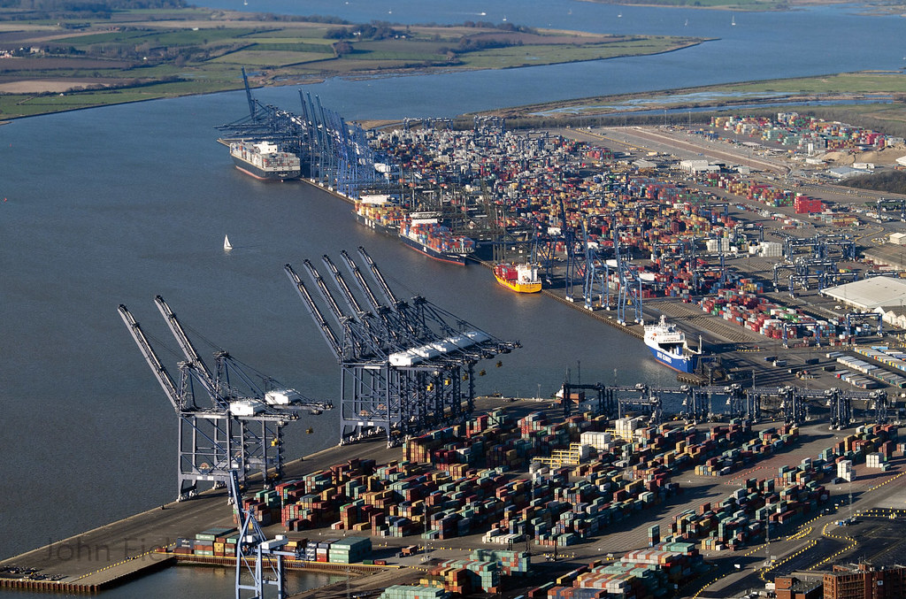
CNN Sustain Framework
A Shared Investment Mindset
Port Developments, Windfarms, Nuclear Projects, Shipbuilding, Defence Projects, Construction & Technology, Housing Developments
Clinical Staff Teachers, GPs – Recruitment & Retention Supported
Example Resources
Connect to Work
Employers
UK Shared Prosperity Fund
External Investors
& Major Projects
Place Level
External Investment ->
Local Jobs for Local People
Partnerships
Local Planning
DWP Partnership
ICBs, PCNs
Supporting
Apprenticeships
Quality Jobs
Coaching
Mentoring
Skills to Employment Pathways
Workforce Pipeline for Care & Health
Community Level
Grassroots Support
SMEs, VCSE, Local Core Employers,
Tourism, Retail
Reduced Demand on Services
Positive Vision that Community
Trusts and Supports

Slide 29





CNN Framework
Long-term impact needs
shared ownership
across a wider coalition
Costs of change are lower in coastal areas — ROI is high
A shared investment mindset is essential

