Slide 1
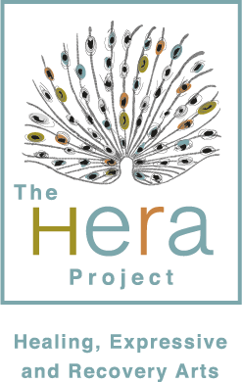
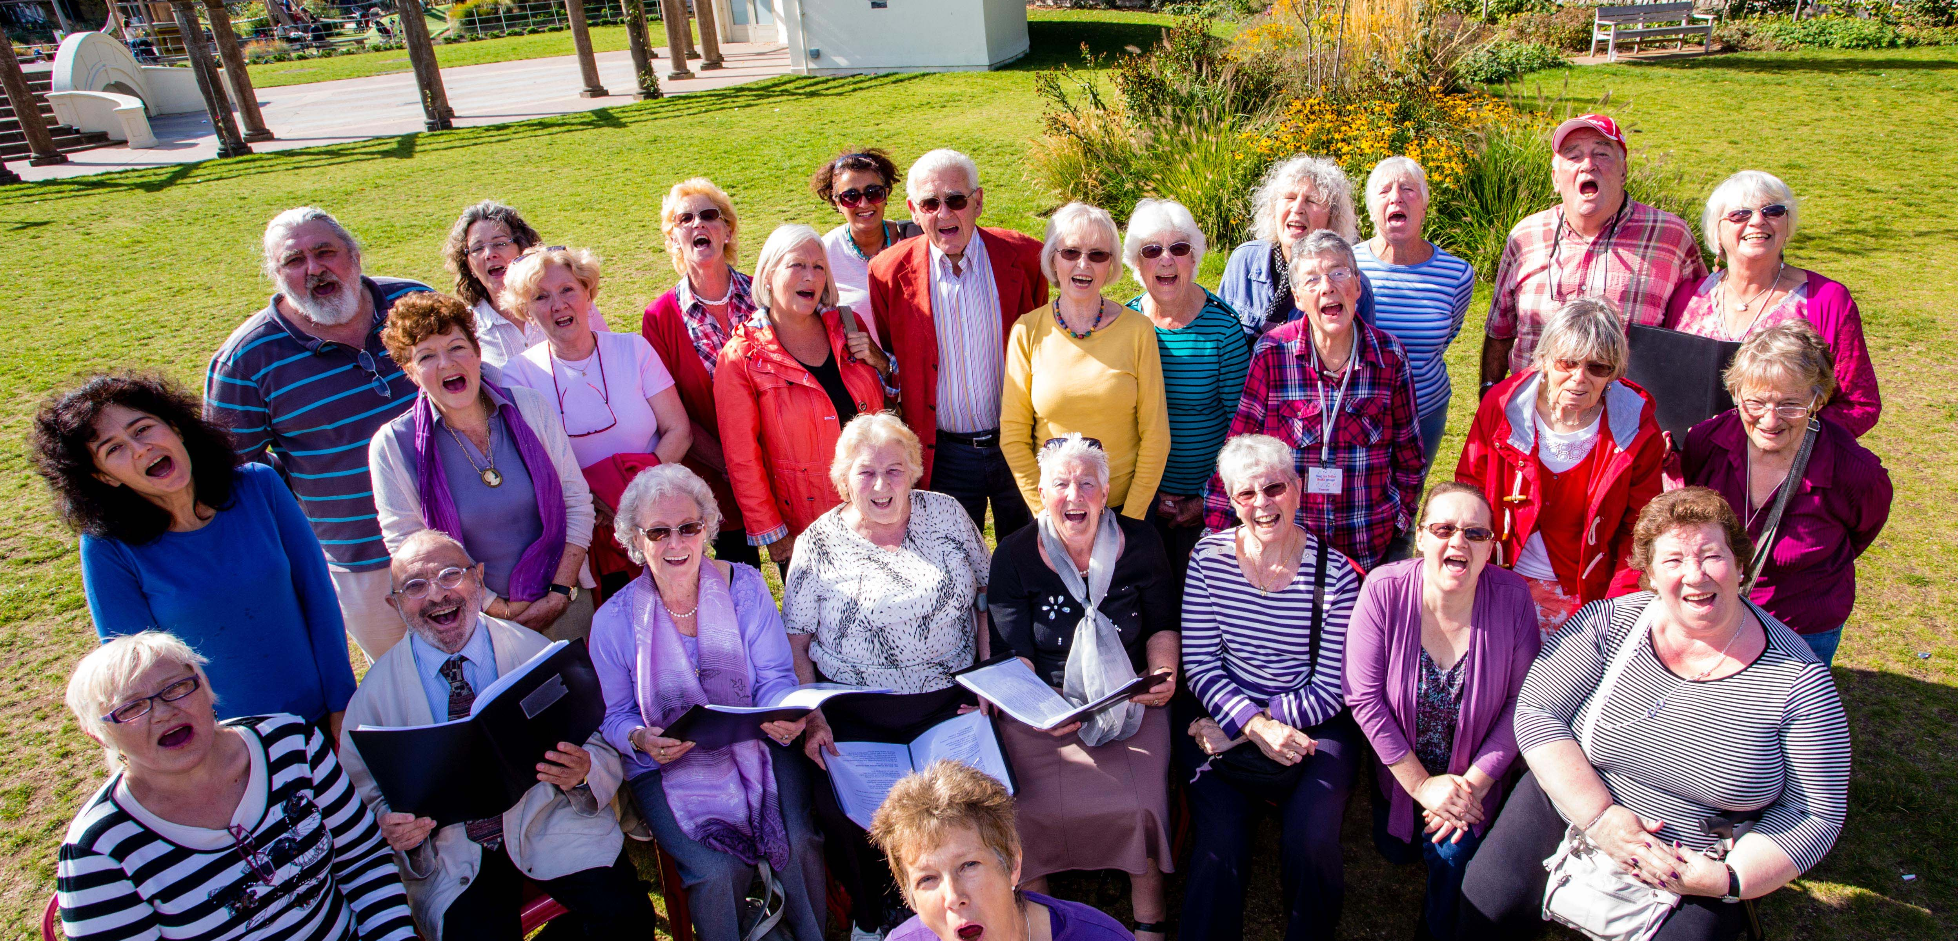
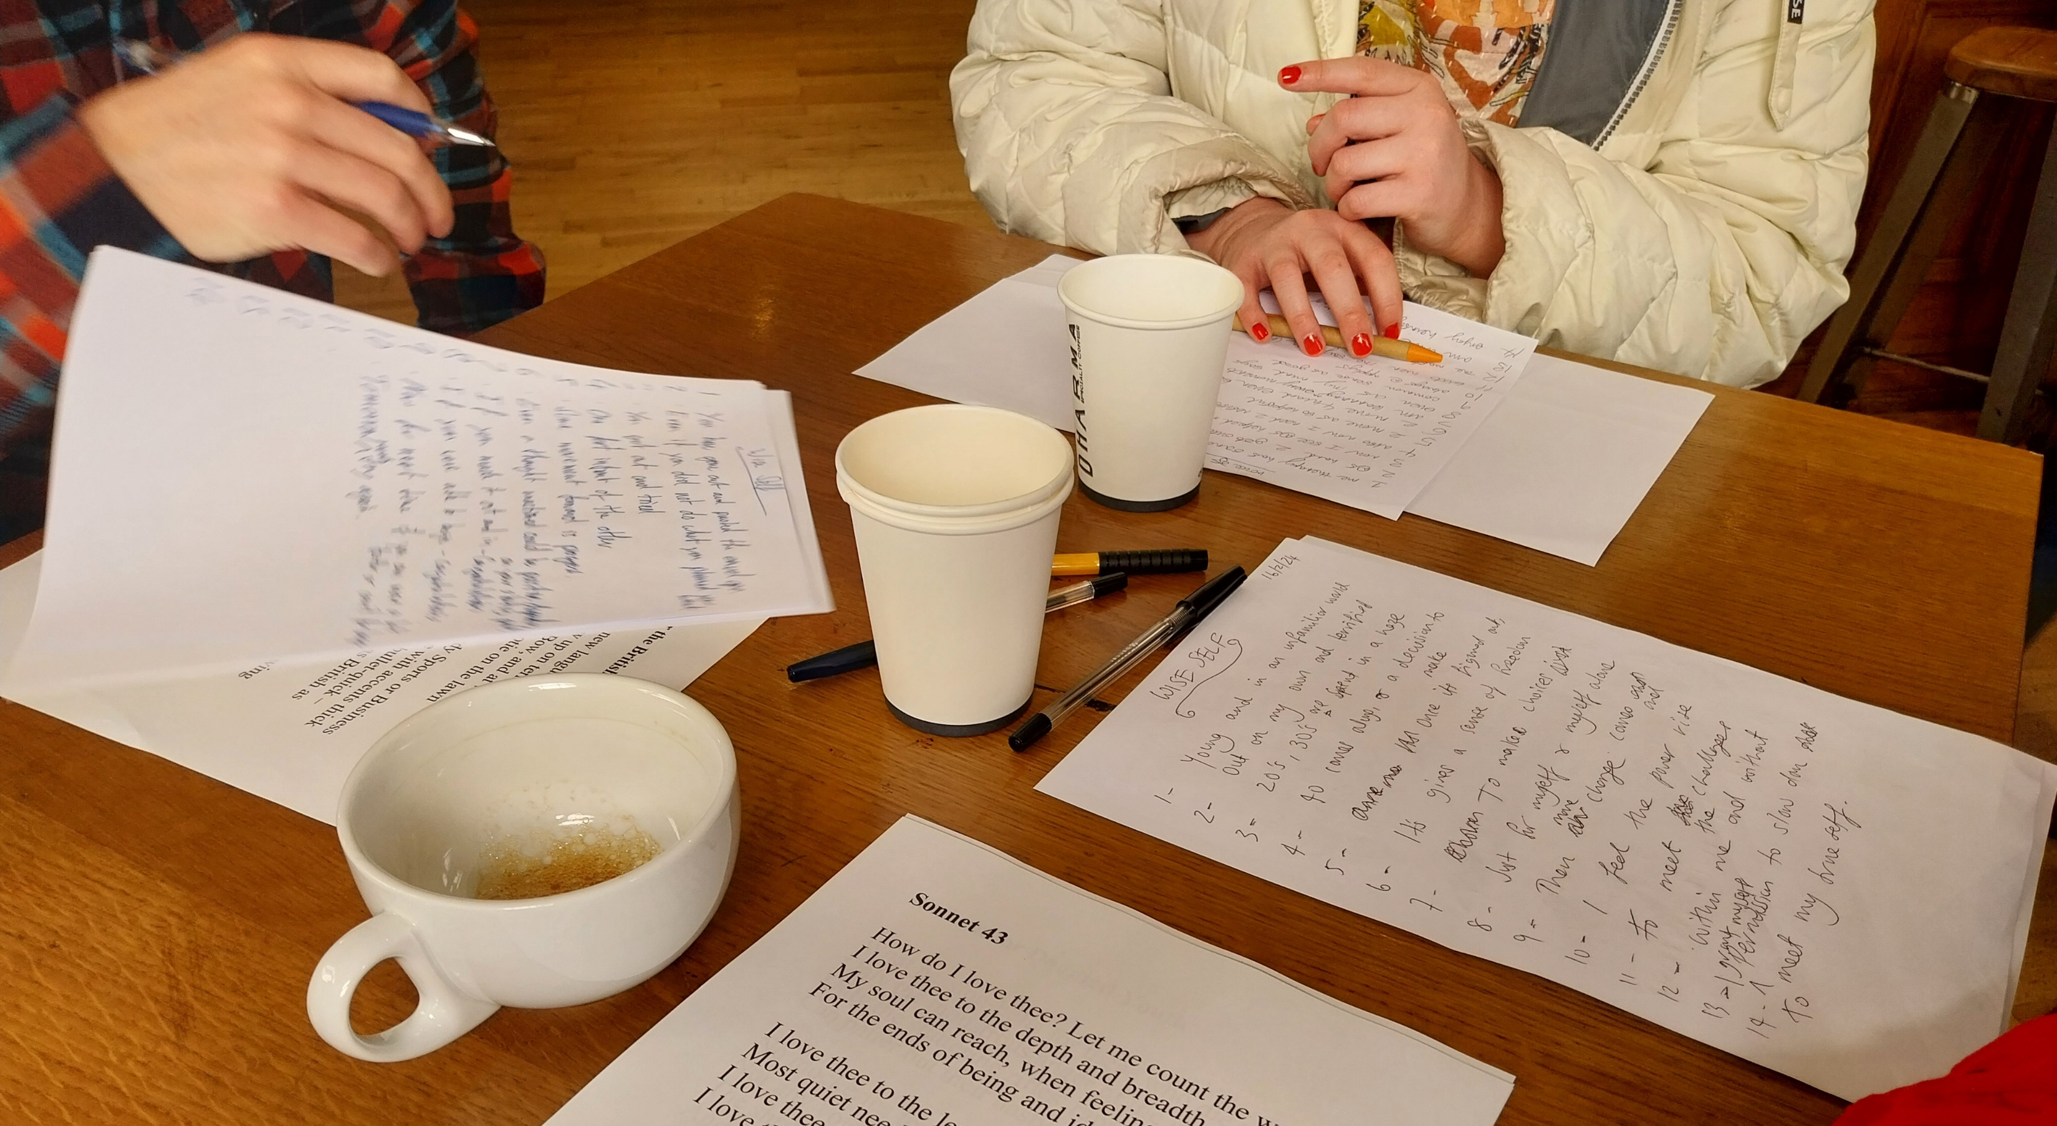
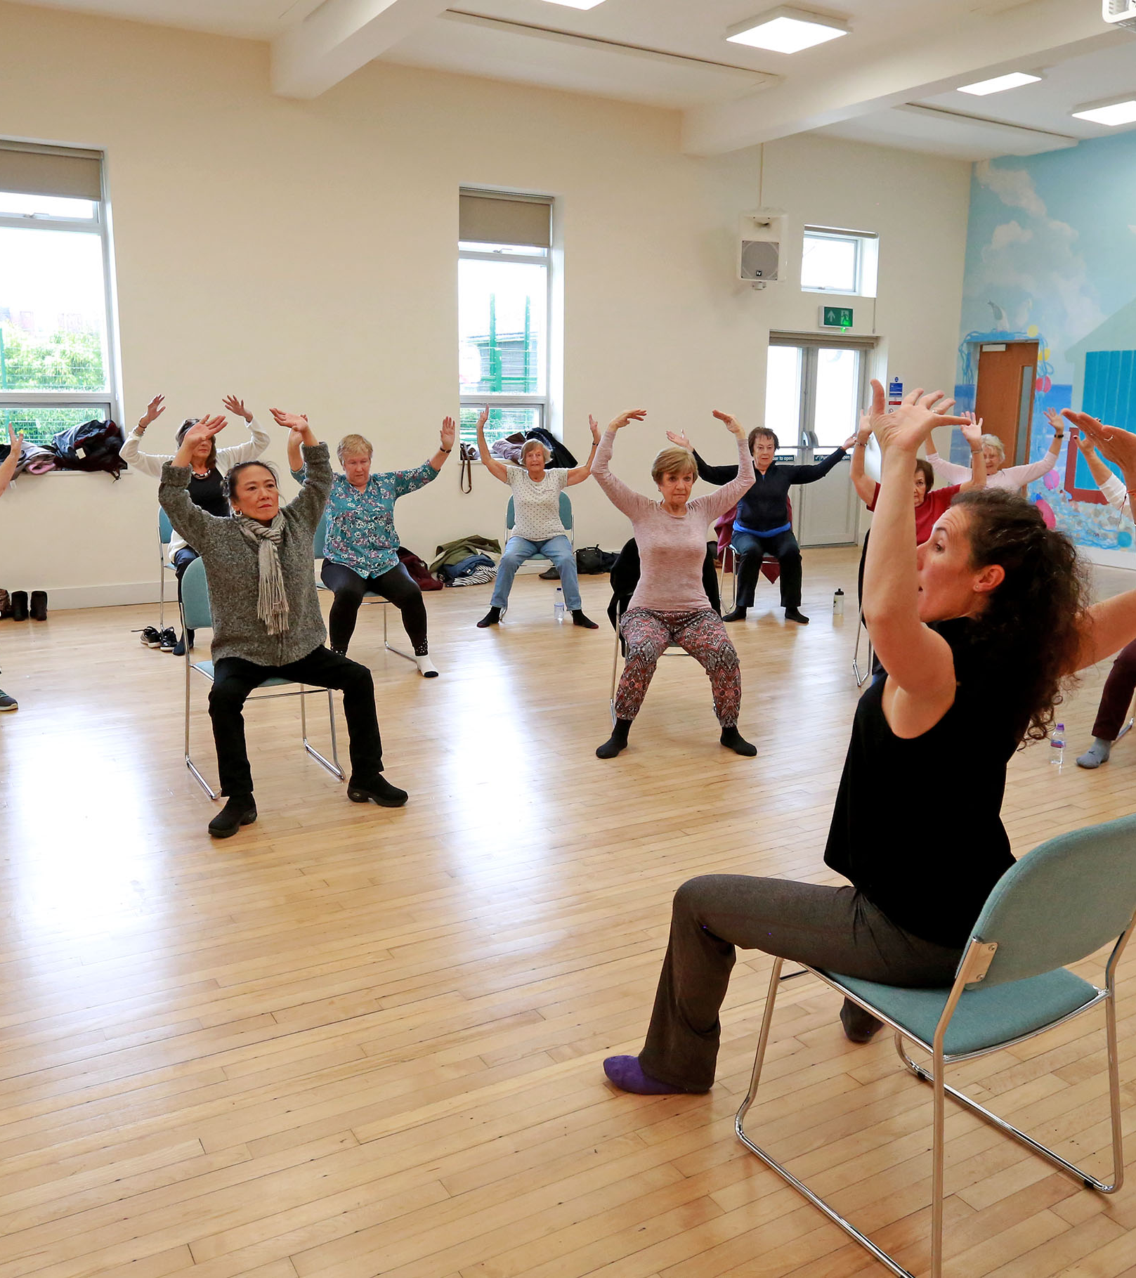

Notes:
1

Slide 2
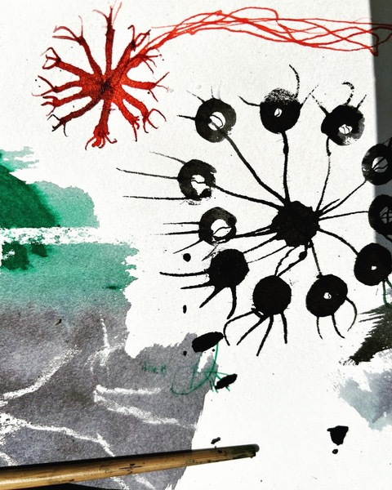
What We Do
Professionally-led creative activities for people living with health concerns – in person and online, in GP practices, community venues, and outdoor spaces.
One-to-one support - NHS Social Prescribing.
Targeted programmes - address health inequalities.
Exhibitions, outings, and events showcasing creativity, sharing best practice, and the importance of creative heath.
Research partnerships with leading institutions such as Brighton & Sussex Medical School (training and project), UCL (dementia prevention), and Brighton + (MCLM).
Training and development in arts, health, and creative enterprise for professionals, including artists and NHS colleagues.
Notes:
2

Slide 3
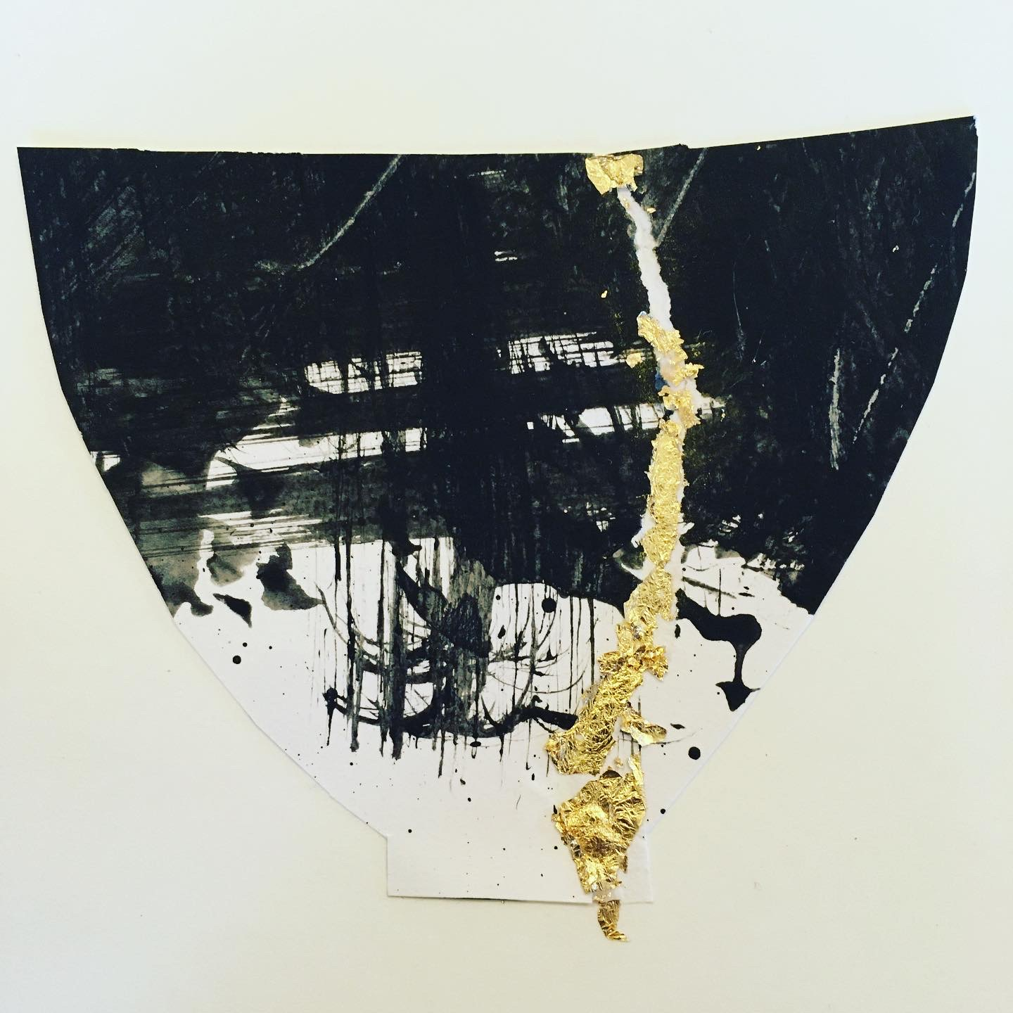
Who benefits?
2024-5
Participants
  Thanks to funding, Hera activities are free for adults aged 18+, with our oldest participant currently 97, representative of Brighton and Hove demographics
  74% report mental health concerns
  51% live with physical health conditions
  31% are neurodivergent
  22% do not have a permanent home
  Over half identify as disabled, with many living with more than one health condition
Common challenges include loneliness, low income, housing insecurity, low confidence, and anxiety – all of which can put health under pressure.
Health and care colleagues
  Our work reduces demand for appointments, hospital admissions, and unnecessary prescriptions.
  Often provides a more suitable referral route for common challenges.

Slide 4
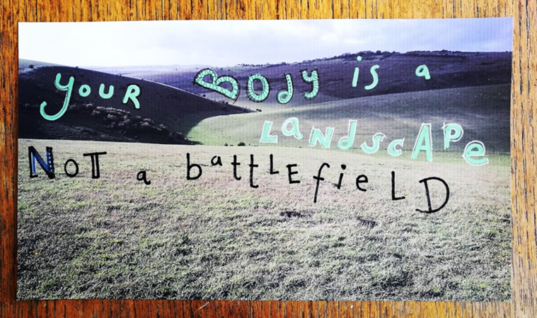
Evidence and Outcome
National Academy for Social Prescribing www.socialprescribingacademy.org.uk
The National Centre for Creative Health https://ncch.org.uk/
Healthcare and professionals
Academics and researchers
Refugees & migrants
Global majority members
Students and pensioners
Job-seekers & homemakers
Protected characteristics

Slide 5
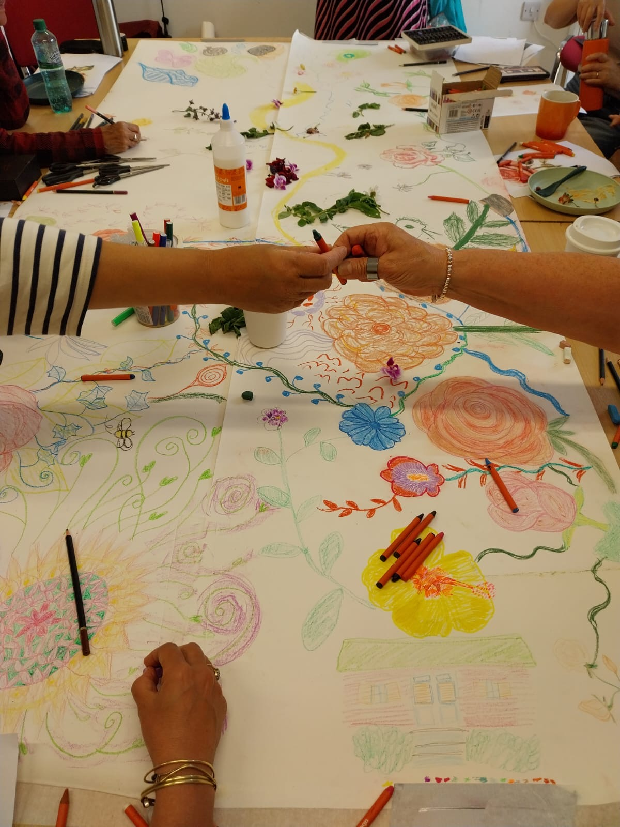
The Hera impact &
participants voices
89% Made improvements in
self-care and managing symptoms
94% Feel more positive &
improved social connections
Notes:
5

Slide 6
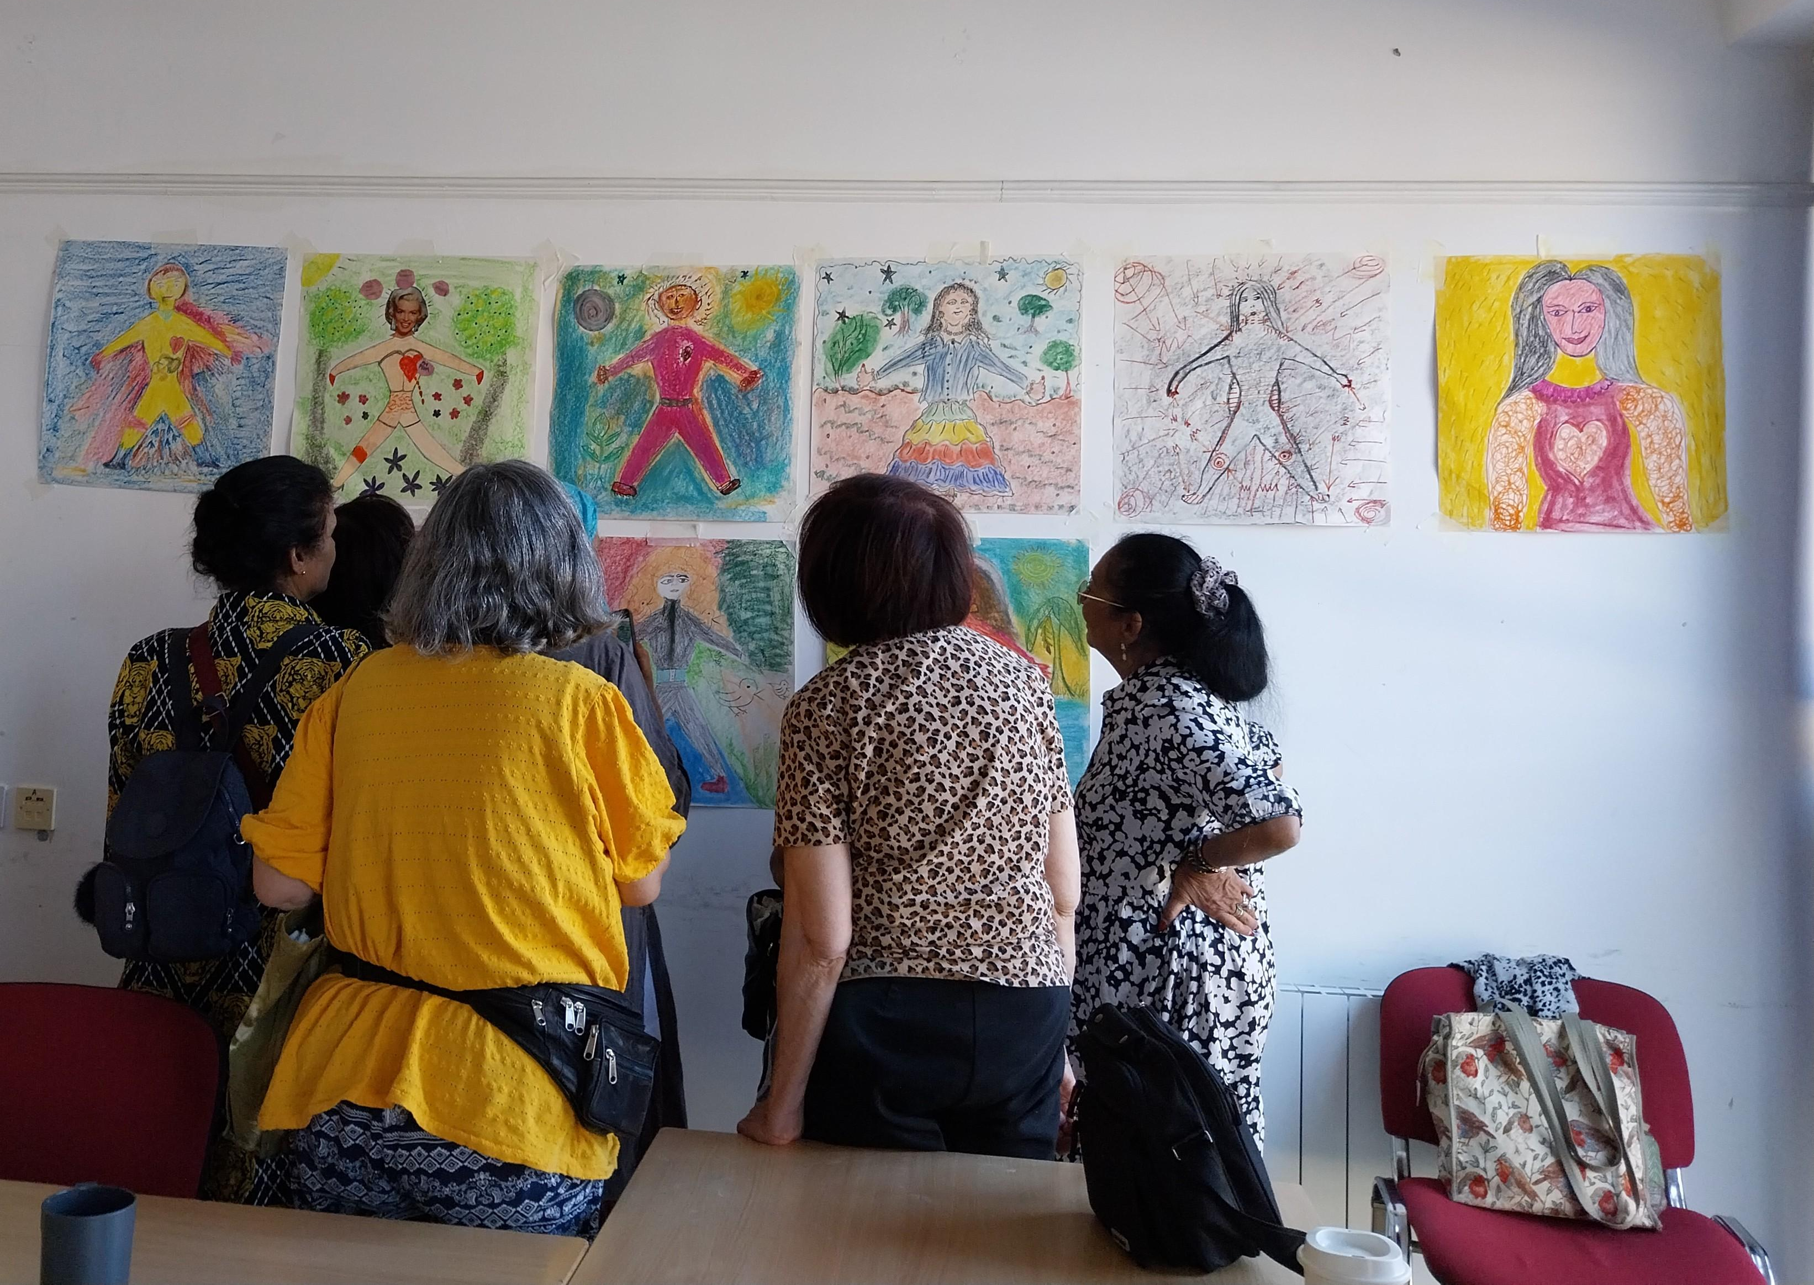
Art for Belonging
Art for Belonging is designed to support refugees, migrants and global majority members of our community to meet major challenges such as health inequalities, ageing, long-term health conditions, loneliness and mental health.
Delivered in a small, welcoming and culturally informed group setting, we explore what it means to belong, establish a new life, and stay connected to one’s culture and traditions.

Slide 7




The Hera Project
www.theheraproject.org.uk
Esther Watts – Director
Esther@theheraproject.org.uk
Ratna Jan Bibi – Creative Programmer
ratna@theheraproject.org.uk

