Slide 1
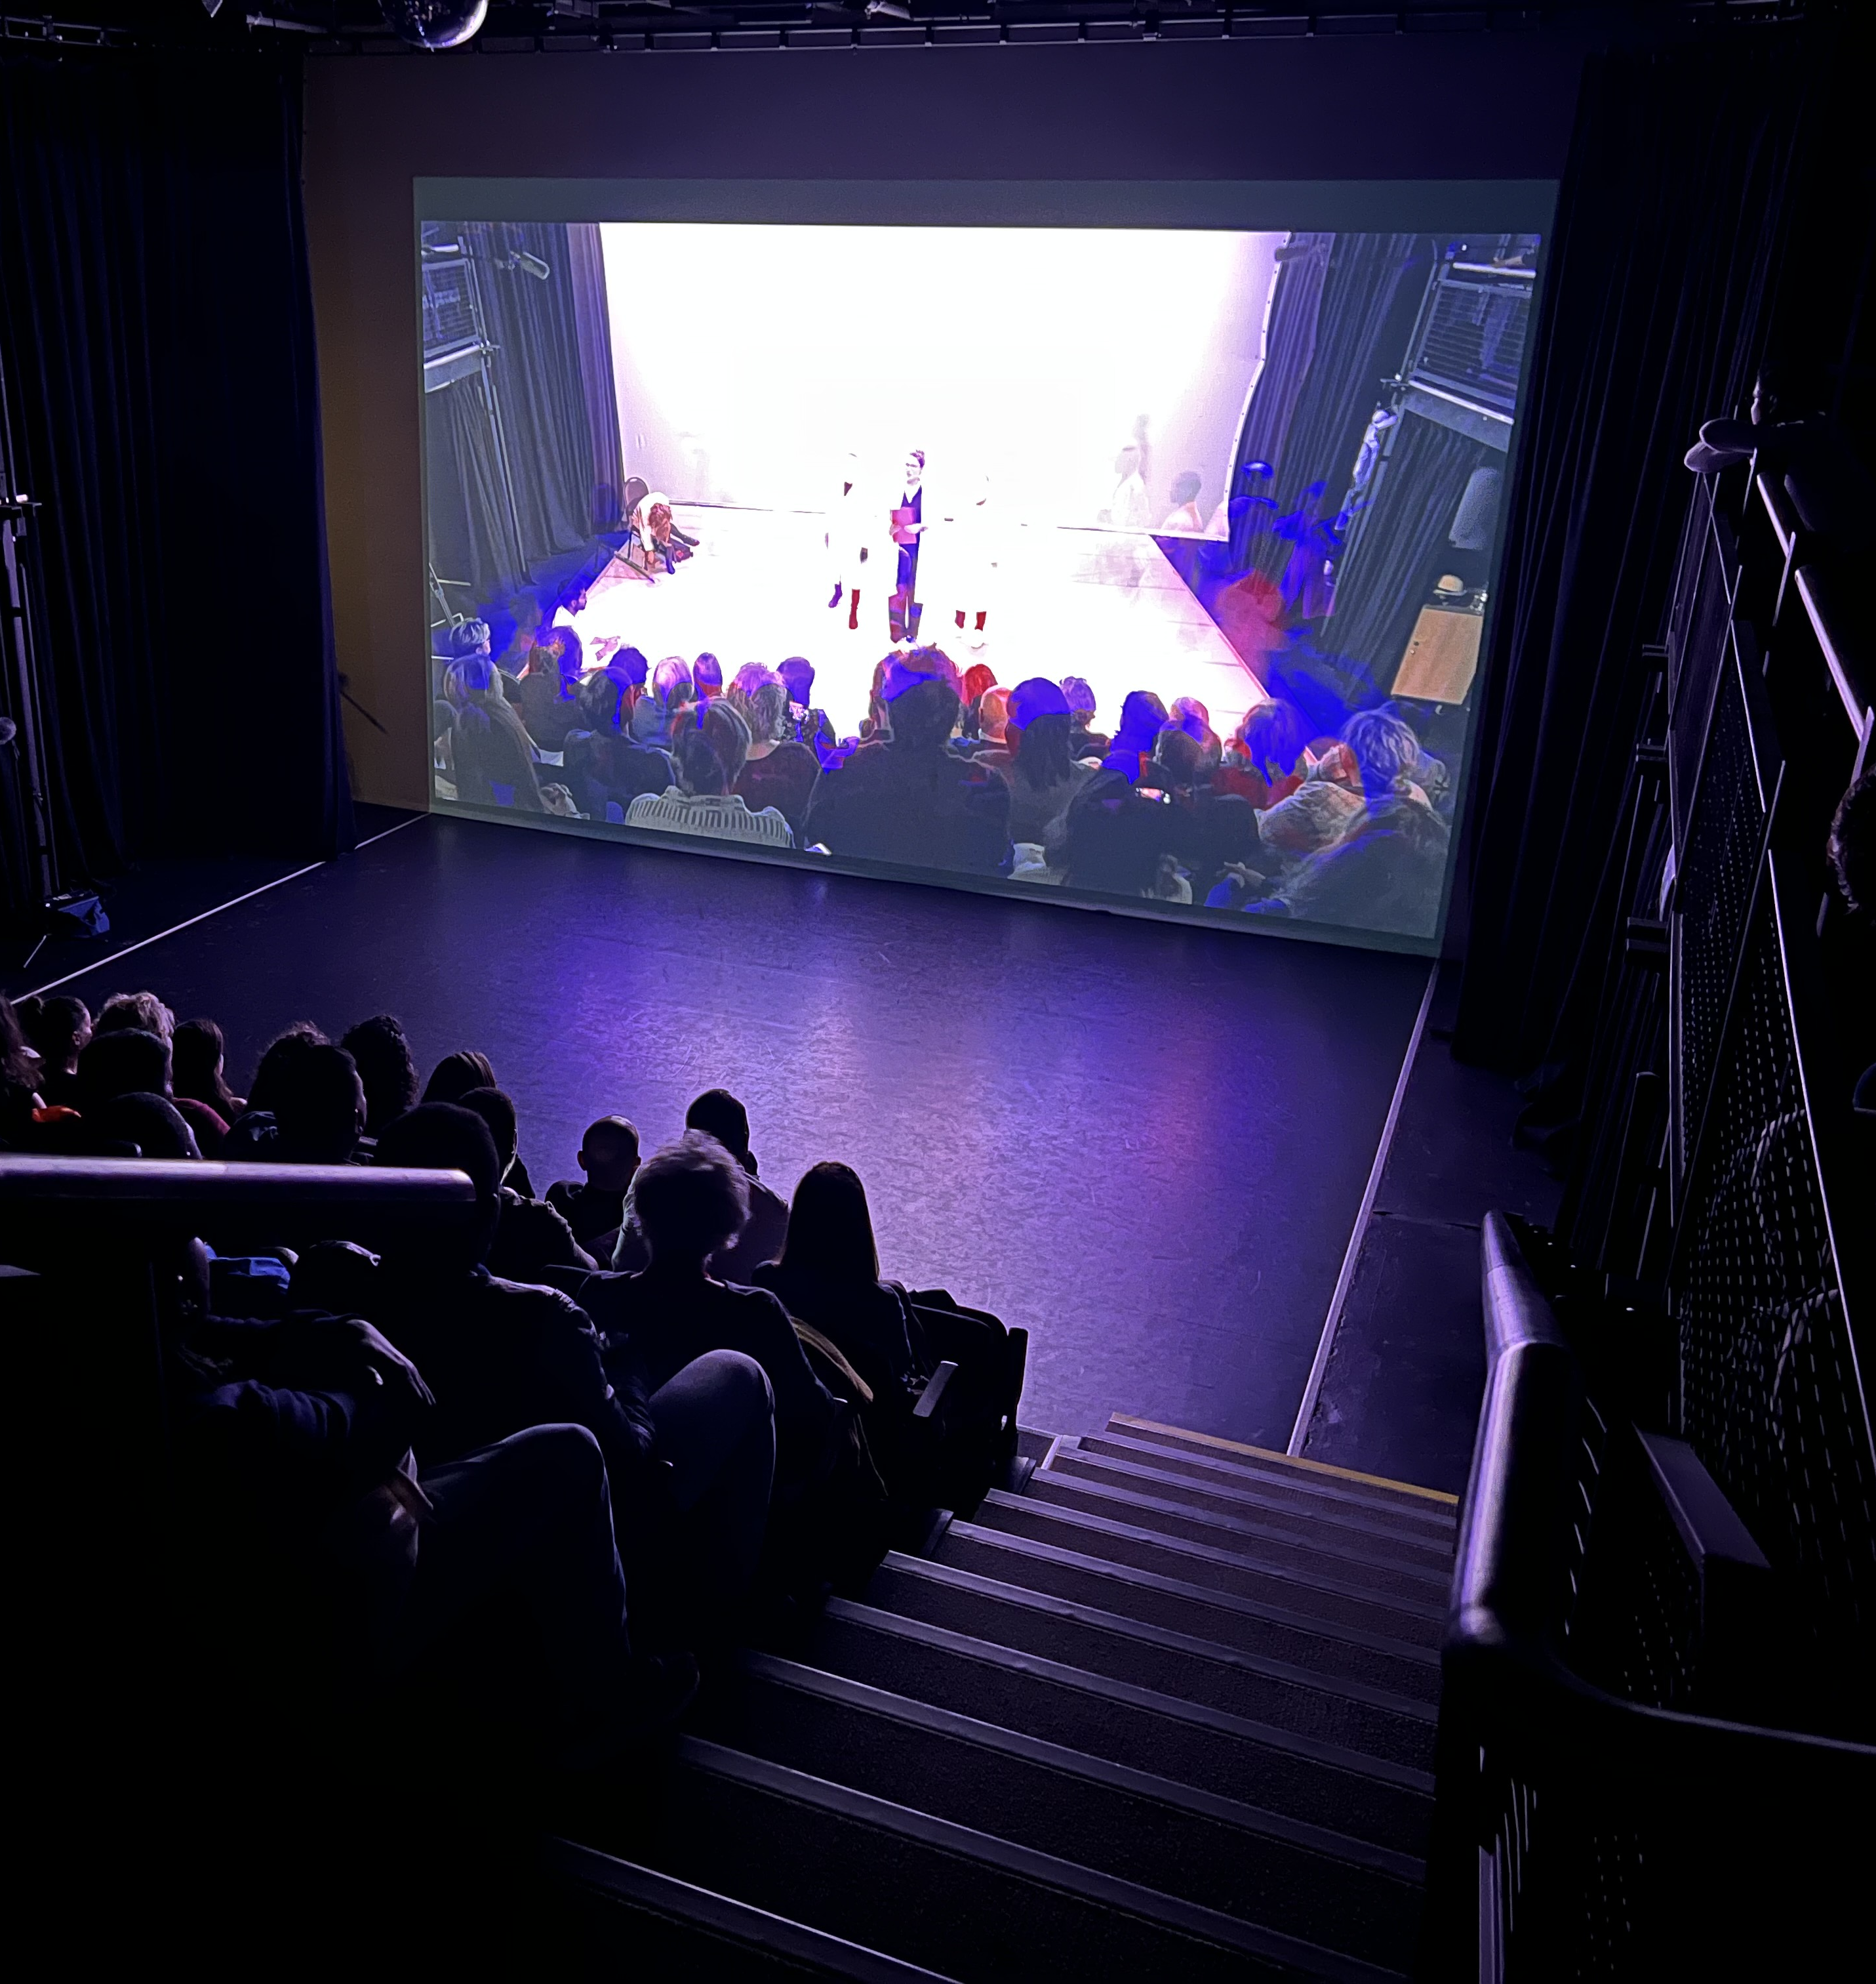
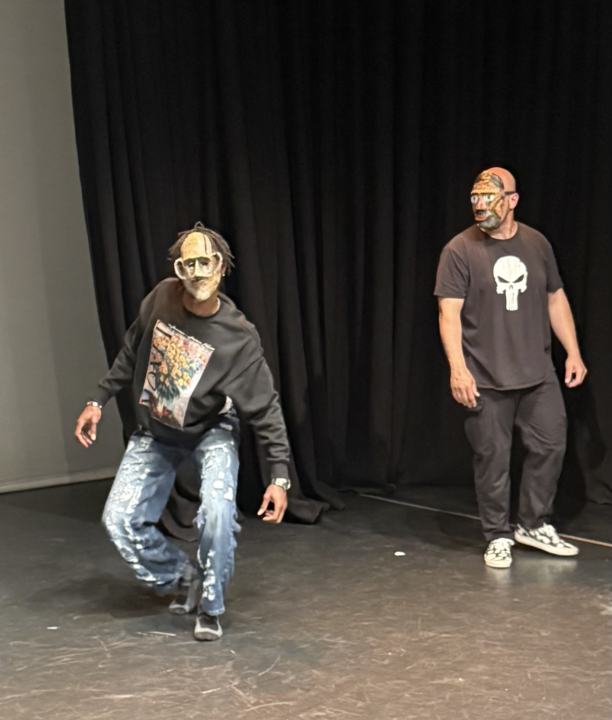
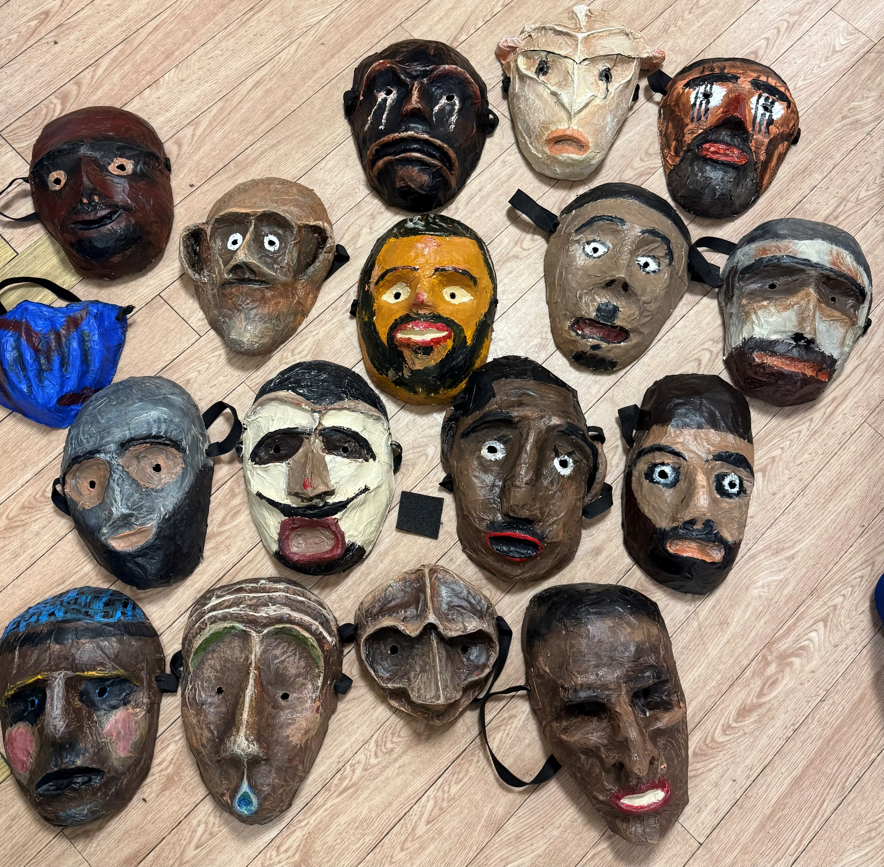
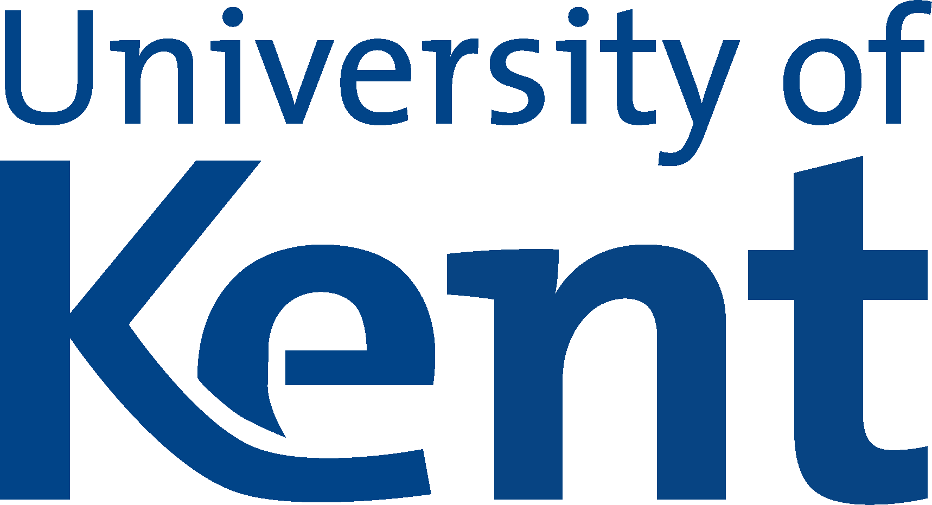
Fostering Solidarities Through Creative Arts in Universities
Projekt Encounter, hosted and supported by University of Kent, School of Arts and Architecture
Inclusive collaboration across communities (students, academics, staff, refugees etc.)
Participatory research film (Encounter) on ethics in applied theatre
Universities as spaces for solidarity and co-creation.

Slide 2
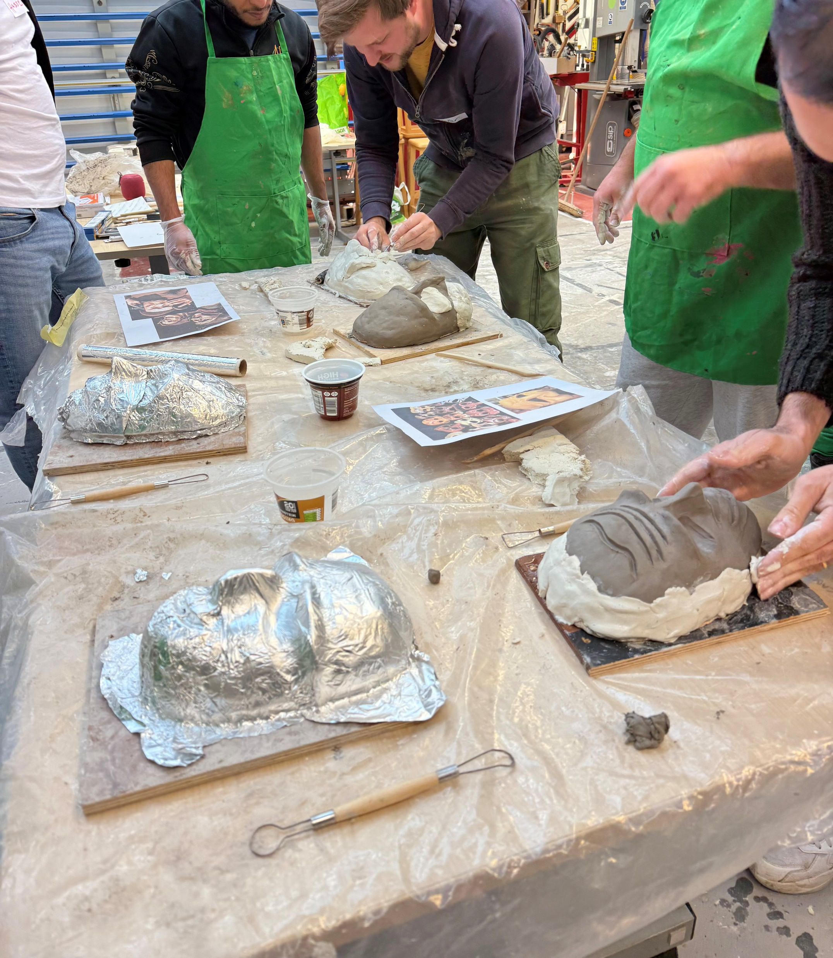
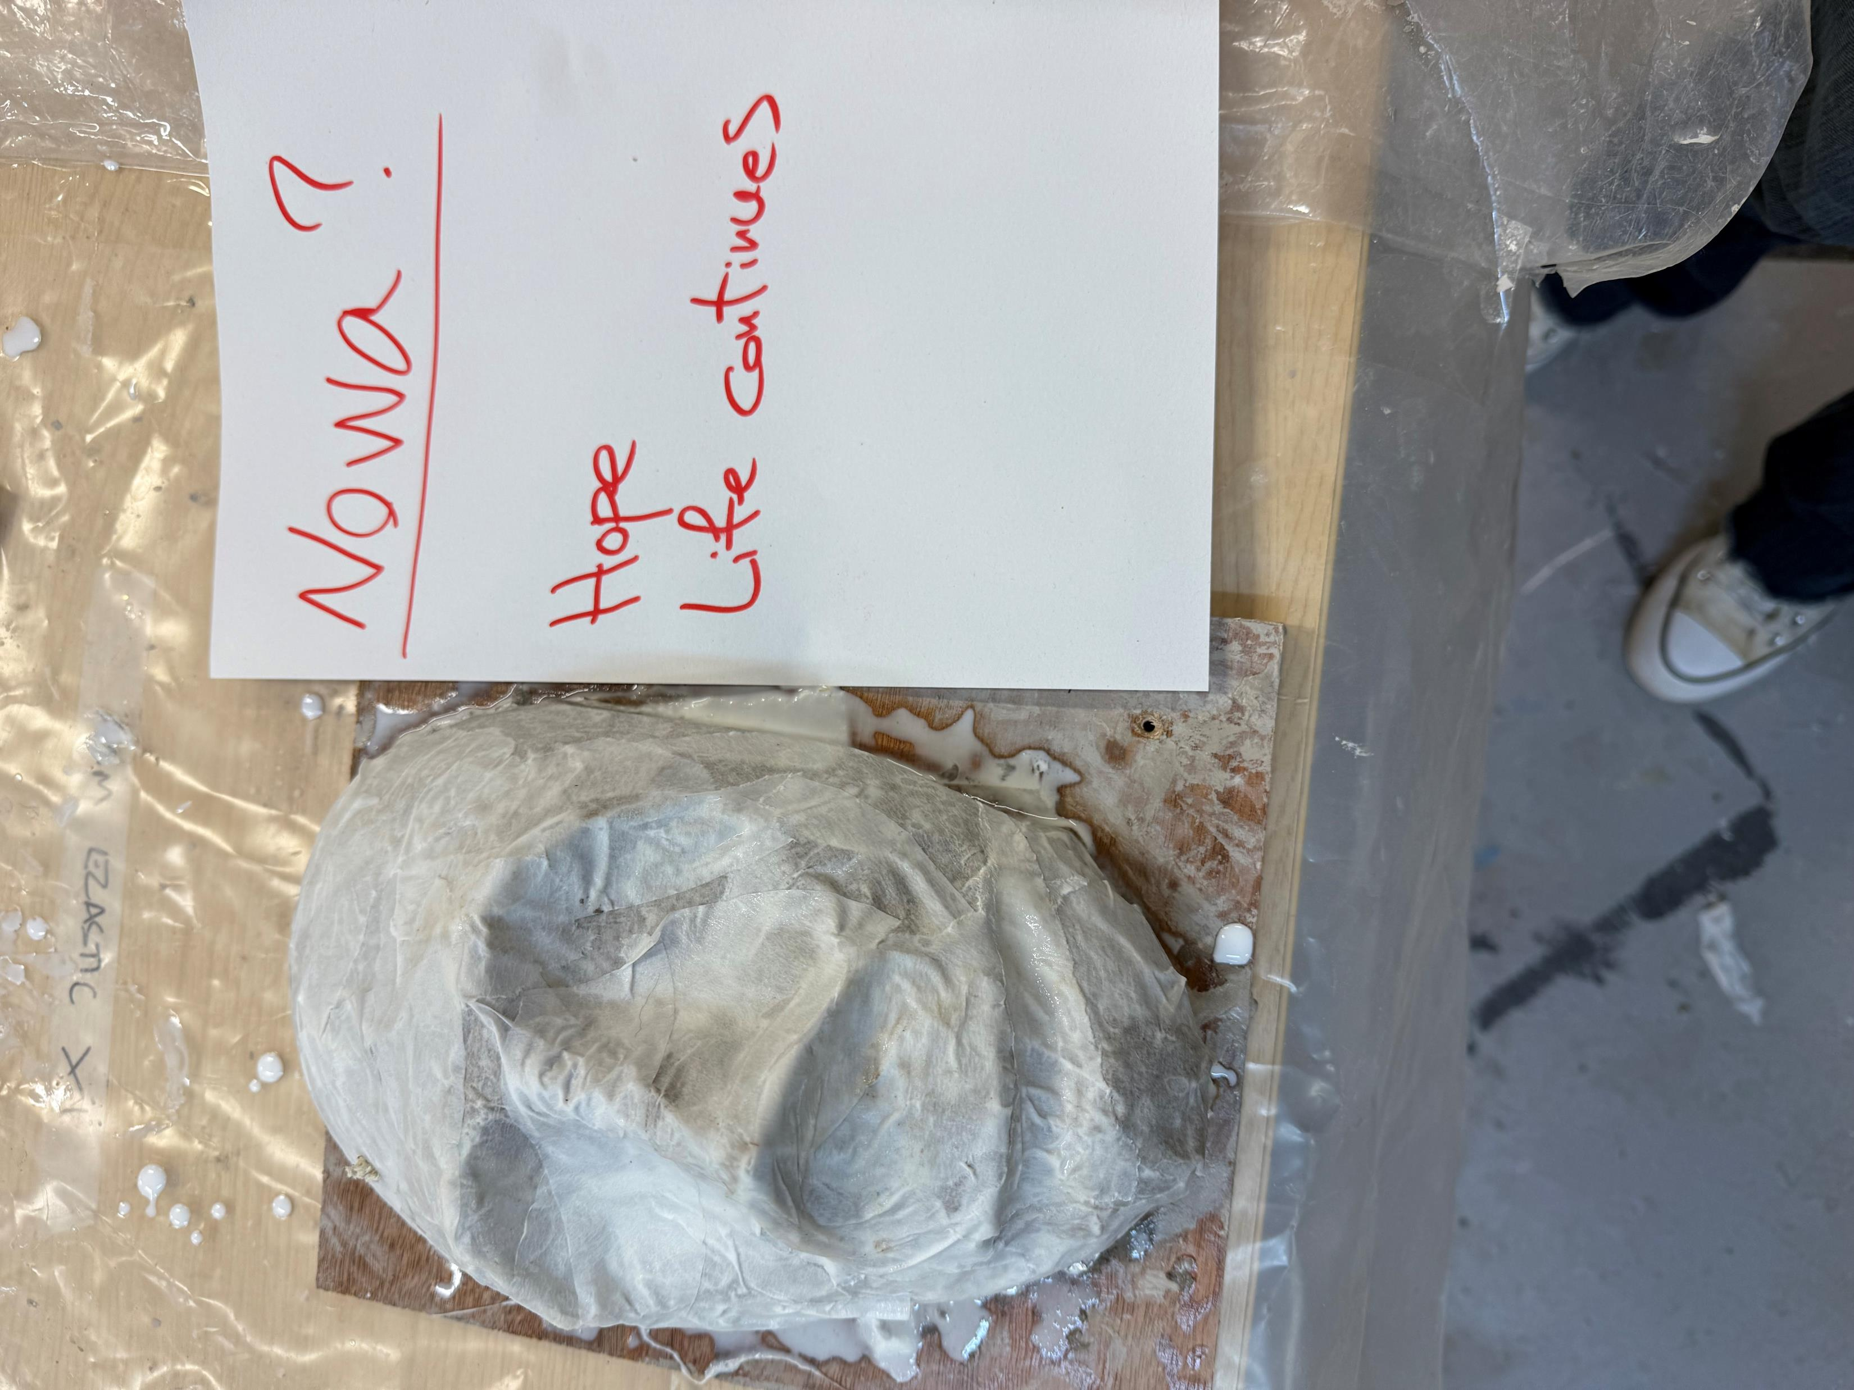
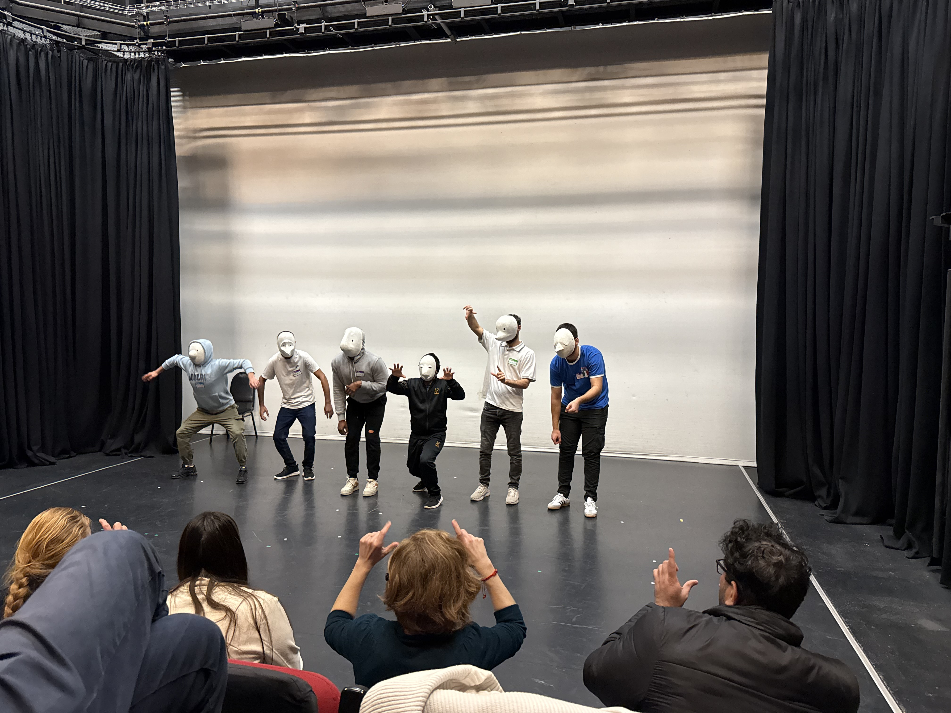
Expanding Expression Through Masks
AHRC (IAA)-funded workshops in mask-making
Non-verbal mediums fostered freer, imaginative expression
Participants engaged deeply despite no prior experience
Aim: to develop basic skills in masked acting and mask-making, encourage creative self-expression, support intercultural dialogue, and enhance wellbeing for a multilingual group of migrants.
The workshops complemented PROJEKT ENCOUNTER’s existing drama workshops by focusing on creative modes of expression not reliant on language.

Slide 3
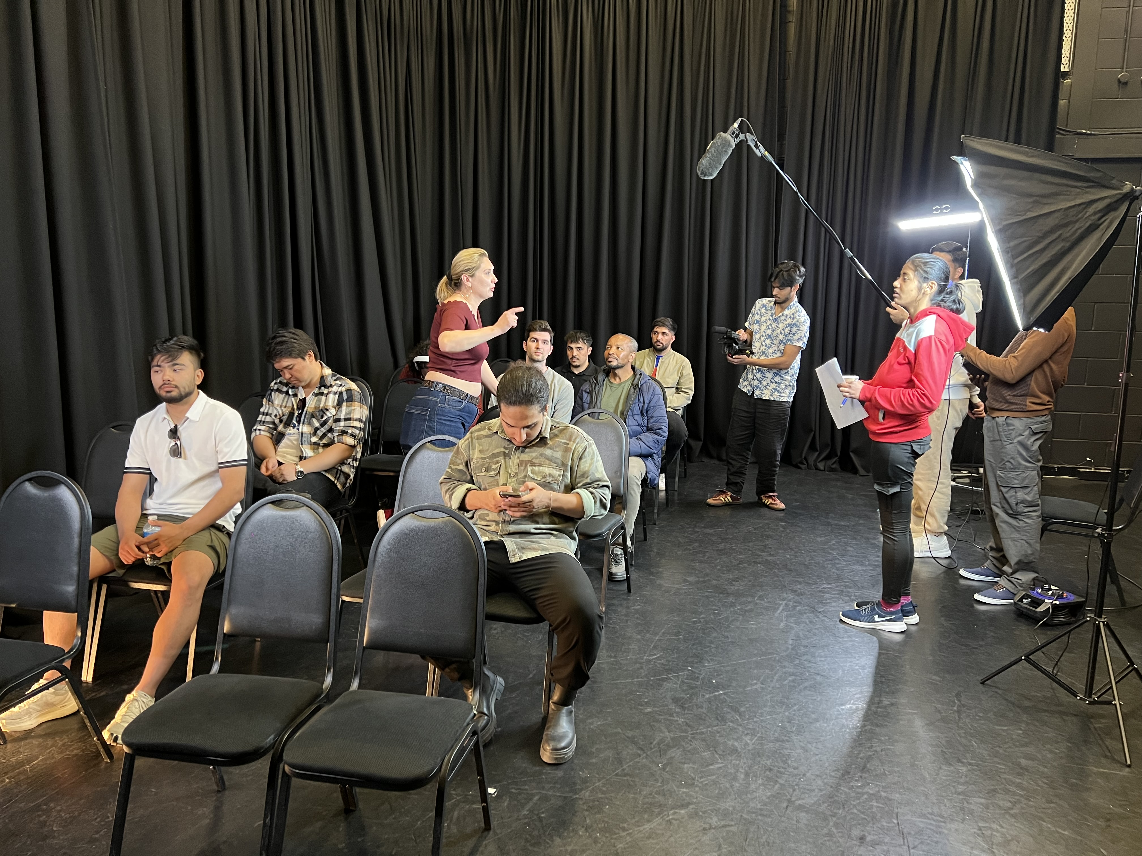
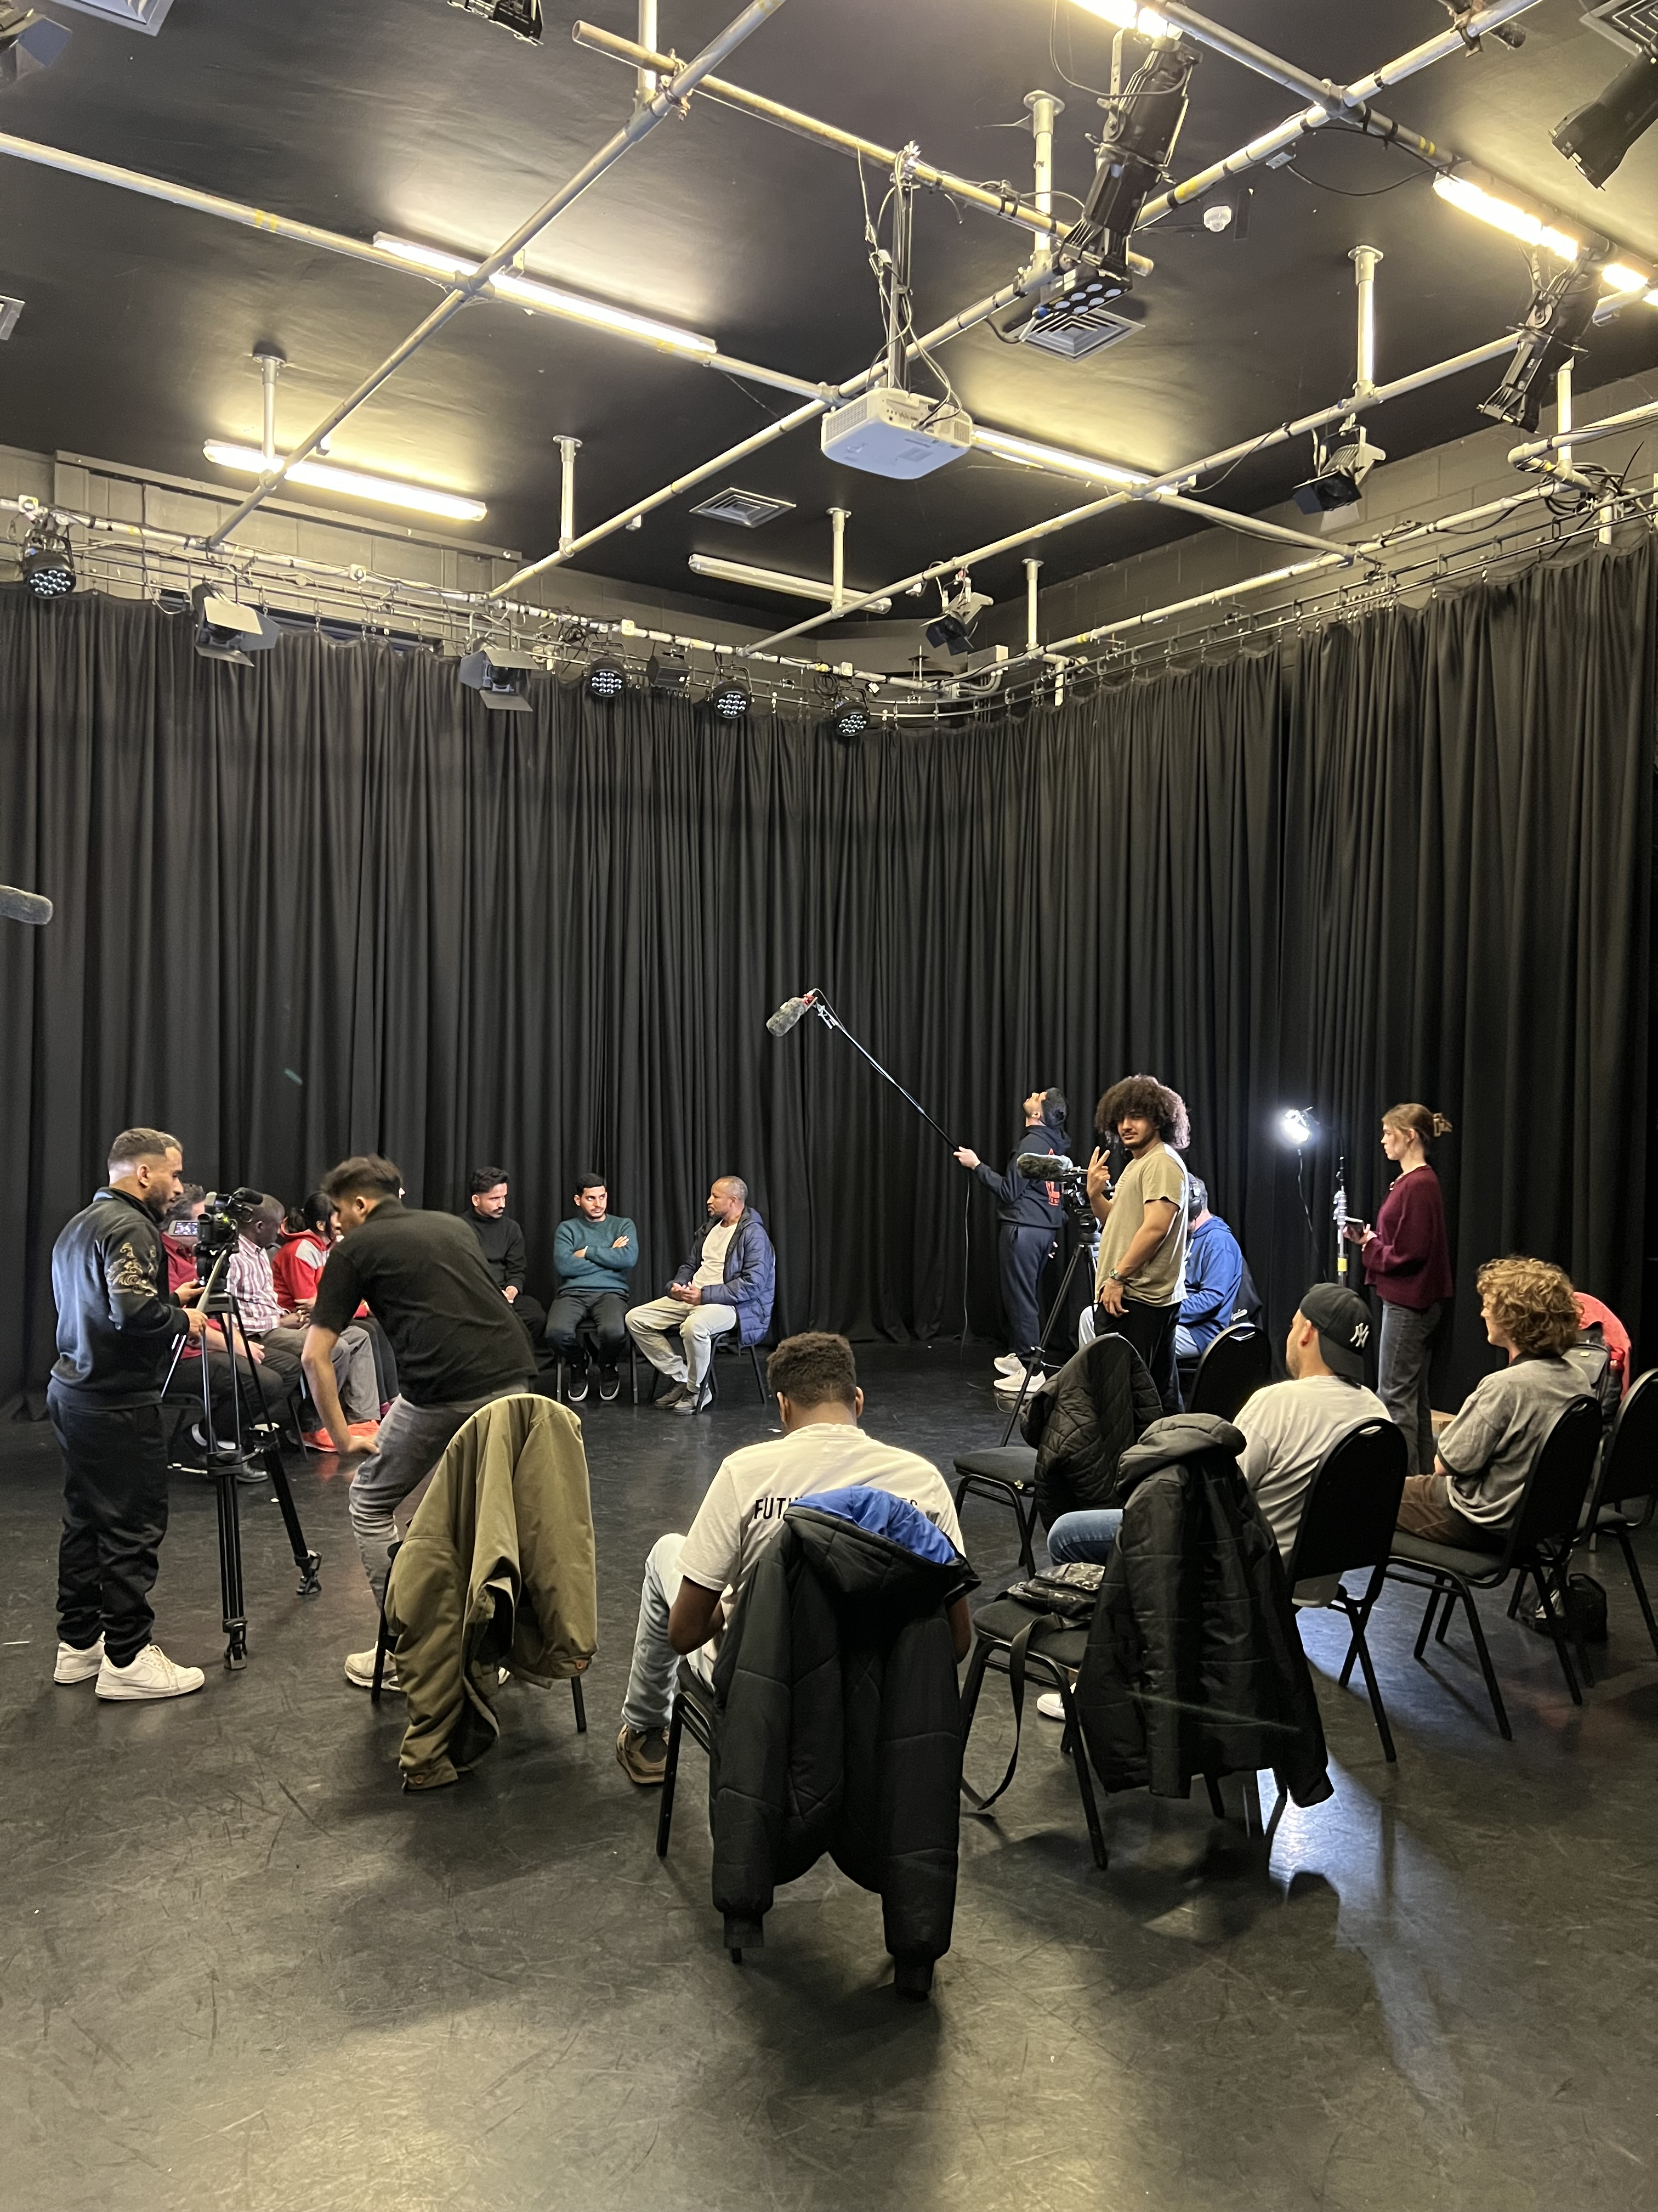
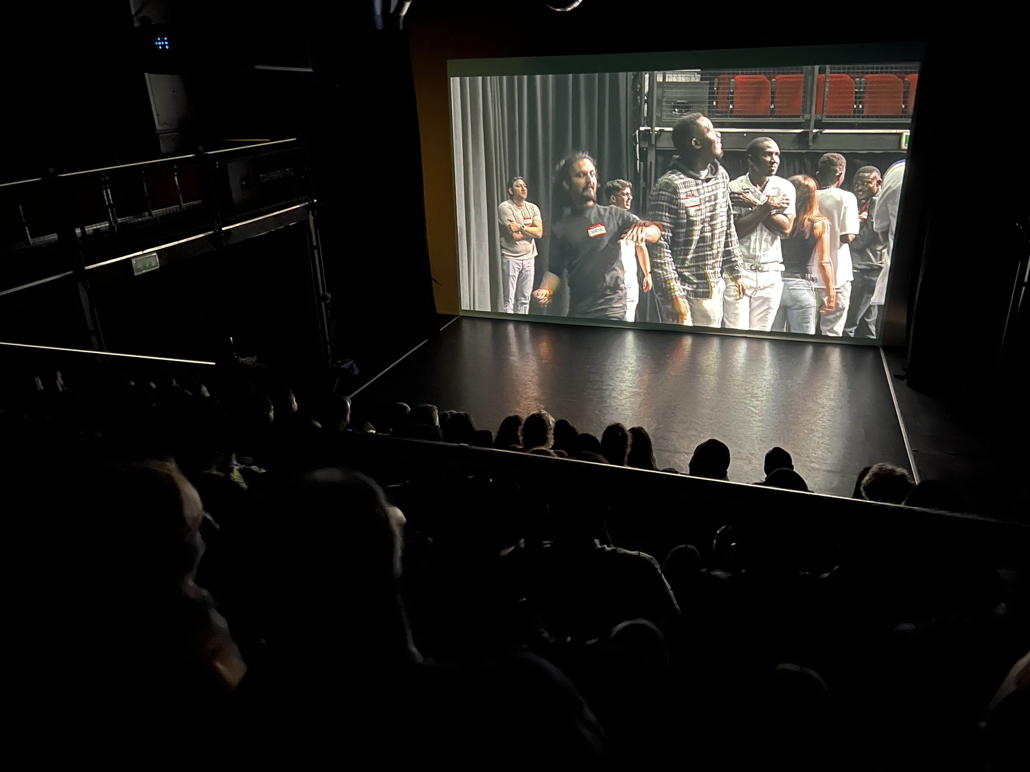
Participatory approach in Filmmaking Workshops
AHRC (IAA)-funded workshops in filmmaking
Participatory approach
Year 1: making a participatory film about the workshops
Year 2: running filmmaking workshops in collaboration with the workshops
Aim: to develop basic skills in filmmaking and team-building, encourage creative self-expression, support intercultural dialogue and storytelling
The workshops complemented PROJEKT ENCOUNTER’s existing drama workshops by providing them with short films made by participants, which were included in the final performance.

