Slide 1

EASTERN ARC CONFERENCE ‘Drawing as sanctuary’ by Dr. Edina Husanovic
University of Brighton and HERA project

Slide 2
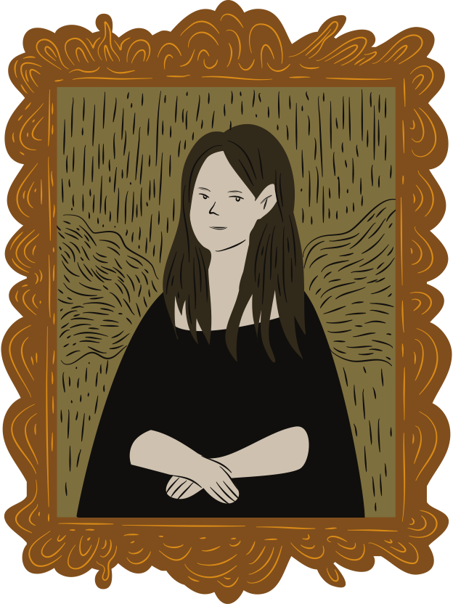
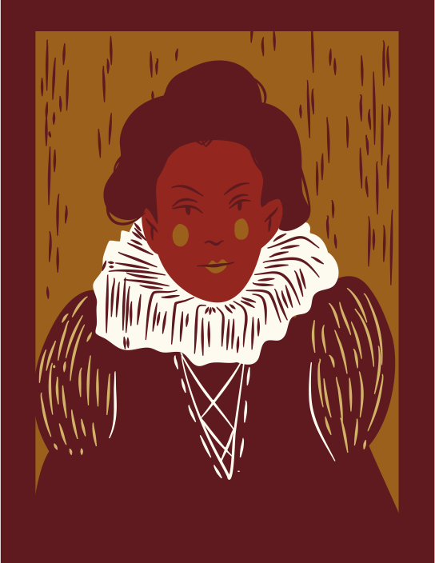
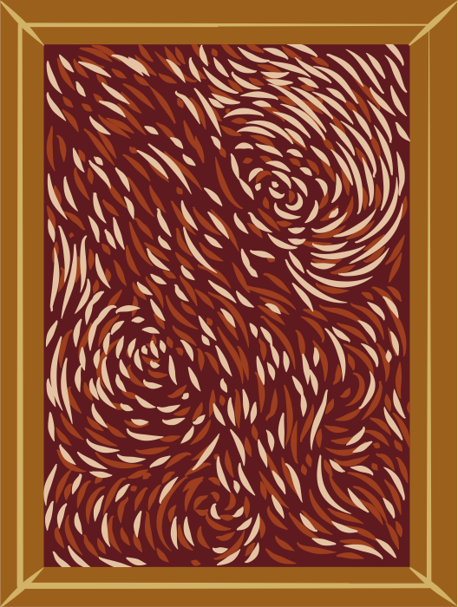
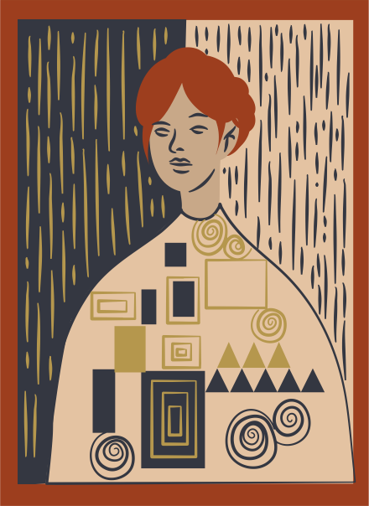
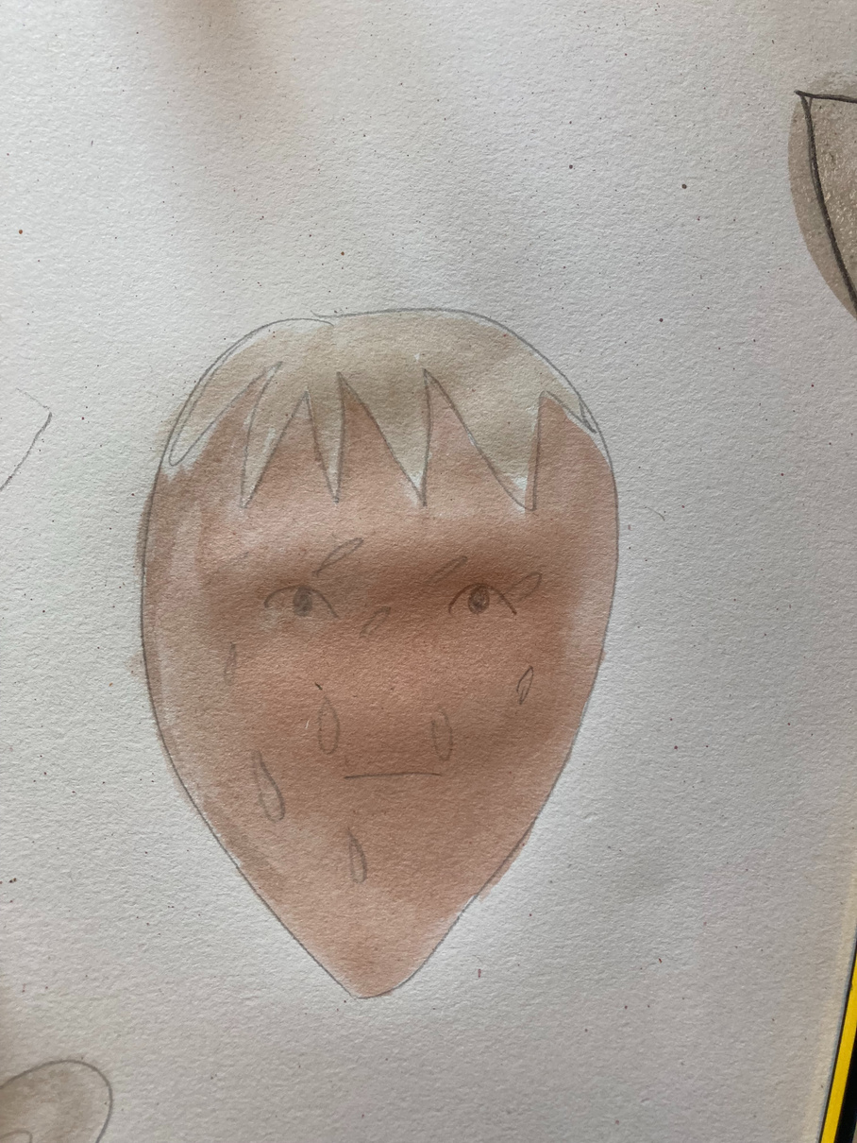
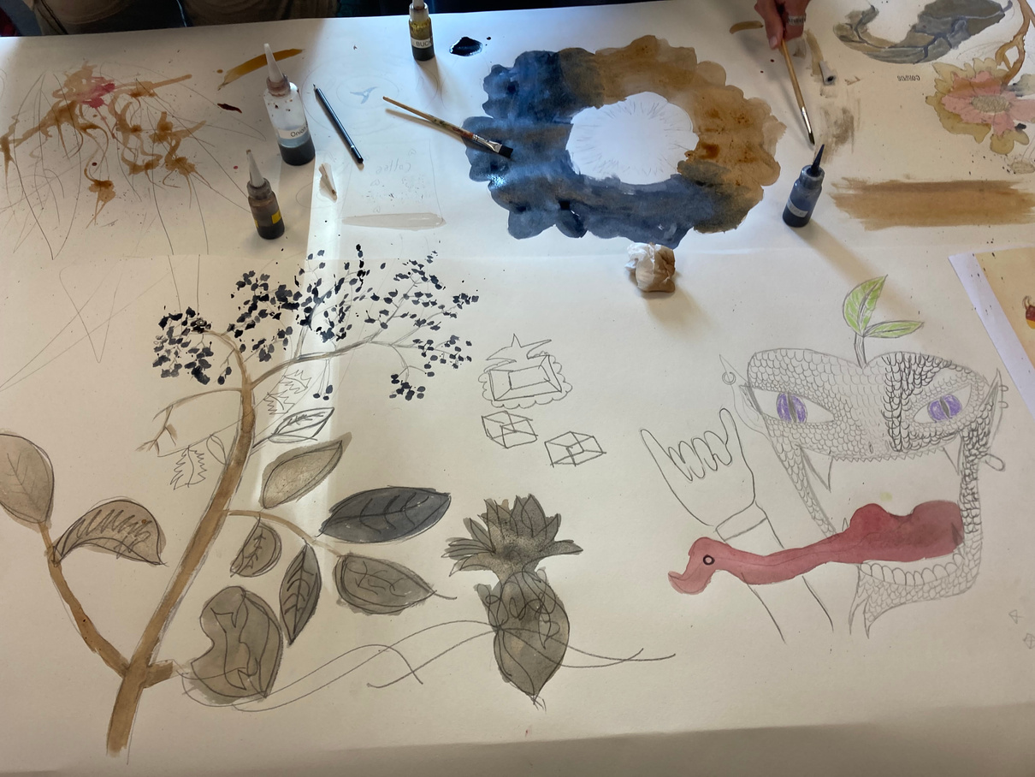
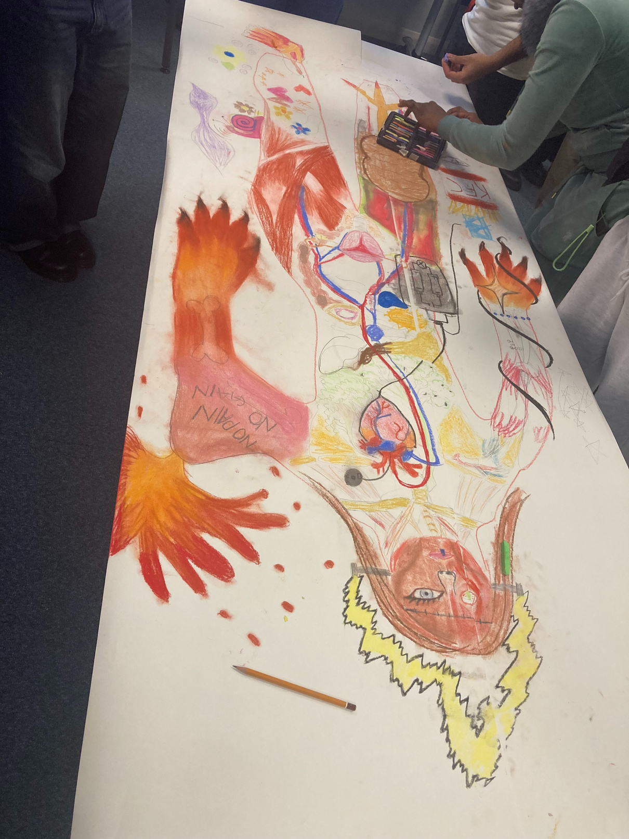
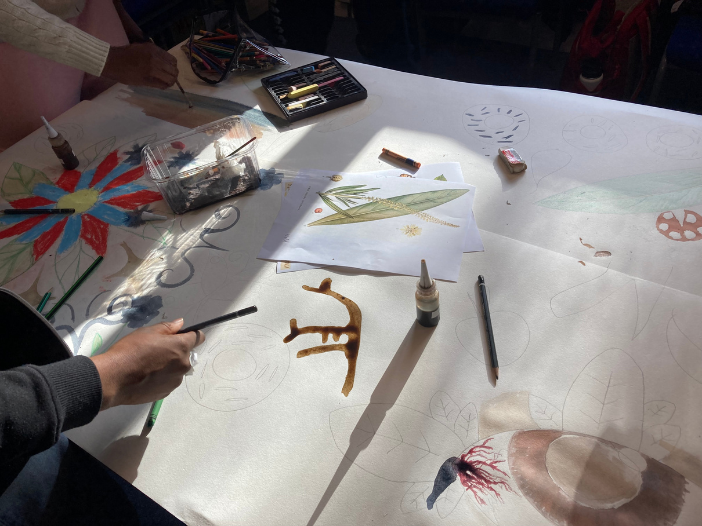
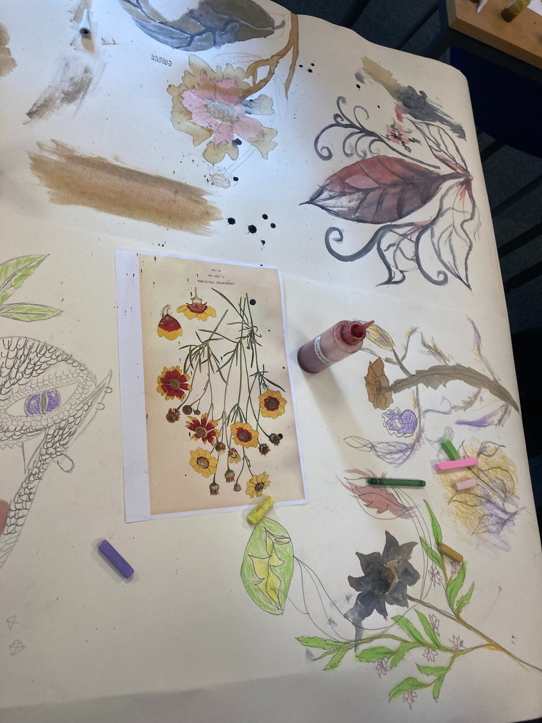
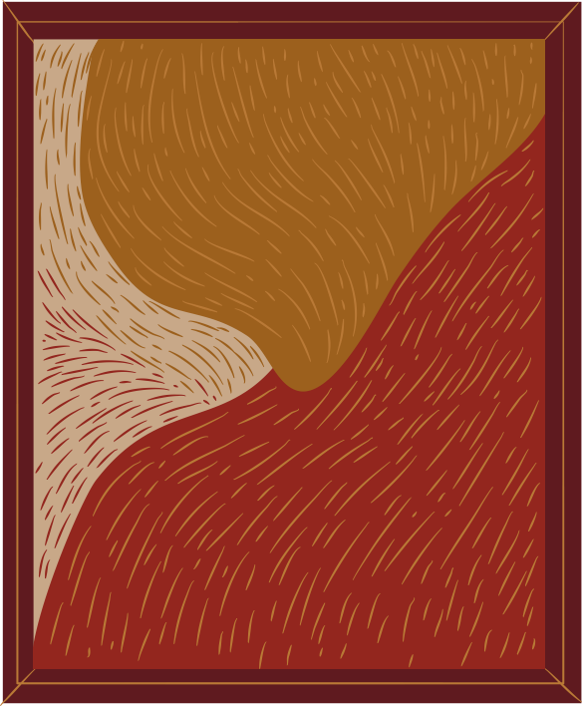
COLLABORATION:
A cornerstone of wellbeing

Slide 3

Why Drawing?
Why should we consider drawing as a sanctuary?
The ways in which drawing contributes to healing and alleviation of suffering.
Why might drawing be a sanctuary for imagination, deep reflection and communal healing?

Slide 4
What is the Connection Between Drawing and Well-being?
PhD performance - collaborative drawing
Overview of the postgrad project at Brighton University research with migrant and refugee groups in Brighton and Brighton and Sussex Medical School (BSMS)
Art for Belonging, HERA project

Slide 5
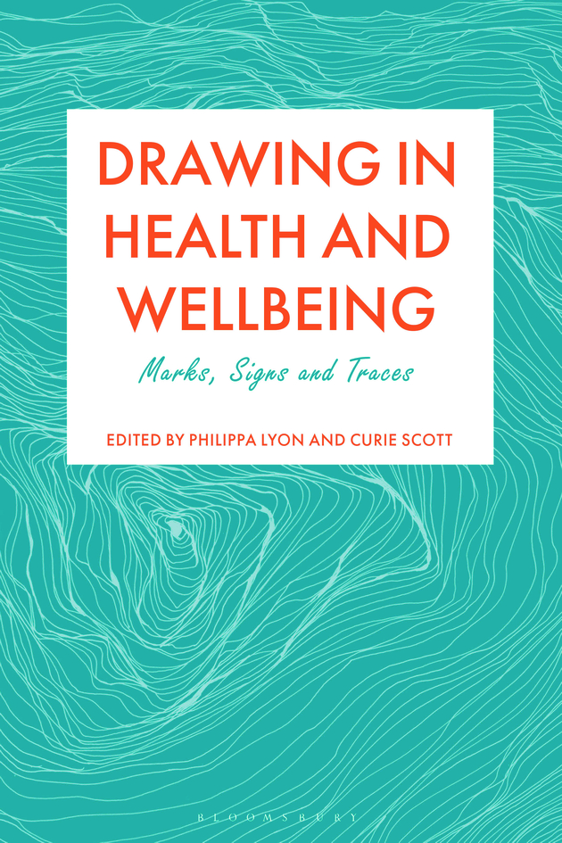
Research Context How Can Drawing Help Us Process difficult Experiences?
The ways that drawing helps us navigate personal or collective trauma.
The space between deep reflection and imagination
The process of drawing ‘can sometimes bring perceptions and memories to the surface”, where drawing becomes a powerful tool ‘amplified in situations where those who are drawing have voices that are less often heard and where many other power imbalances might be present’ (Scott 2025:9)

Slide 7
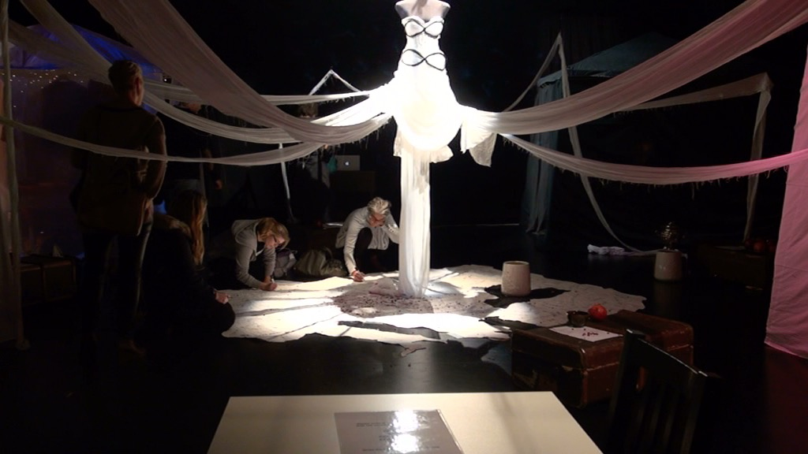

Slide 8
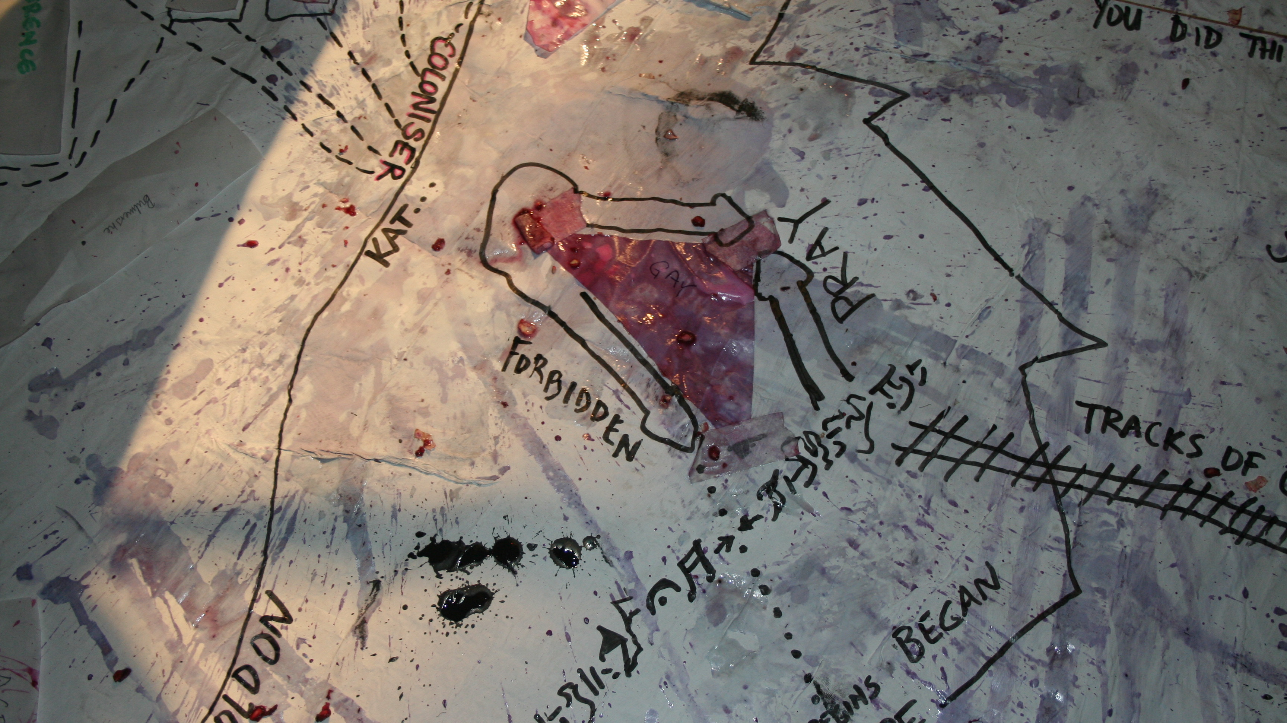

Slide 9
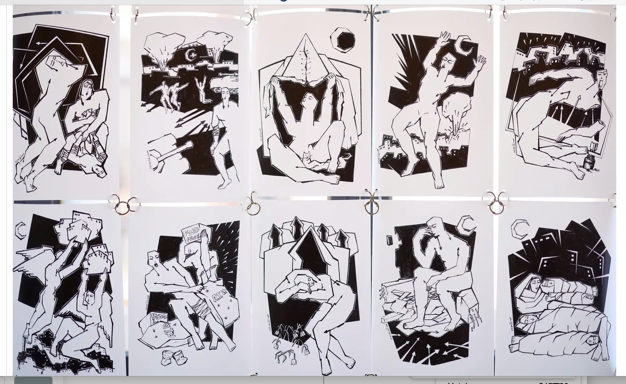
Maisara Baroud, Gaza 2024

Slide 10

Tuzla, Bosnia and Herzegovina, 25 May 1995

Slide 11
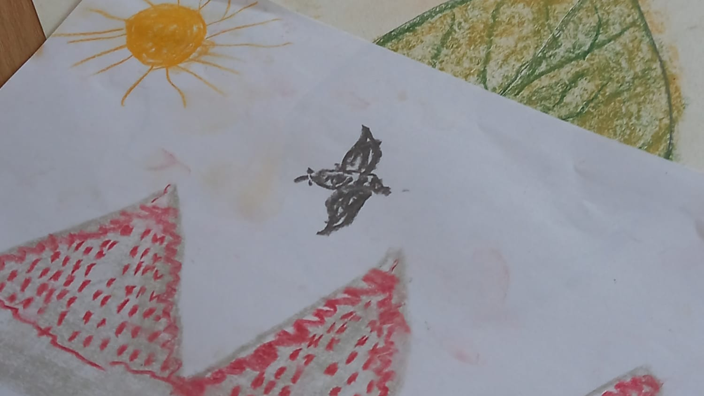
Imagination as sanctuary

Slide 12
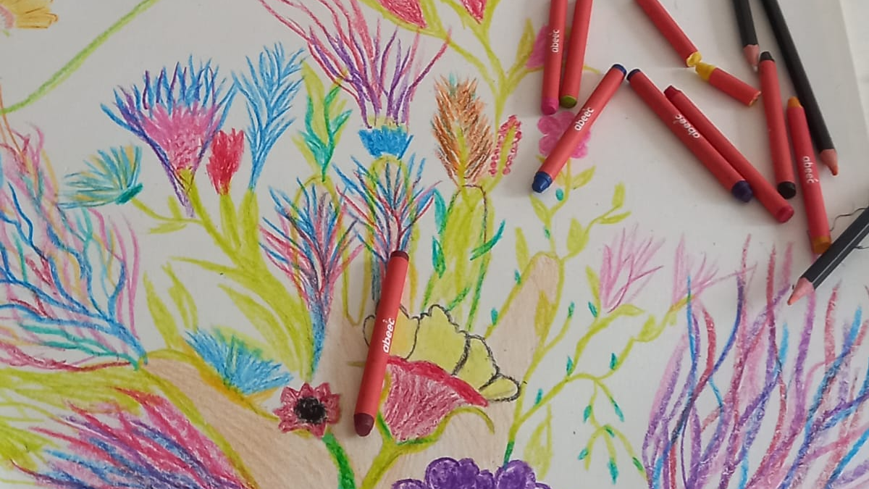

Slide 13
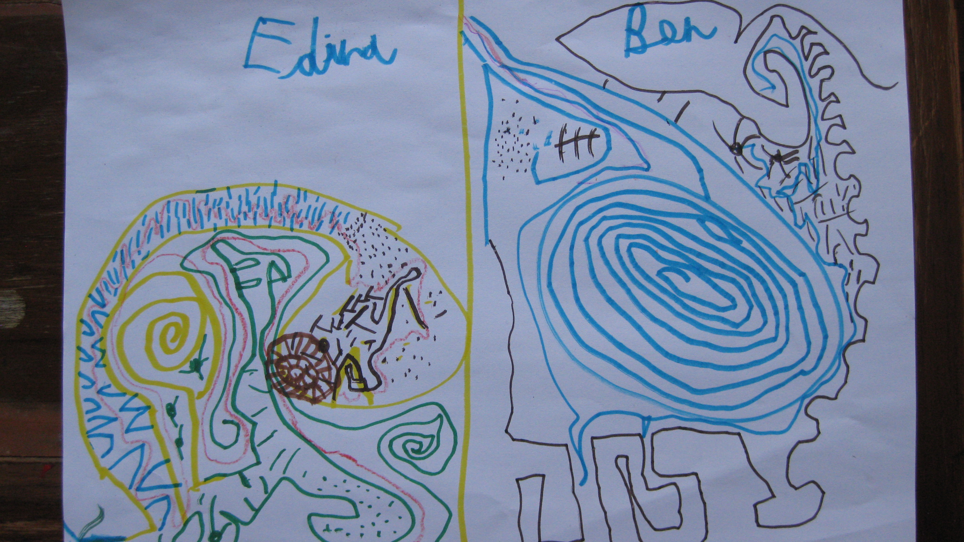
DRAWING AS dialogue

Slide 14
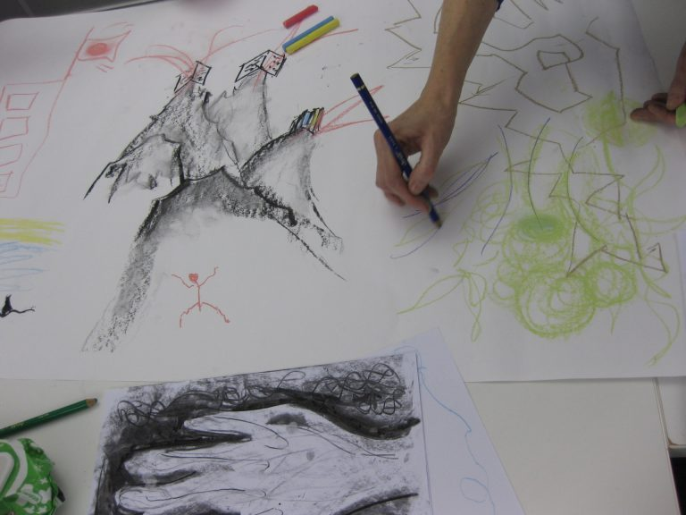
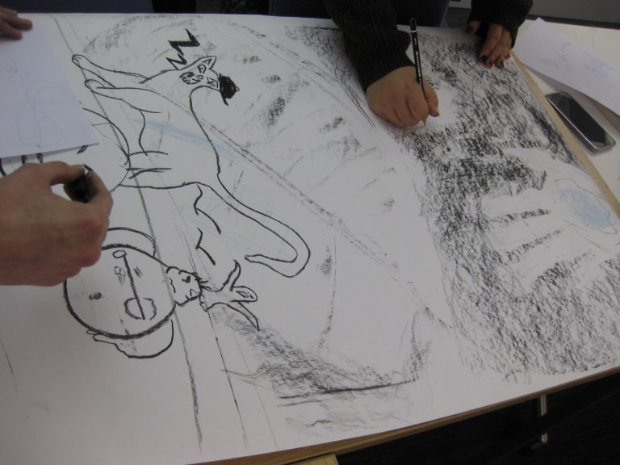
We explored our experiences of migrations and journeys to UK with; drawing with the left hand and eyes closed, following a memory of leaving home and arriving at the University for the first time, re-drawing those memories together on a sheet of paper and finally, moving to the courtyard, making invisible drawings by walking in the courtyard following an imagined pattern, and making a joint ‘ma drawing’ on a large sheet of paper by dipping one shoe into a charcoal pigment
Drawing Migrations sessions 19/11/21 and 19/1/22

Slide 15
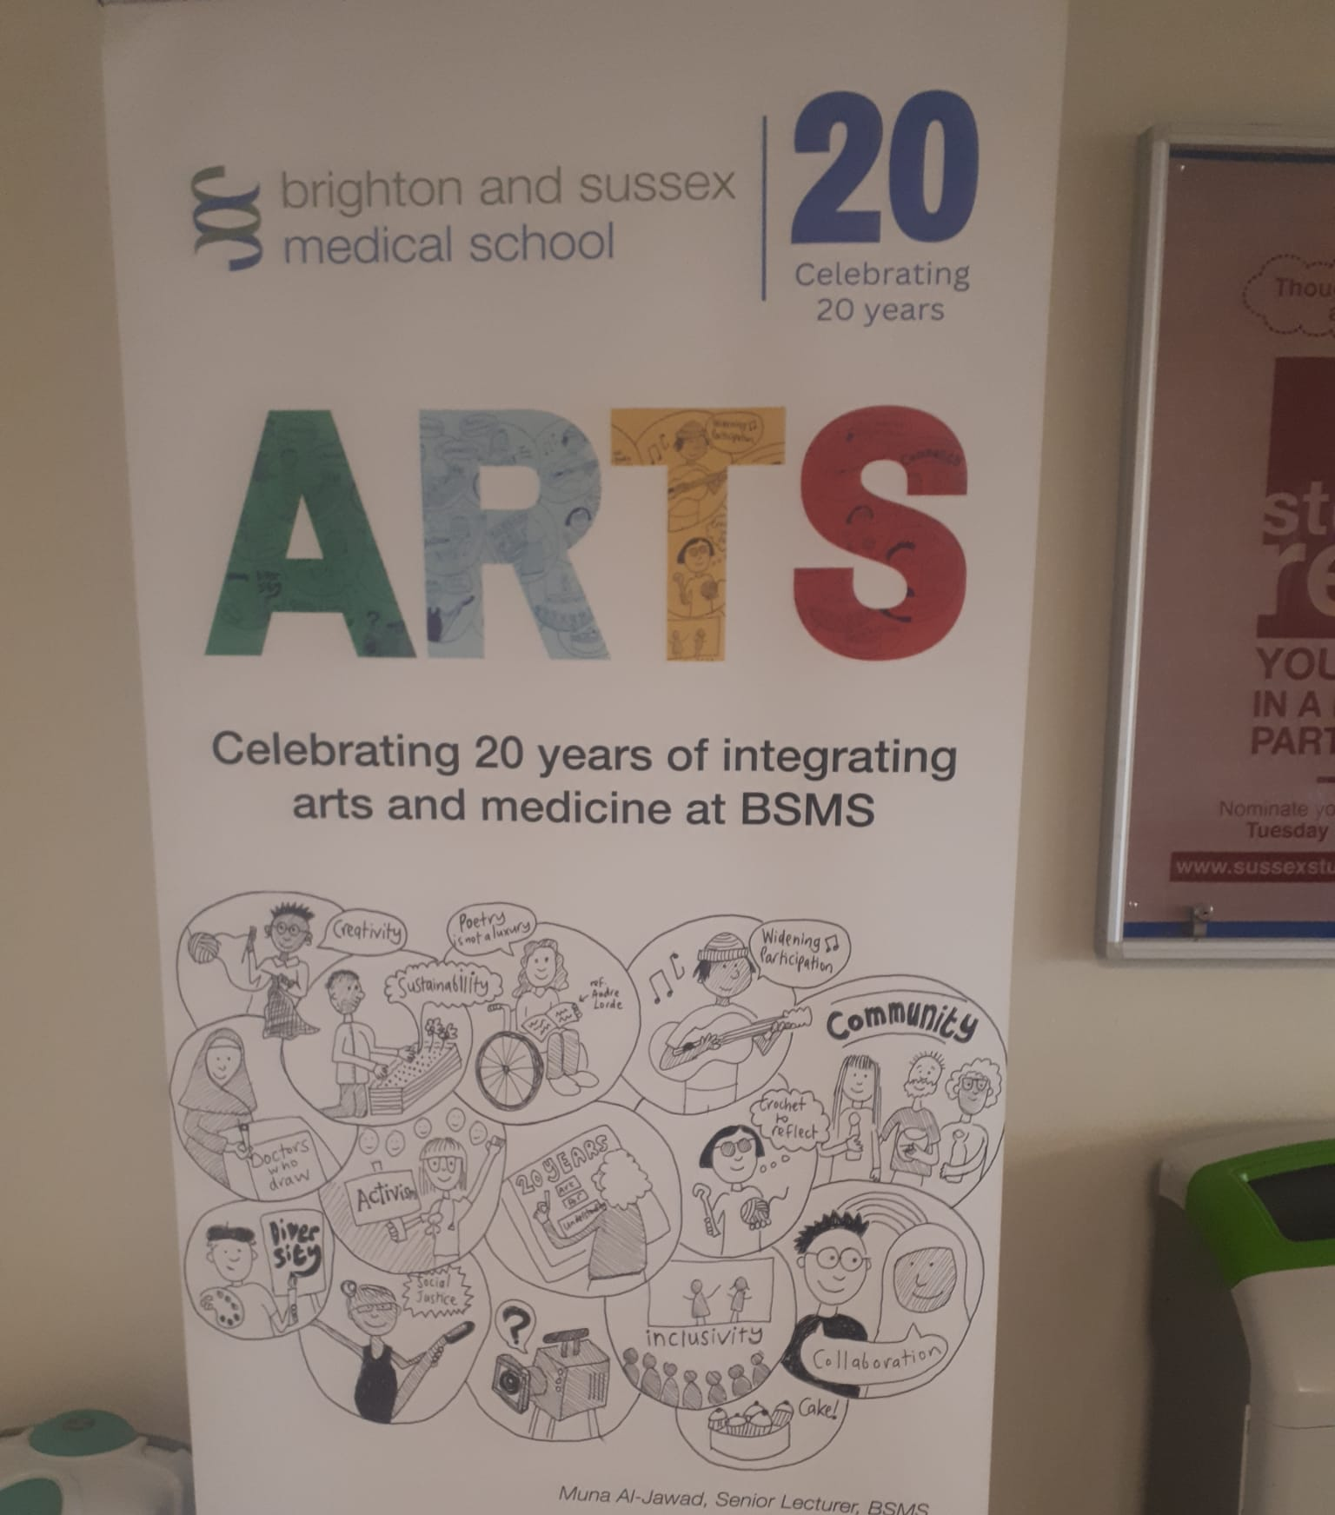
What Happens When Medical Students Engage with Drawing?
What would happen if future doctors practiced drawing regularly?
How does this challenge traditional medical training?

Slide 16
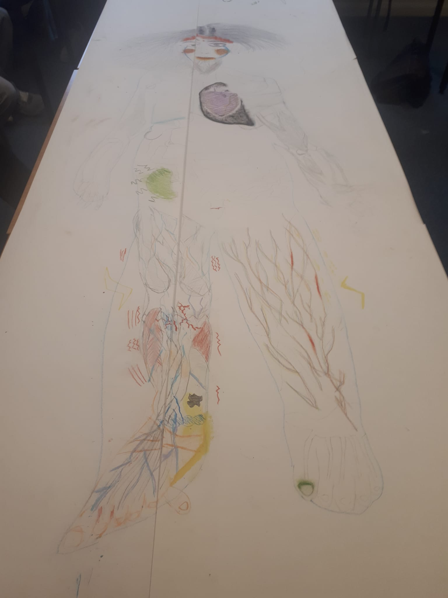
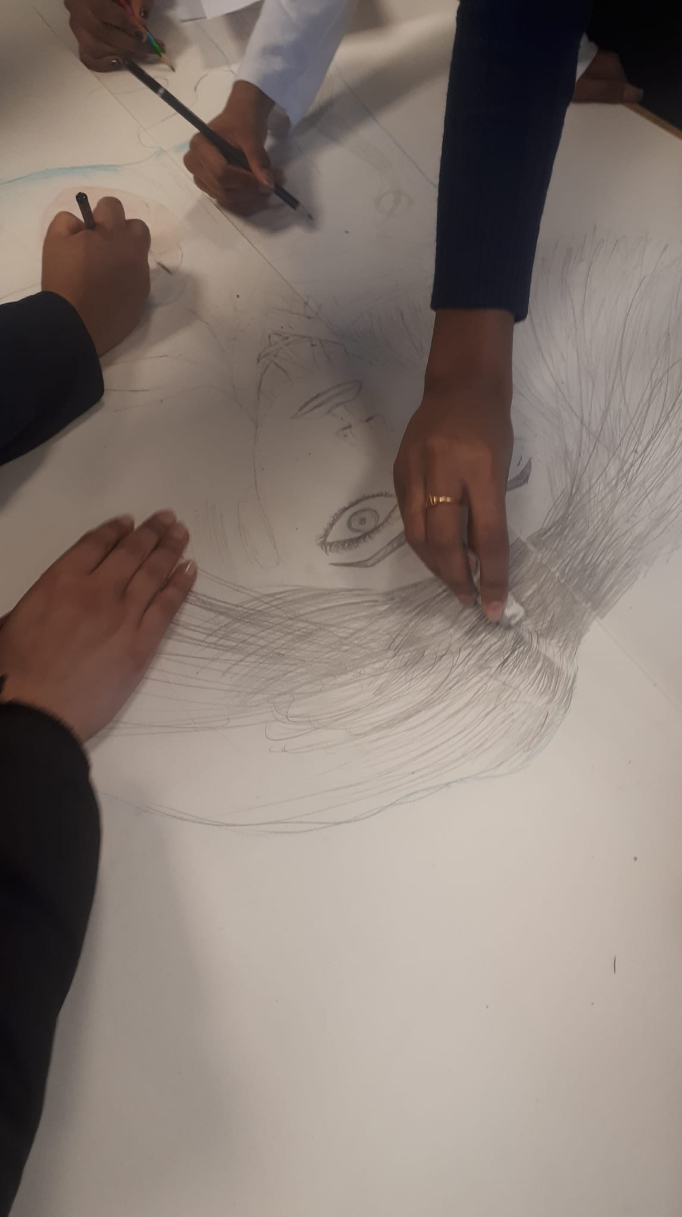
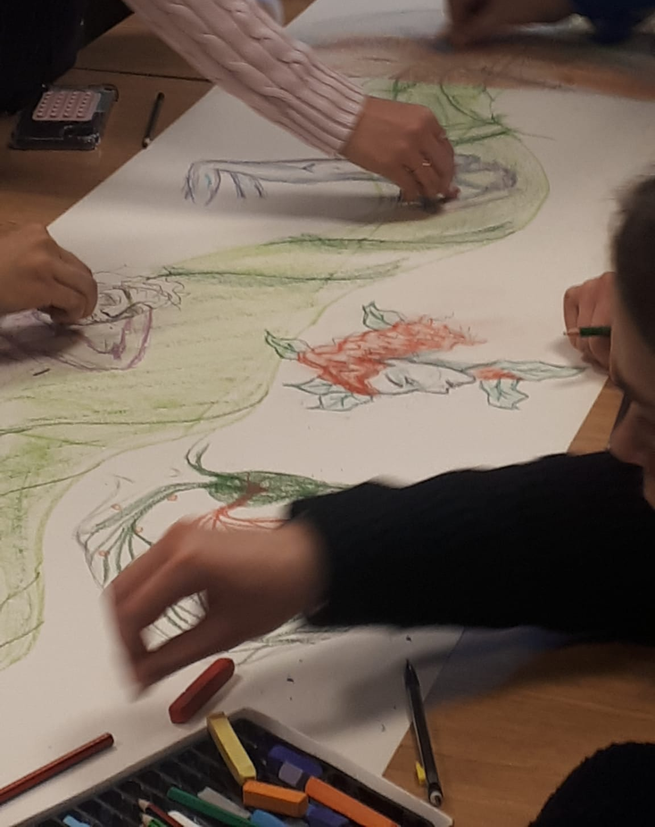
What Kind of Activities Were Used?
Collaborative drawing
Life Drawing
Body Mapping
Storytelling and drawing
Natural dyes
Golden ratio and drawing
Movement and drawing …

Slide 17
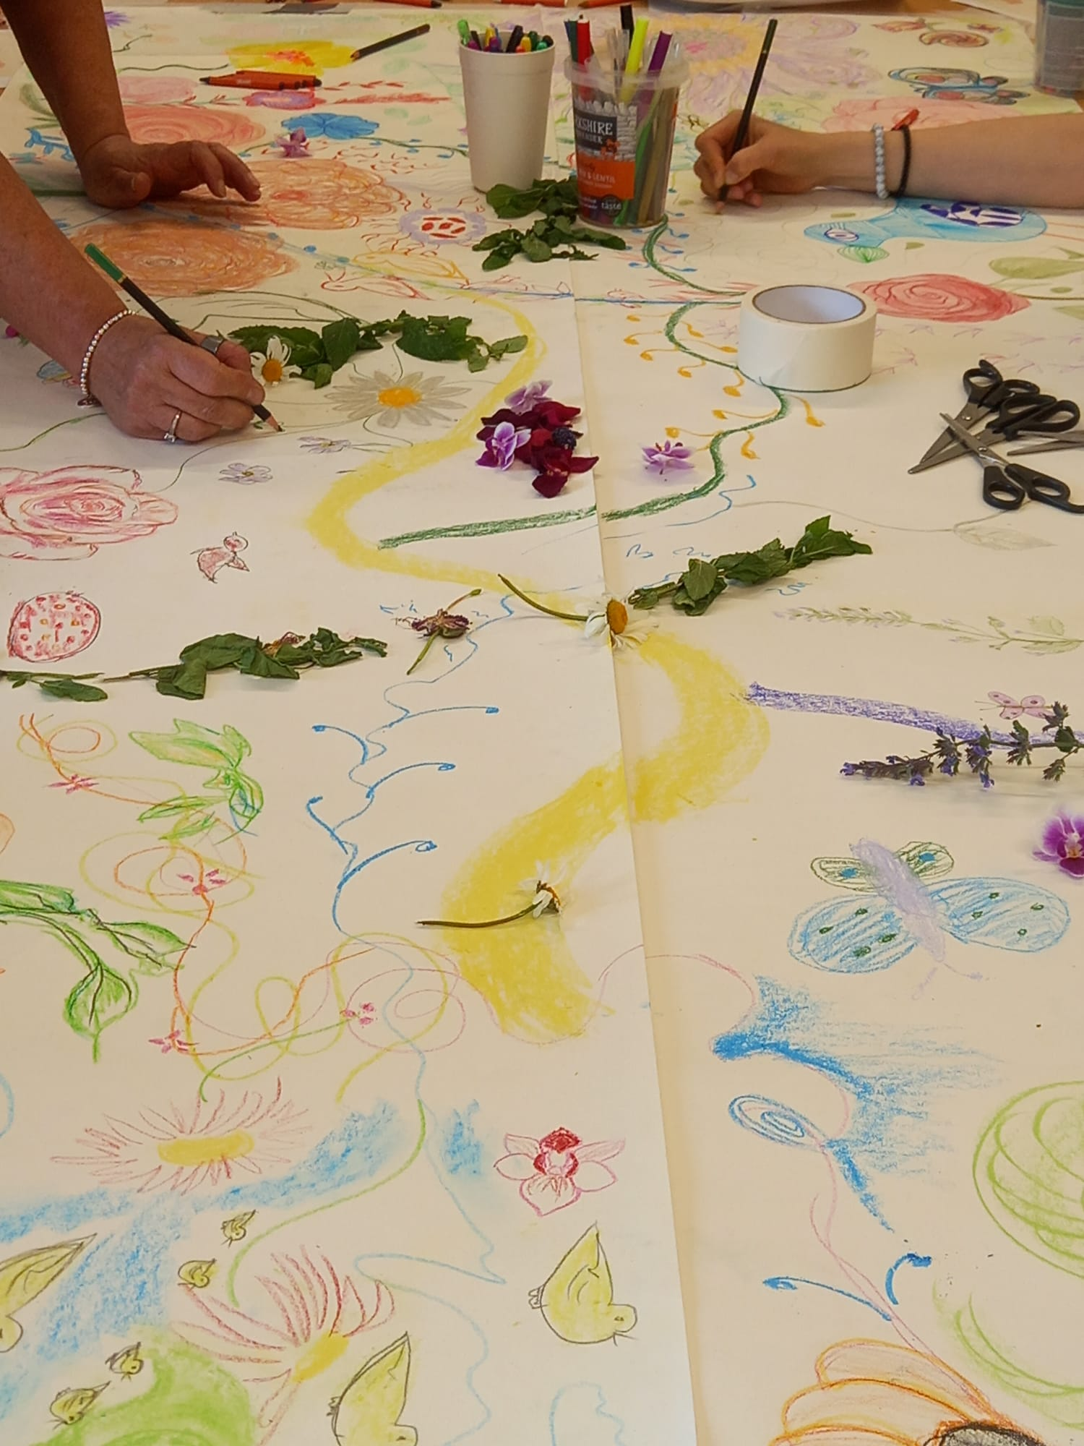

How do We Measure the Impact?
How do we know that drawing makes a difference?
What insights did we gain from reflective journals and questionnaires?
How did participants' perceptions change over time?
Some previous questions that students explored in their presentations were:
How can art support medical students?
Art therapy use in the treatment and management of chronic illnesses
The impact of art on mental health
Effectiveness of art therapy in schizophrenic patients and how it can be used to ameliorate symptoms associated with other mental health disorders ?
How can drawing be used to improve wellbeing and communication with patients with chronic health conditions?
The Effect of Art on people living with MND
Creative therapy in prisons

Slide 19
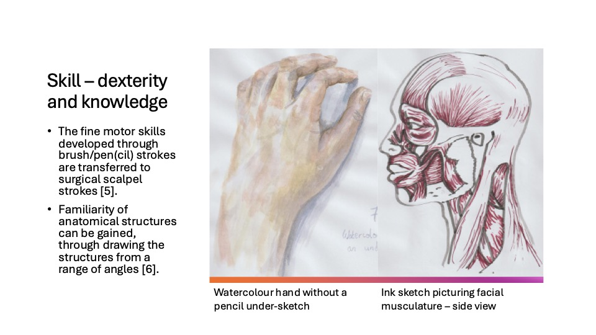

Slide 20
What Are the Wider Implications? What Can We Learn From This?
Could drawing be used more widely as a mental health intervention?
Call for action: Encouraging creative approaches in health and education

Slide 21
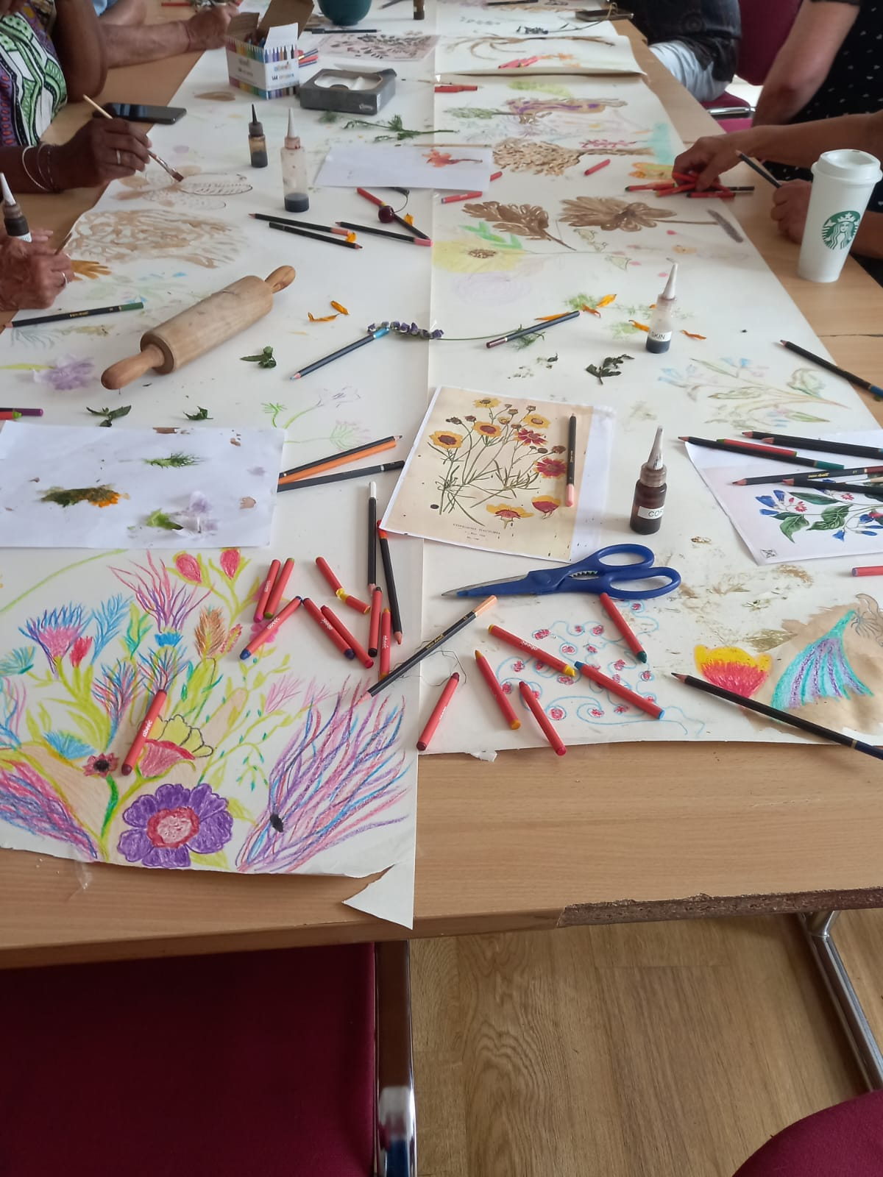
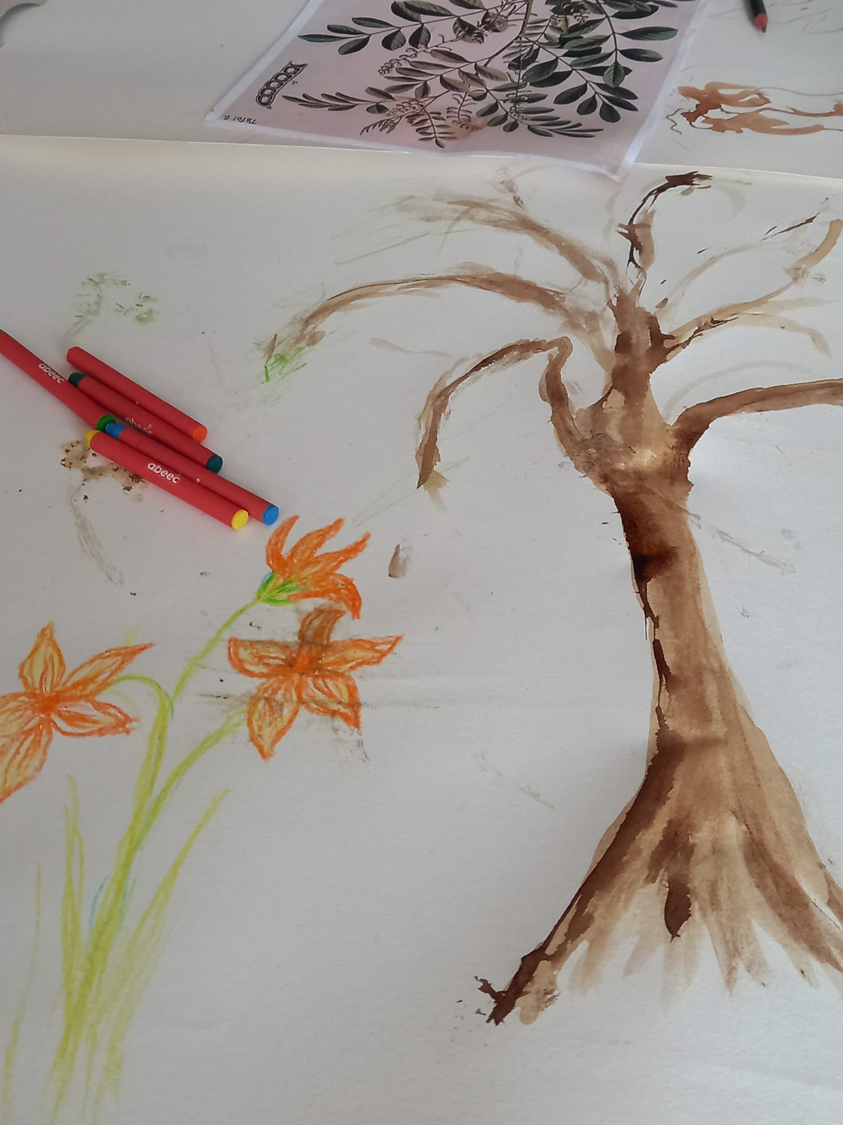
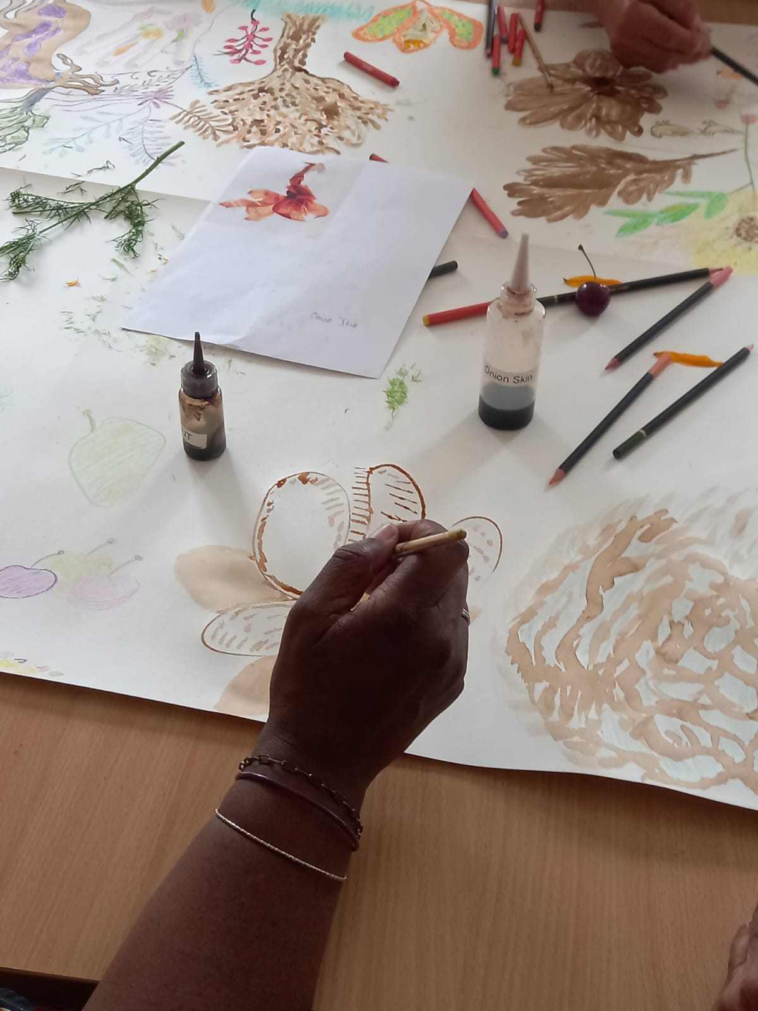
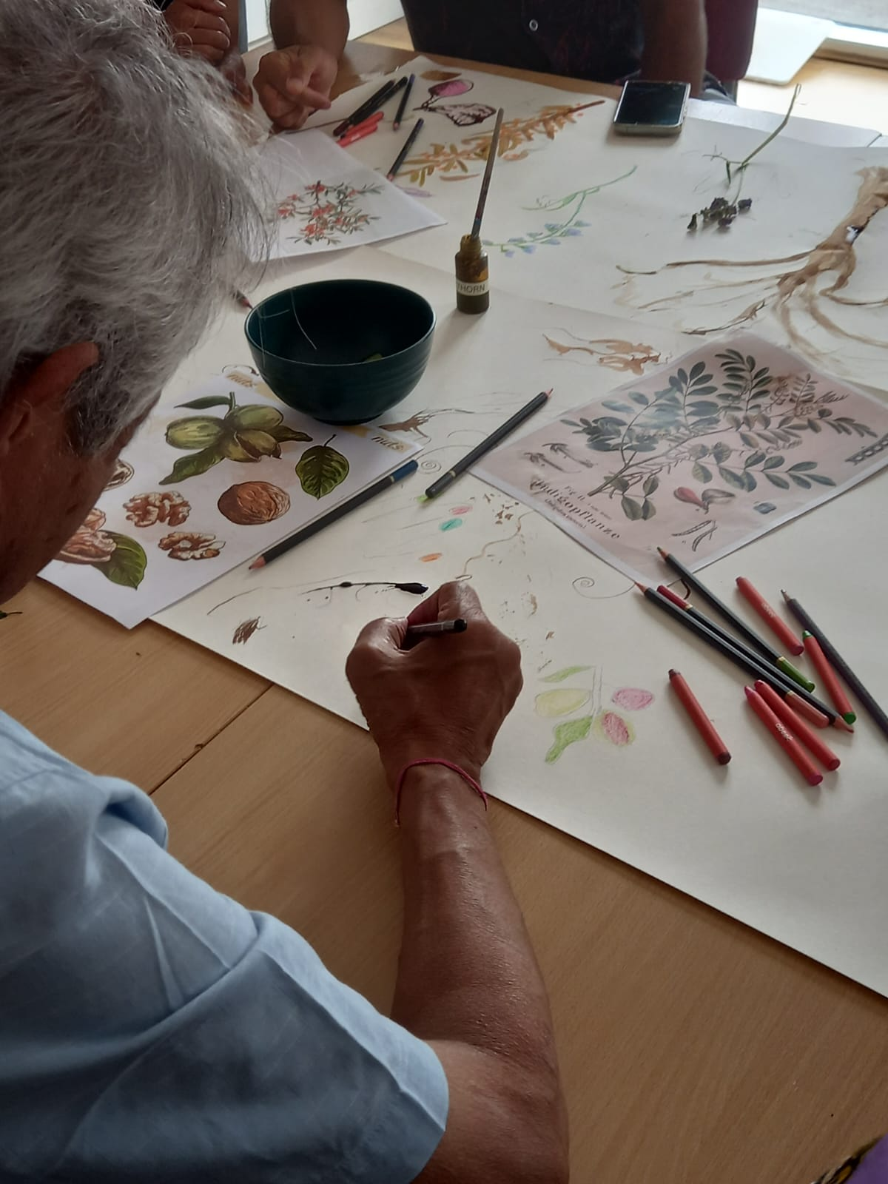
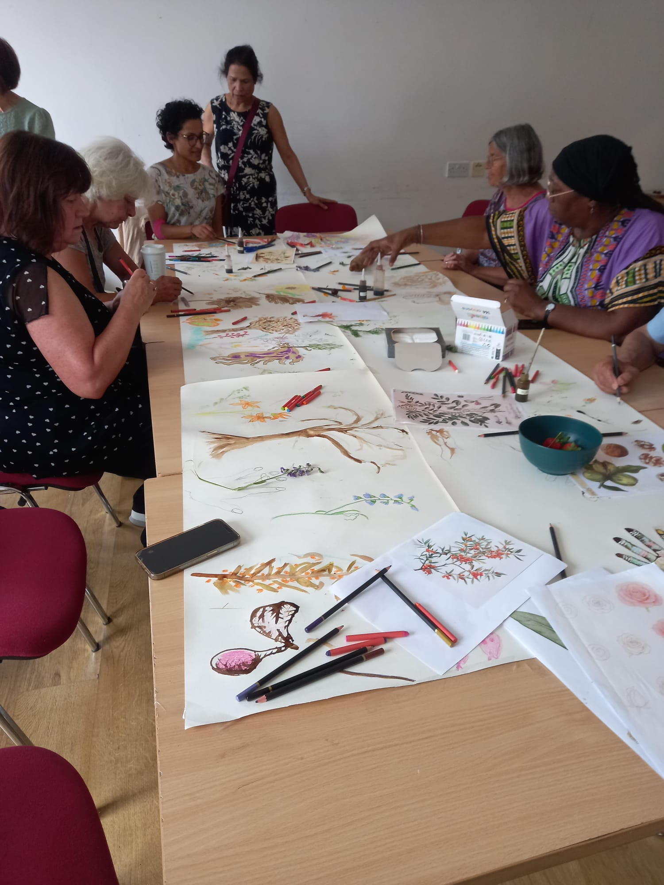
ART FOR BELONGING
Art for Belonging

Slide 22
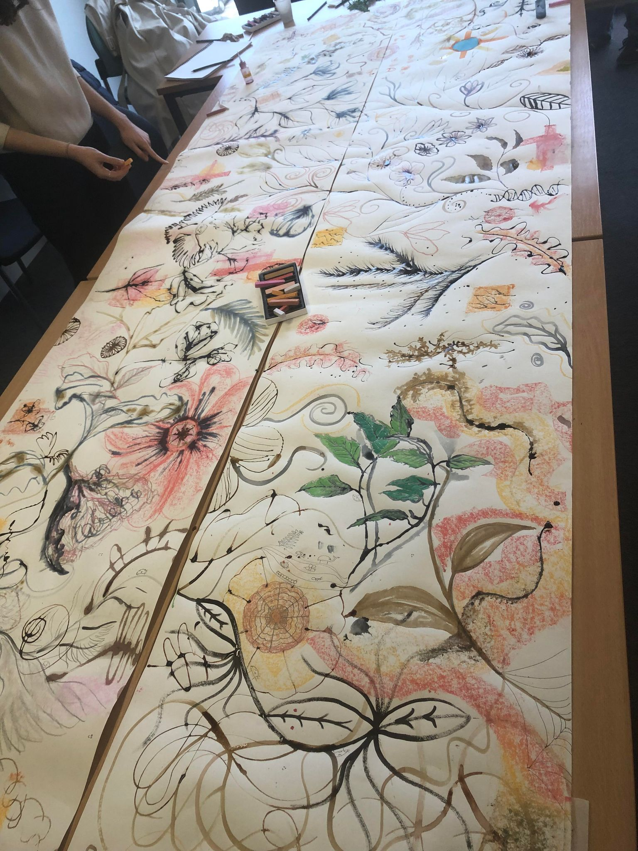
Improved mood during the day
Increased attention to details
Accepting mistakes and adapting
Enjoying the process rather than the result
Less comparison to others and past works
Accepting the fluidity

Slide 23
Dialogue – from outside to inside
Collaborative dialogue on paper leading to
Cultivation of the dialogue between analytical scientific side of the brain and creative, intuitive, sensual, interpretive side
To a dialectical, hybrid space where understanding, reconciliation,
and healing of various types of trauma can take place

Slide 24
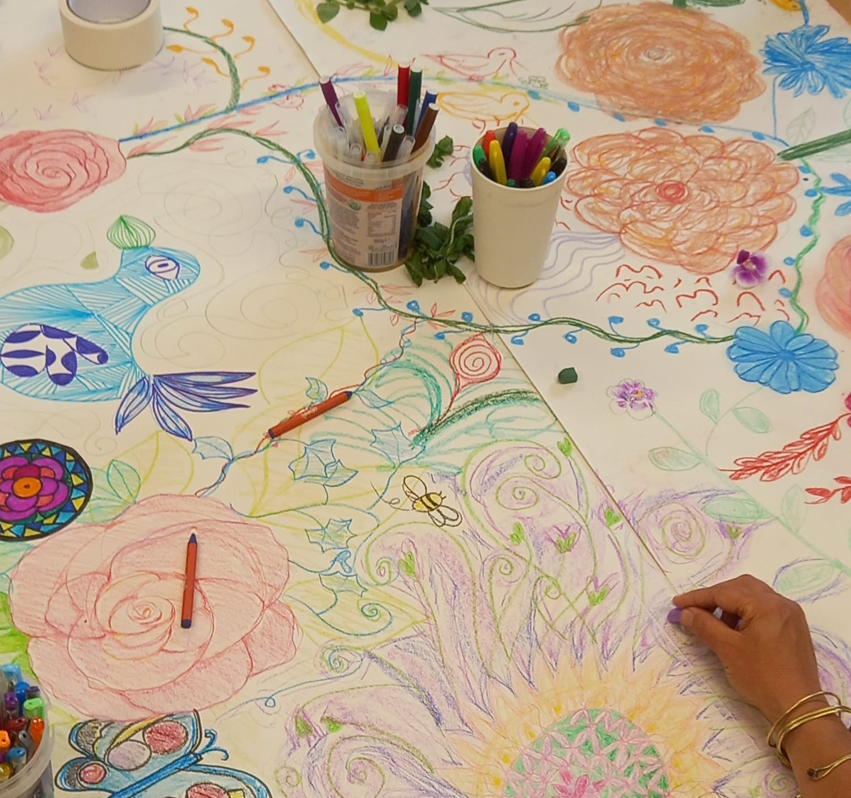
Art for Belonging
Cultivating the sanctuary for Concerted dreaming

Slide 25
