Slide 1


Supporting refugee young people access and thrive in higher education
EARC, September 2025

Slide 2
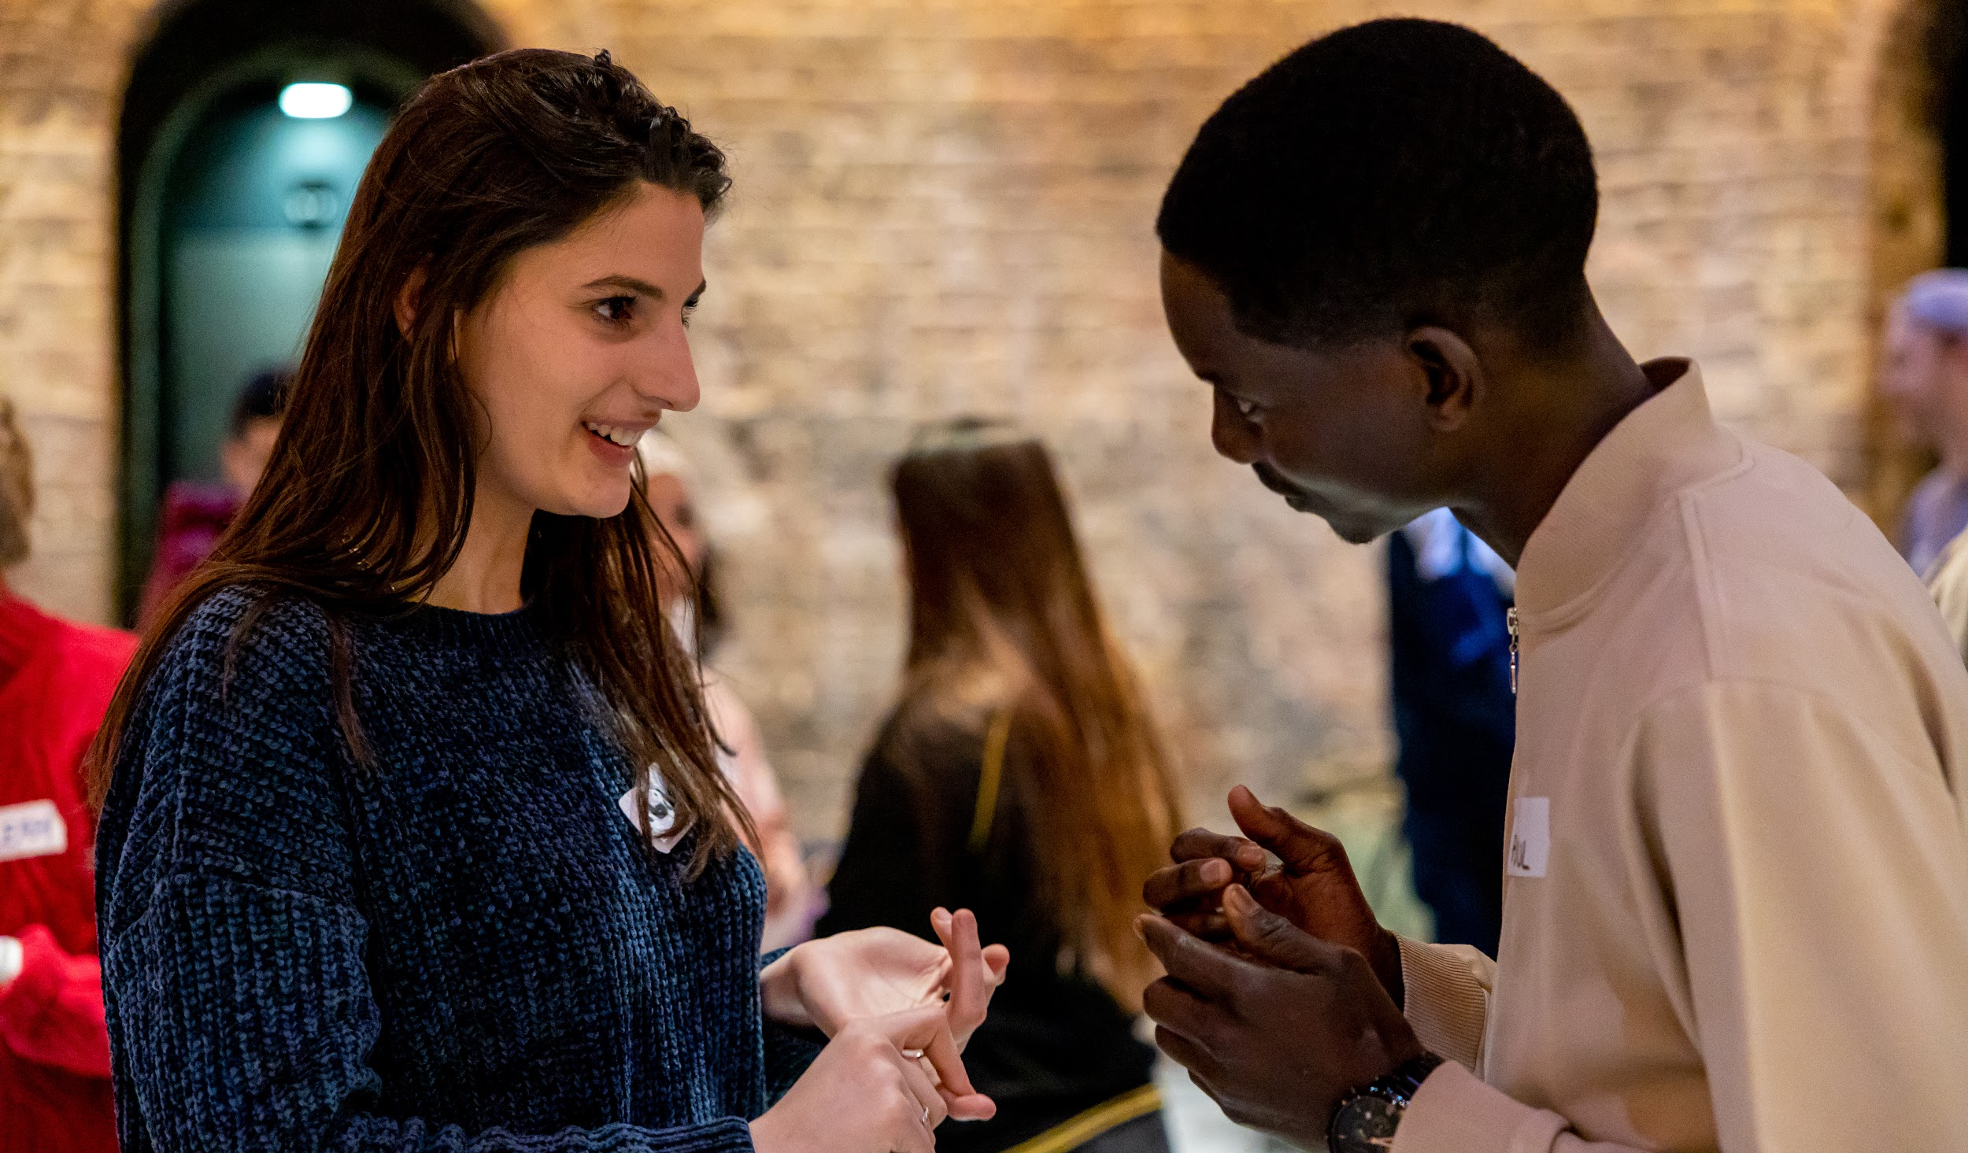

At Refugee Education UK we are working towards a world where all refugee and asylum-seeking children and young people can access education, thrive in education, and use that education to create a hopeful, brighter future.
About REUK

Slide 3



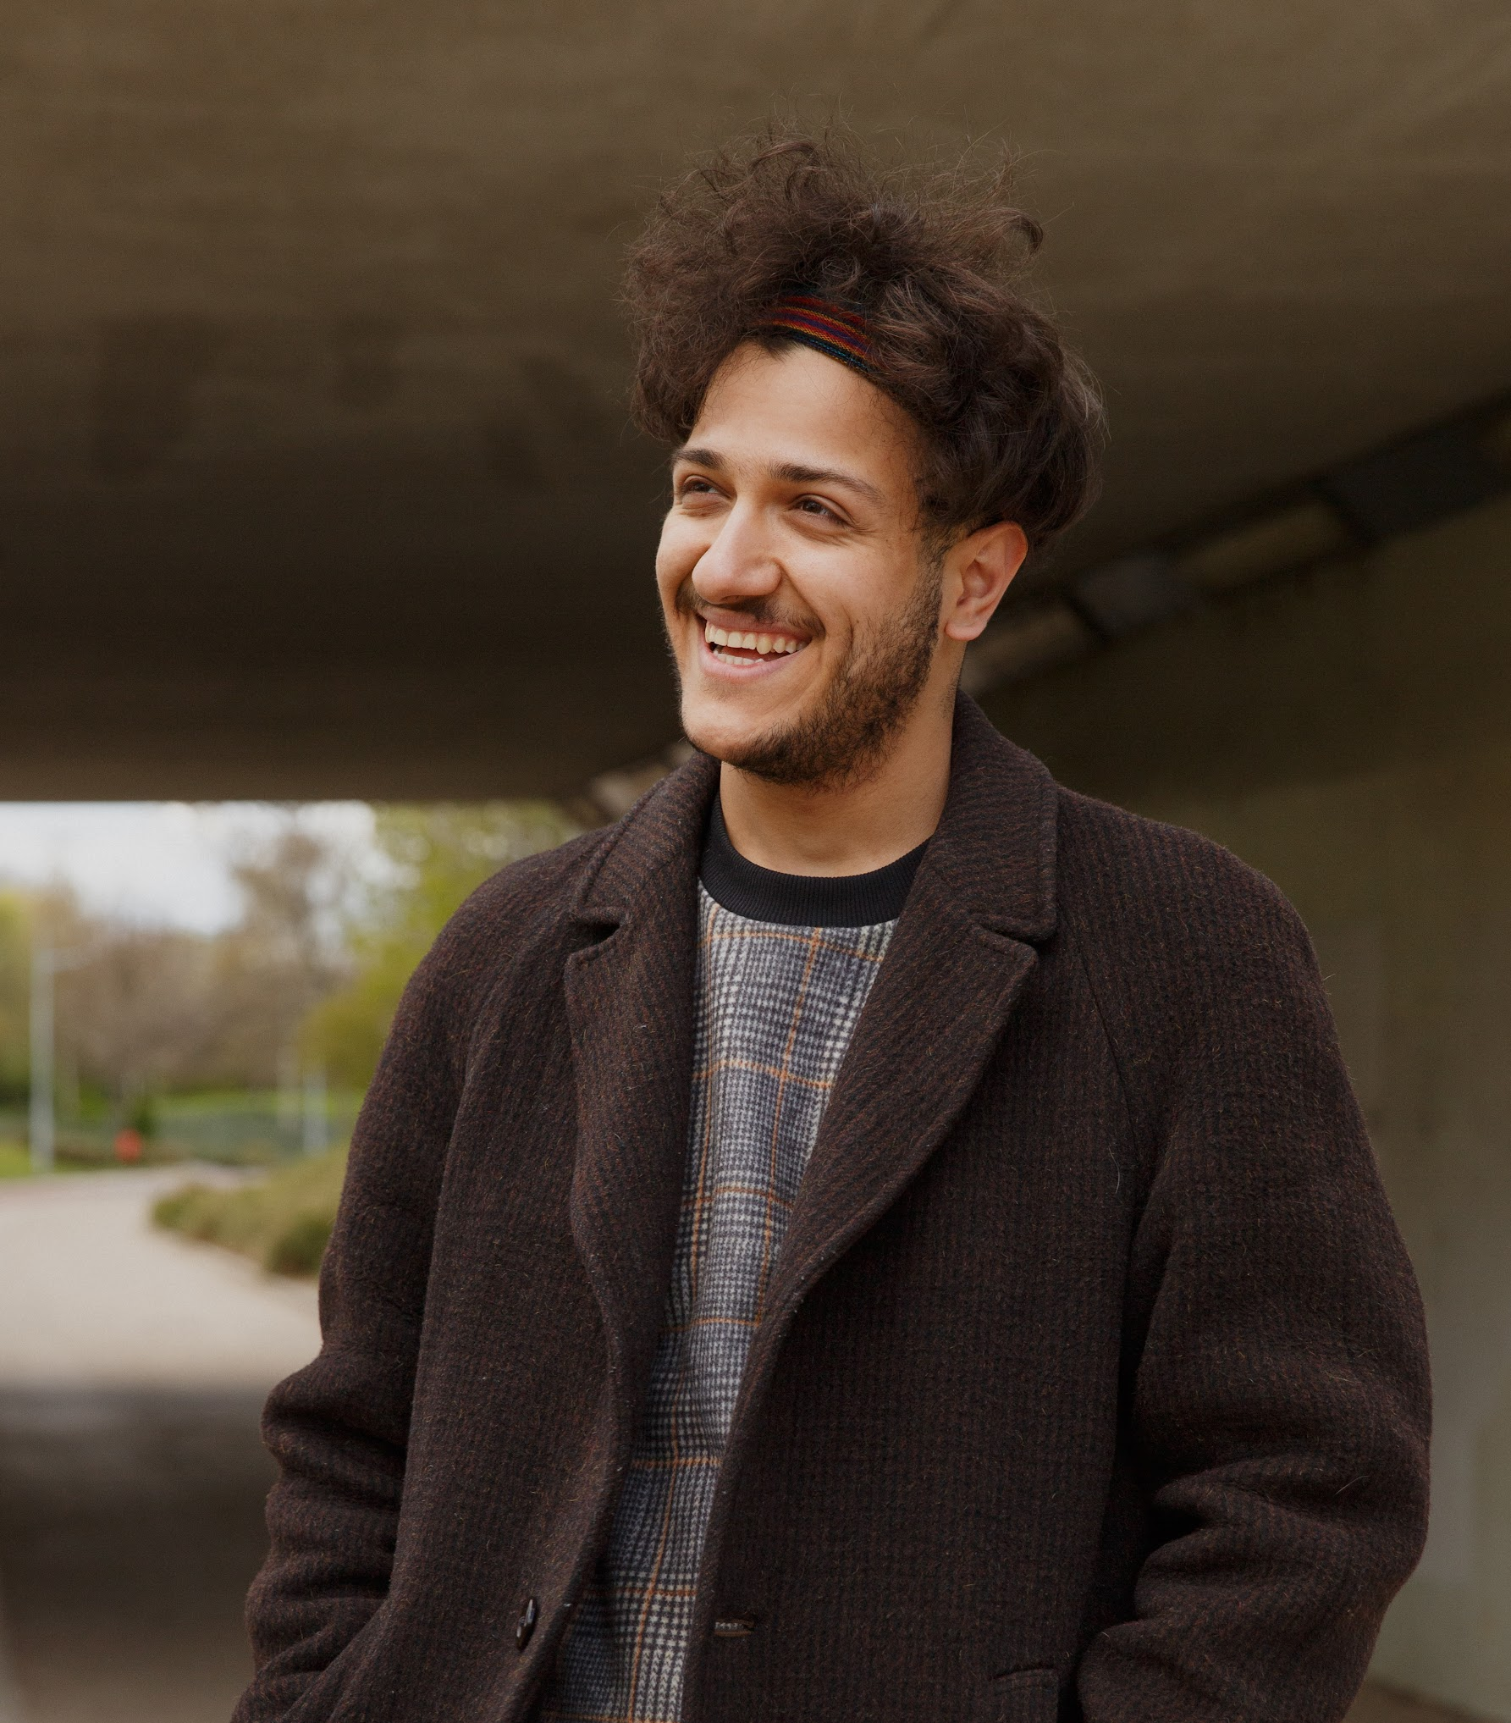


Education
Access
National Advice Line service
Access to Further Education support
Access to Higher Education support
Pathways
Education Thriving
Educational Mentoring
Orientation Programme (Oxford)
Education Change
Research & Policy
Youth Advocacy
Leadership Course
Training

Slide 4
Today’s presentation
“You have to treat us equal but with more justice”
(young person in FGD)

Slide 5
Barriers to accessing and thriving in university
Not meeting university level requirements
Inability to afford the cost of going to university
Missing or inaccurate information
Instability and isolation

Slide 6
Enablers to accessing and thriving in university
Interpersonal relationships: mentors and role models
Young people’s strategies: resilience, determination and helping others

Slide 7
Hear from Aiya Abdalla
REUK Youth Advocate

Slide 8
The role of universities
Providing local refugees and asylum seekers with information and guidance
Nurturing refugee young people’s aspirations for university
Helping local young people meet university-level English language and study skills
Overcoming financial barriers

Slide 9

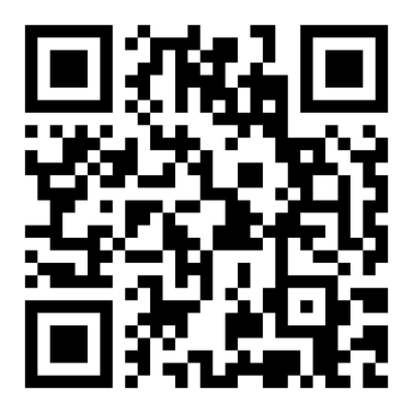
Stay connected!
LinkedIn: Refugee Education UK
Sign up to REUK’s Education Professionals Network
If you have any questions about today’s session or would like to chat further, you can contact me: divya@reuk.org
Visit our website: www.reuk.org

