Slide 1
Digging out hidden / impenetrable data and making it usable
Dr Jo Wilding, University of Sussex
j.m.h.wilding@sussex.ac.uk

Slide 2
The law
Legal Aid, Sentencing and Punishment of Offenders Act 2012, section 1:
The Lord Chancellor must secure the availability of legal aid in accordance with Part 1.
All asylum seekers are entitled to legal aid for their application and appeal (unless they can afford to pay privately)

Slide 3
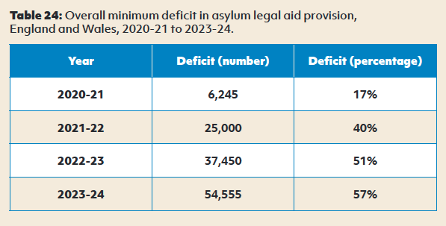
The reality

Slide 4
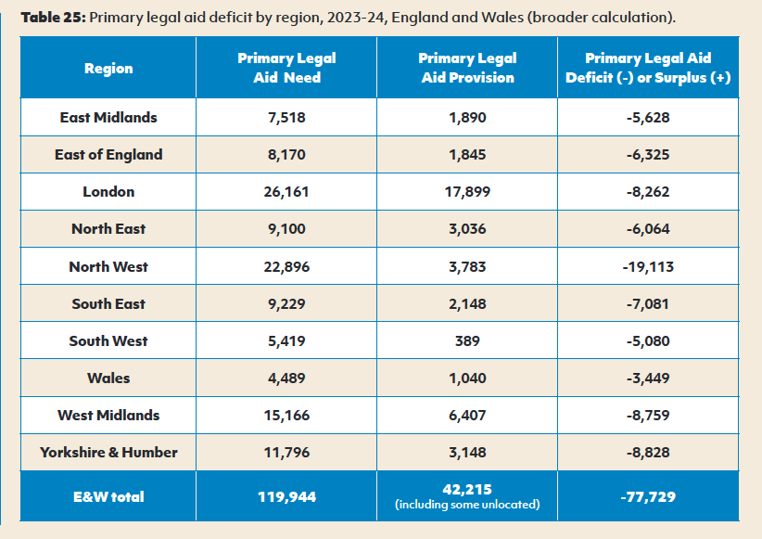
National and regional breakdown

Slide 5
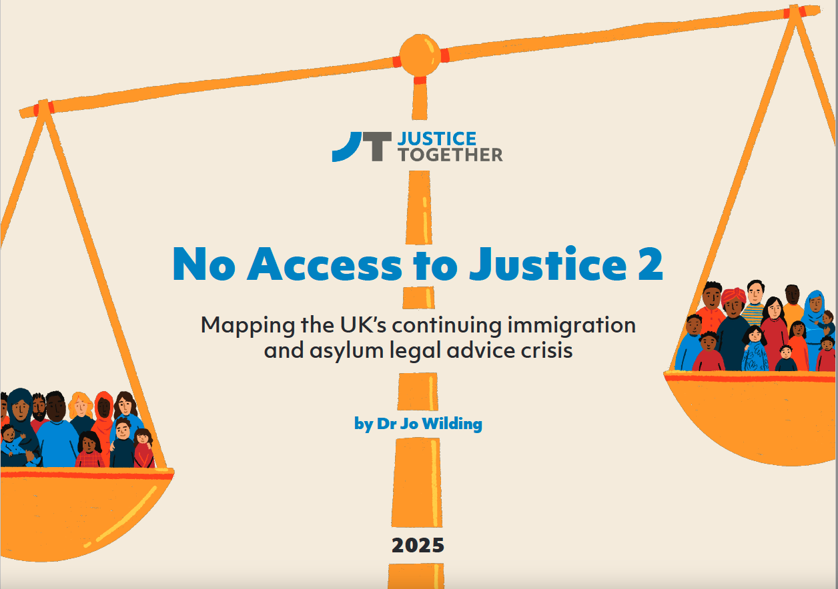

Slide 6
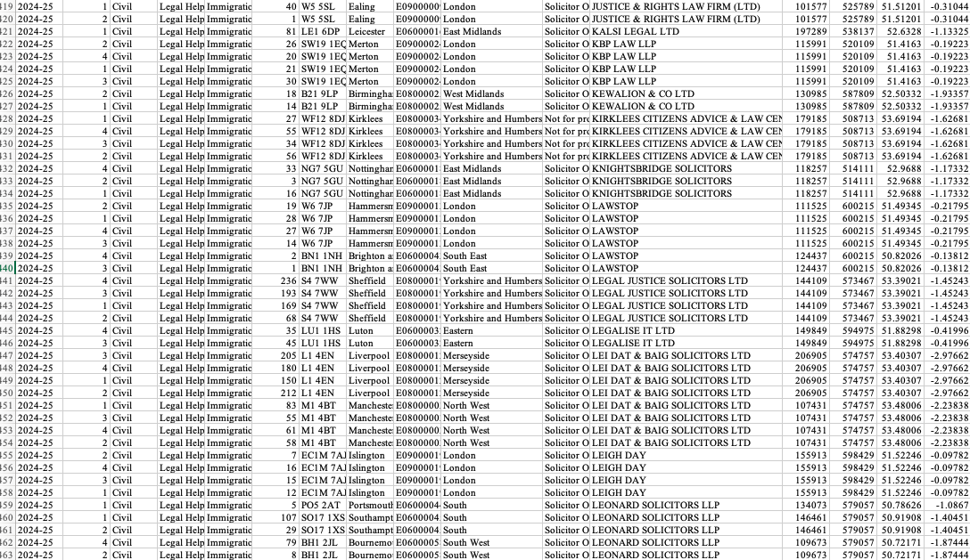

Slide 7
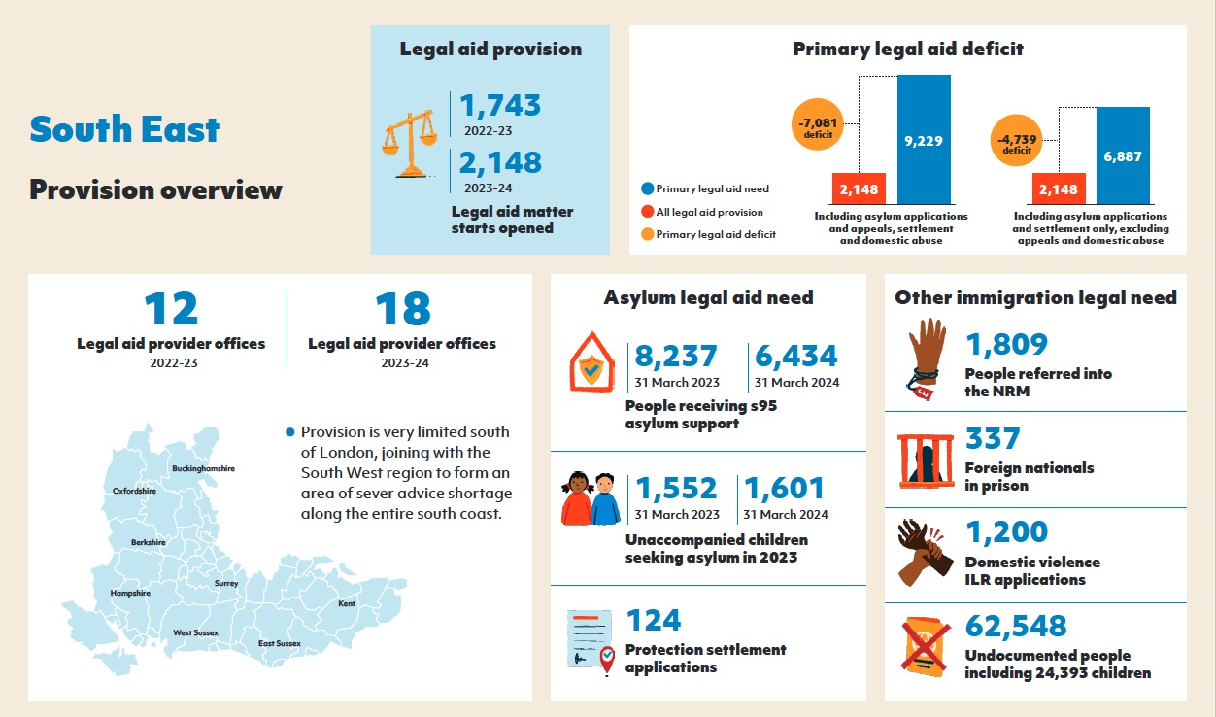

Slide 8
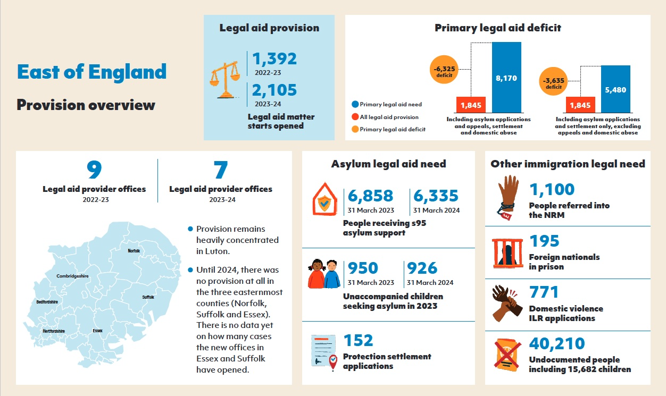

Slide 9
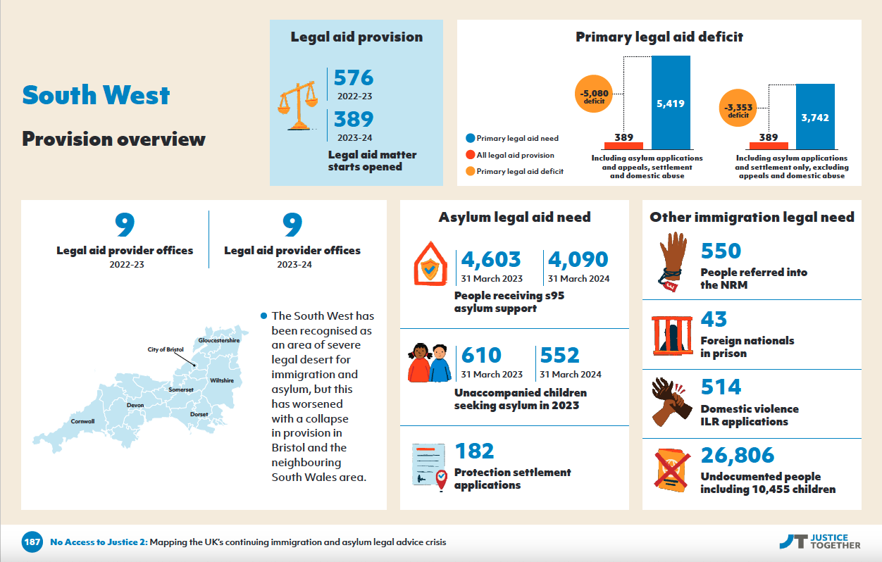

Slide 10
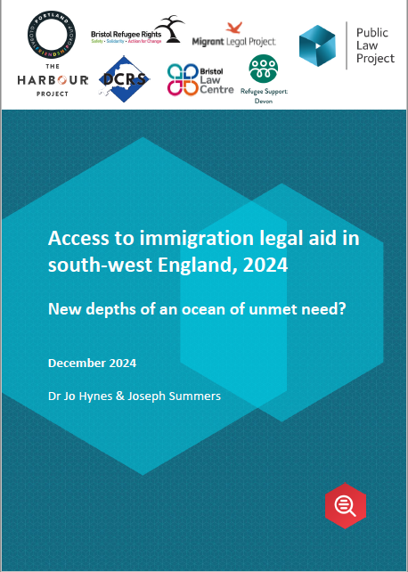
Why remote access is not a solution
There was no month where 50% or more providers listed had capacity.
On average, 20% of providers had capacity, but not for asylum appeals.
Only11% of providers had capacity, including for asylum appeals.

Slide 11
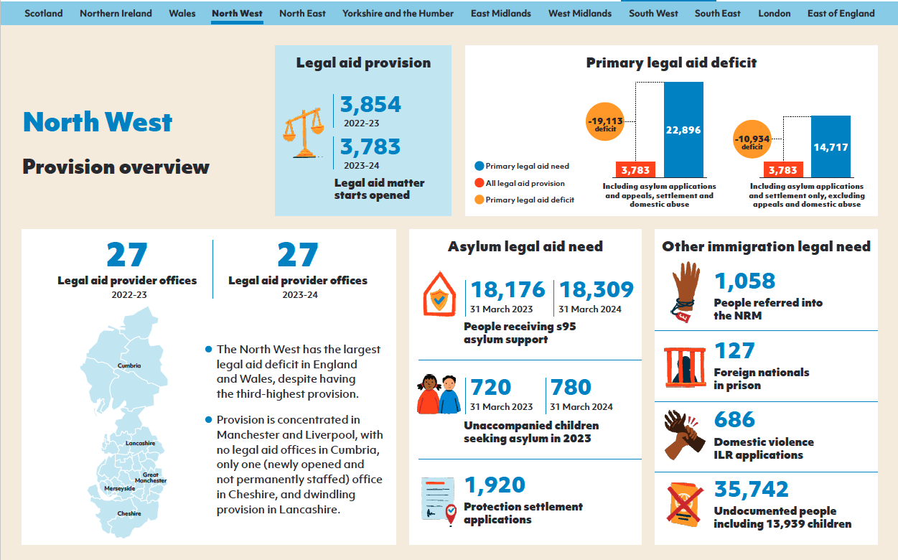

Slide 12
What is the data useful for?
Judicial review of Lord Chancellor for failure to fulfil duty
Advocacy with / by local authorities
Advice agencies and Law Centres’ fundraising
Certain teams in Ministry of Justice

Slide 13
What about other areas of law?
Harder to estimate need numerically → using Indicators of Multiple Deprivation
Shows severe coastal advice deserts in social welfare law

Slide 14
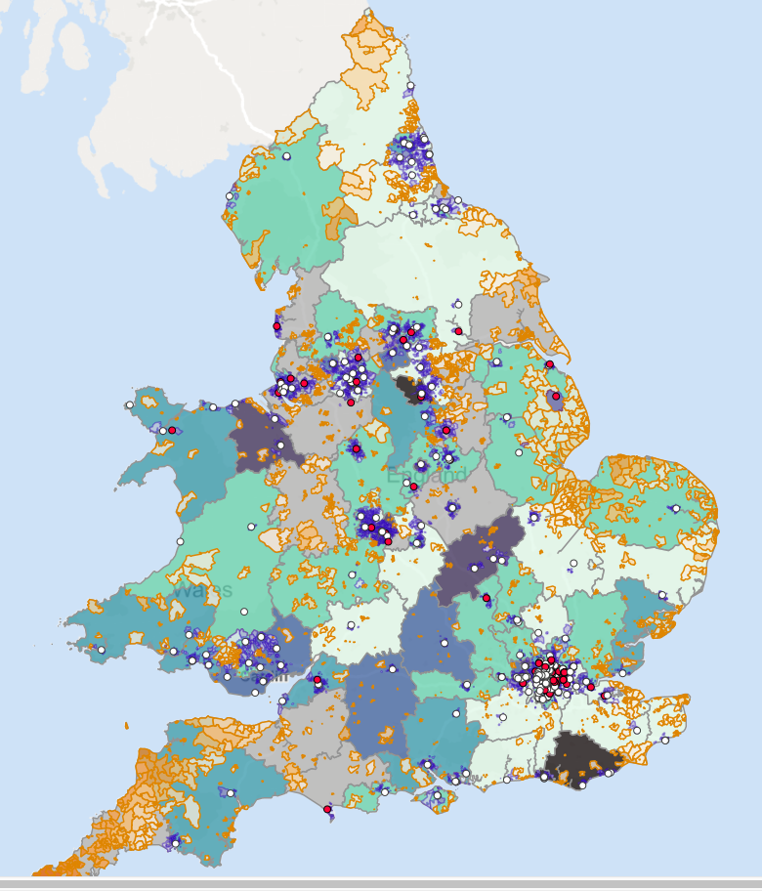
Housing –
Legal Help
Distance from legal aid layer
White dot = provider office
Red dot = provider office – dormant contract
Patches = most deprived 20% on IMD
Orange patches = further than average from provider office
Blue patches = closer than average to provider office

Slide 15



Legal aid maps
http://legalaidmapping.org.uk/map/

