Slide 1
Eastern Arc Conference 2023:
Food in a Time of Crisis
Urban agriculture for resilient urban food systems?
Findings on the challenges and opportunities of UA during the COVID-19 pandemic
Victoria Schoen, Chris Blythe, Silvio Caputo

Slide 2
FEW-meter
The research for this paper stemmed from our work on the FEW-meter project.
This was a 5-country study that collected data from gardens and farms over two growing seasons (2019 and 2020)

Slide 3
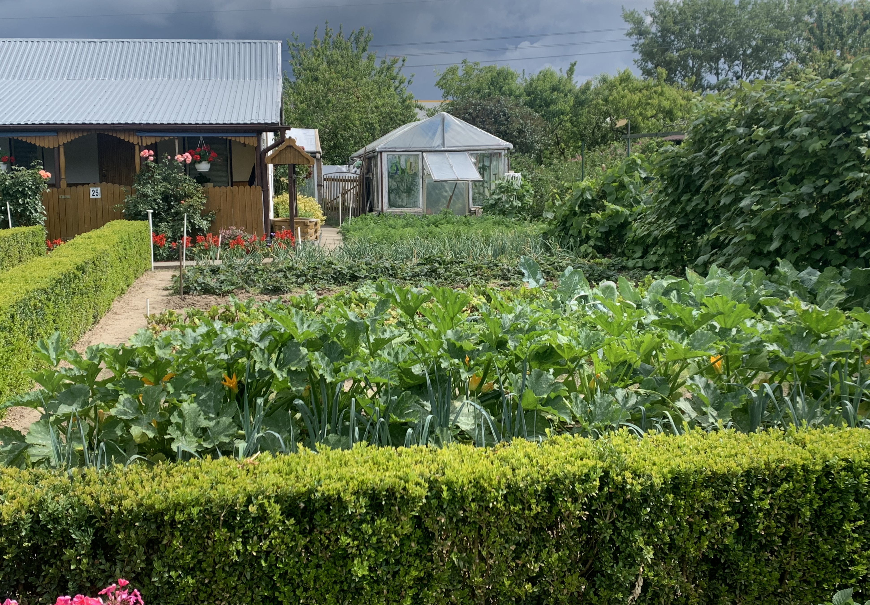
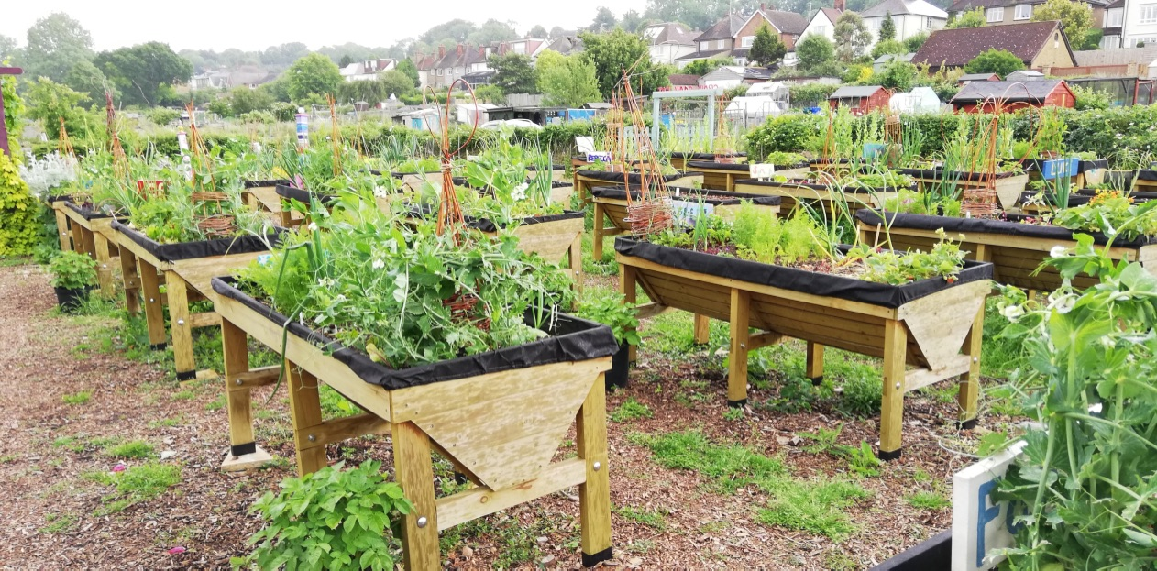
Definitions
Urban agriculture - agricultural practices in urban areas and their surrounding regions (peri-urban), and involves horticulture, animal husbandry, aquaculture, and other practices for producing fresh food or other agricultural products.
An allotment is a plot of land used by an individual for growing vegetables or flowers
A community garden is any piece of land gardened by a group of people for the benefit of the group and the wider community.

Slide 4
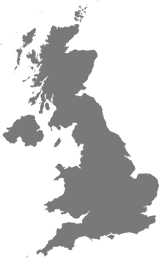
FEW-meter study locations
7 community gardens
1 community farm
1 allotment garden
12 allotment plots
London
Gorzów Wielkopolski
Ruhr Area
New York
Paris
30 allotment plots
4 home gardens
2 urban farms
1 school garden
Nantes
11 allotment plots
3 urban farms
2 school gardens
6 community farms

Slide 5
Methodology
For the COVID-19 work, we took a two-pronged approach to data collection:
1. Questions were added to policy expert interviews
2. A bespoke survey of urban farms and gardens was completed.

Slide 6
Findings
The ability to operate sites during the pandemic
2. Attitudes towards local food production
3. Future opportunities and challenges

Slide 7
1. The ability to operate sites during the pandemic
Community gardens
Allotment gardens
Garden participation
Loss of social function

Slide 8
2. Attitudes towards local food production
Food system fragility
Role of local food
Effects on food access
Sales outlets
Food distribution
Diversification of offer
Role for urban food growers

Slide 9
3. Future opportunities and challenges
Demand for services post-lockdown
Demand for garden produce
Financial impacts

Slide 10
Discussion
1. Food security
2. Policy response and adaptation
3. Mental and physical benefits
4. Grant dependent vs. commercial gardens
5. Allotment gardens vs. community gardens
6. Future policy

Slide 11
Final thoughts
Urban agriculture was a healthy and meaningful way to support post-COVID recovery
Policy recognition of the contribution that gardens made to resilience during the pandemic and the contribution that they can continue to offer given the right circumstances.

Slide 12
Thank you for your attention!

