Slide 1
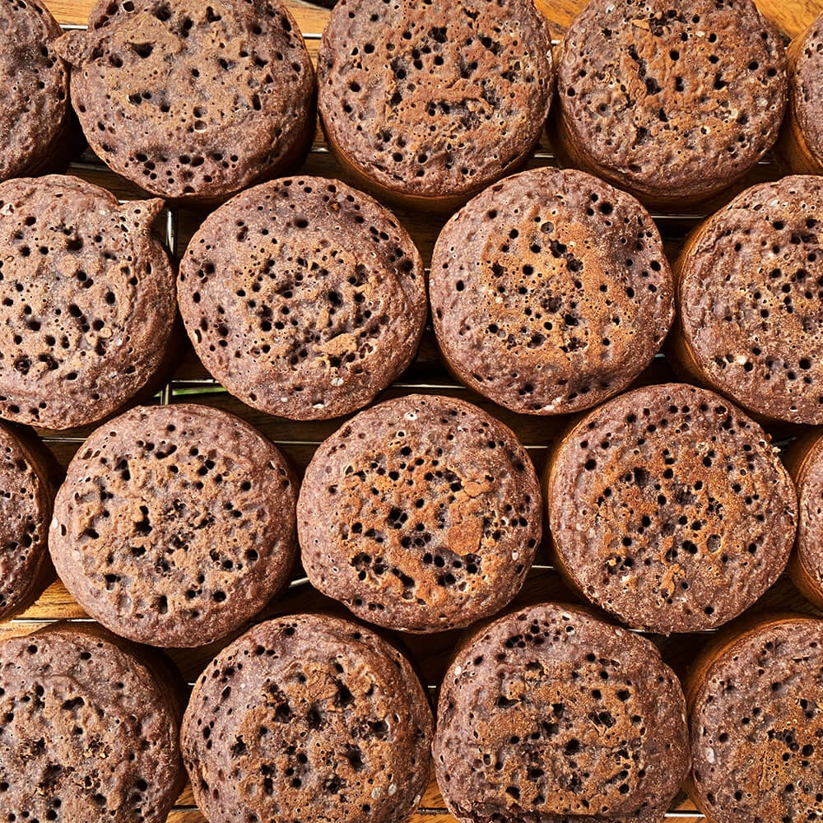
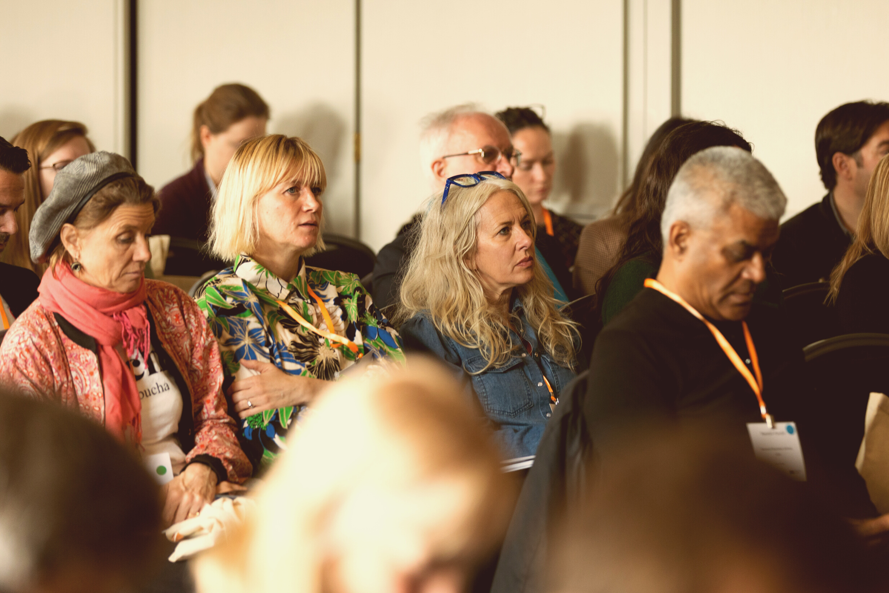



Food Innovation Cluster
Strengthening the link between academia and food and drink businesses

Slide 2
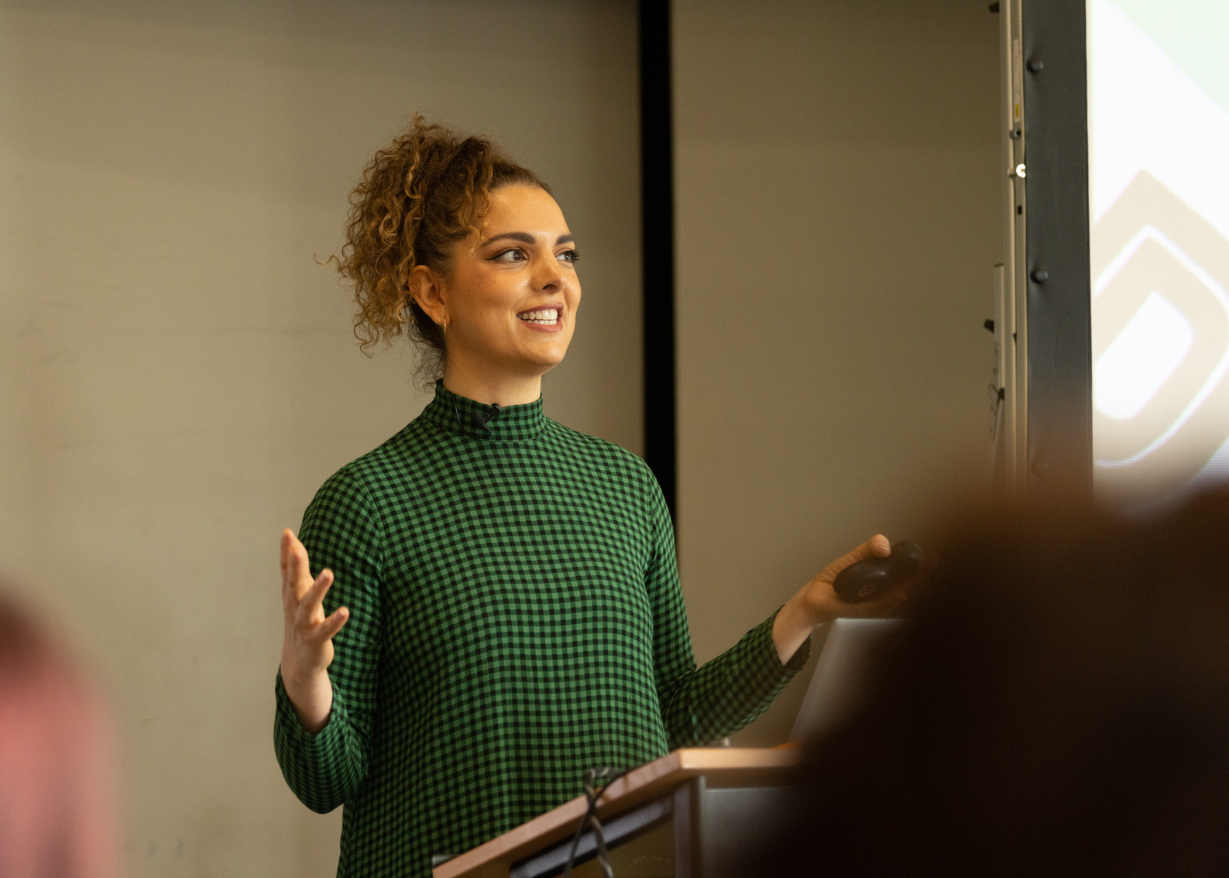
WHAT IS THE CLUSTER?
Since 2021, the University of East Anglia (UEA) has been building a growing Food and Drink Innovation Cluster in Norfolk and Suffolk. It connects food and drink producers, suppliers and researchers whilst promoting knowledge exchange, collaboration and innovation.
The Cluster is the only trade organisation for the food and drink sector in East Anglia and Norfolk and Suffolk together are home to 1,000 F&D businesses that employ 35,000 people.
The Cluster is linked with the Norwich Research Park and the world-leading research institutes alongside the University of East Anglia, ranking 1st for food and drink research (REF 2021), enabling the opportunity for expert collaborations and research.
The dynamic and passionate team are championing member businesses in the UK and abroad, whilst lobbying for SMEs.

Slide 3
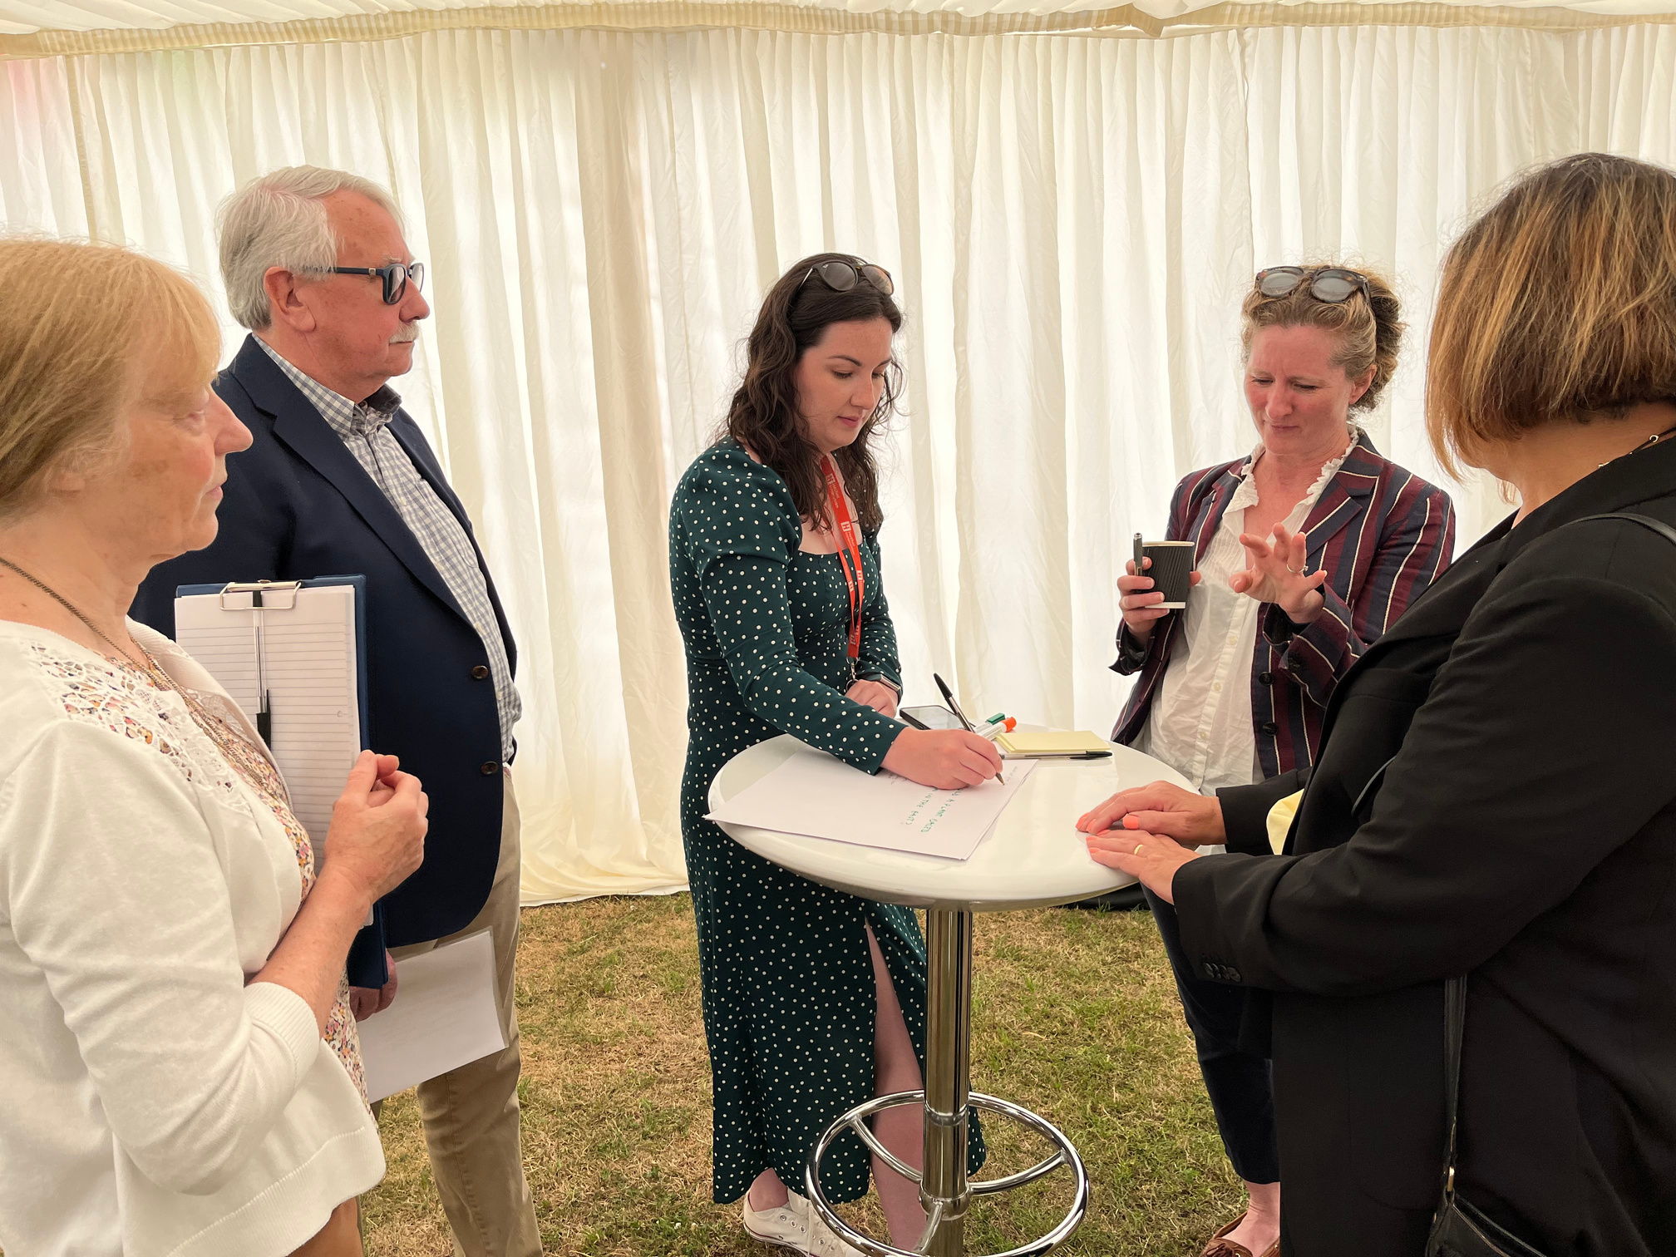



WHAT IS THE CLUSTER?
COMMUNITY
We are building a world-leading food and drink cluster, building a community for the sector in Norfolk and Suffolk and beyond
INNOVATION AND RESEARCH
Members gain access to our extensive network of academics, researchers, institutes and funding partners to innovate and write funding bids
SUPPORTING GROWTH
We promote members to the wider industry, promote the region on a global scale as a food destination of choice and create opportunities for commercial growth

Slide 4
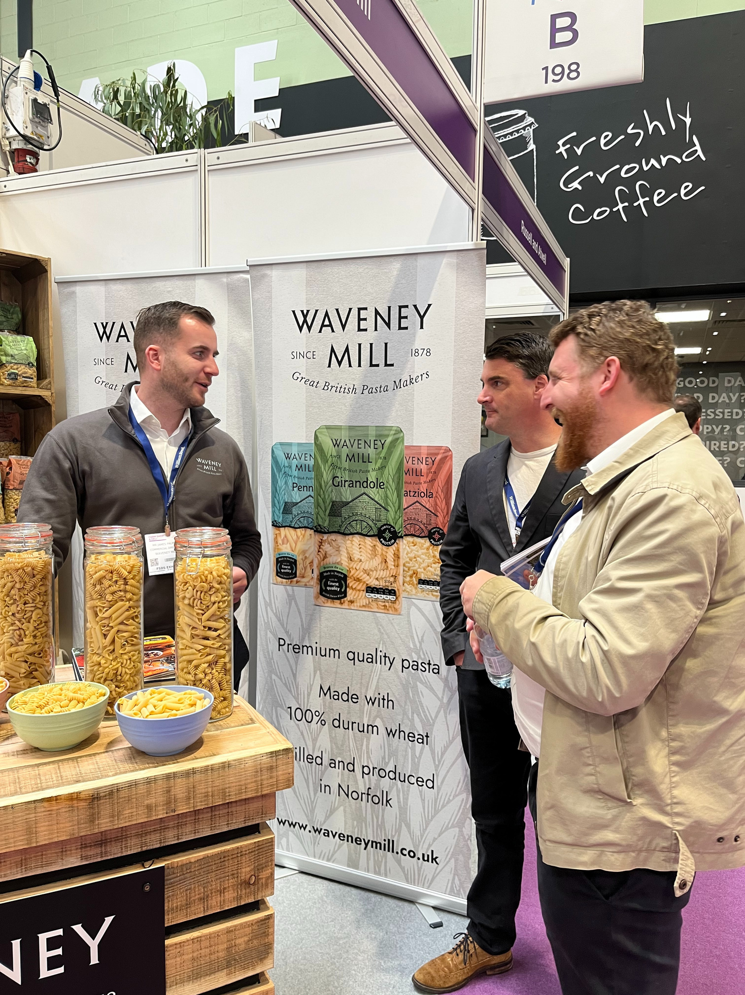





ACHIEVEMENTS SO FAR
The Cluster is now home to over 500 members
Unlocked national sales opportunities for 12 food & drink businesses
Planned & delivered over 50 events to over 1,700 attendees
Over 40 collaborations between industry & academia
Connected 250 food & drink businesses within Norfolk & Suffolk
84%
Of our members responded 4.2 out of 5 to the question: how likely are you to join the cluster long term?

Slide 5
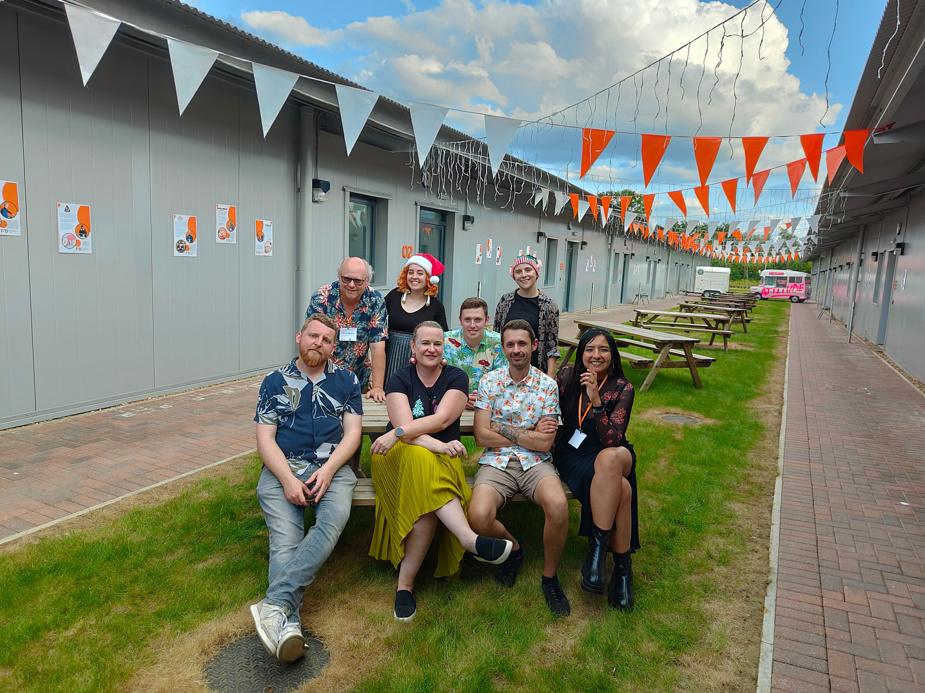




HOW WE DO IT
We will create and deliver a world-leading programme of activities tailored to our food and drink business community.
We are not just an events company, we are a community and the place to call for any information about the food and drink industry in the East of England
TAILORED EVENTS
Building on the previous years 50+ events we will continue to tailor events to the needs of our members
COLLABORATIONS
Our extensive network unlocks opportunities to connect with research bodies: we will provide SMEs with expert research, innovation, work experience and advice
INDUSTRY INSIGHT
Working with our knowledge partners on the Norwich Research Park, we will provide market insights and knowledge to our members - our members will be one step ahead making business decisions
MEMBERSHIP TARGET
300+
Our membership is currently free of charge (until 2024) after which we will launch a tiered membership model. We currently have 250+ food and drink businesses amongst 500+ members.
Our target is to retain 300 paying members by end of 2025

Slide 6
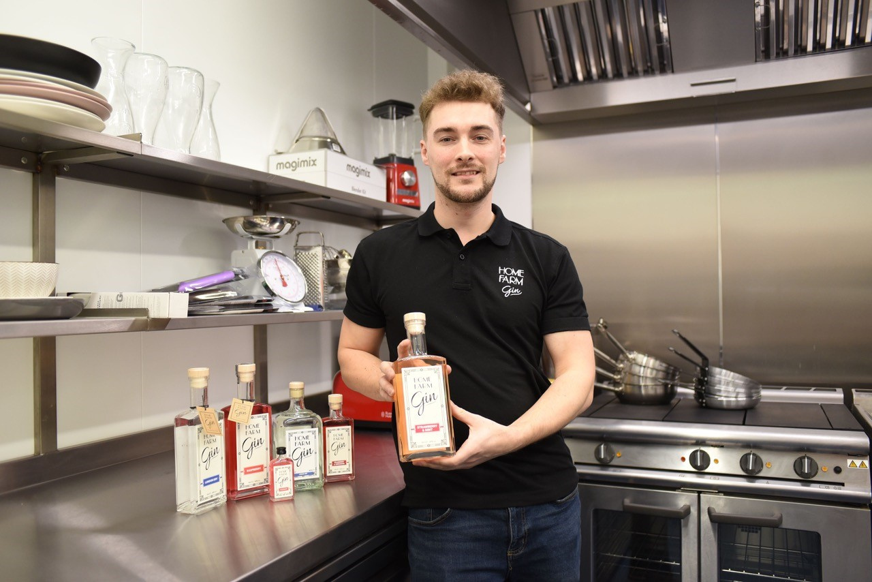
HOW DOES THE CLUSTER WORK?
EVENTS
  networking events
  workshops and themed events
  online webinars
  training events
  conference
SERVICES AND RESOURCES
  events
  business support
  online content and support
  knowledge: market insight reports and more
  funding news and support
UNIQUE OPPORTUNITIES
  training and CPD for food and drink businesses
  opportunity to attend trade shows on cluster stand
  conference and national events
  collaboration projects with students and academics
  exclusive opportunities and discounts (vegan accreditation for example)

Slide 7

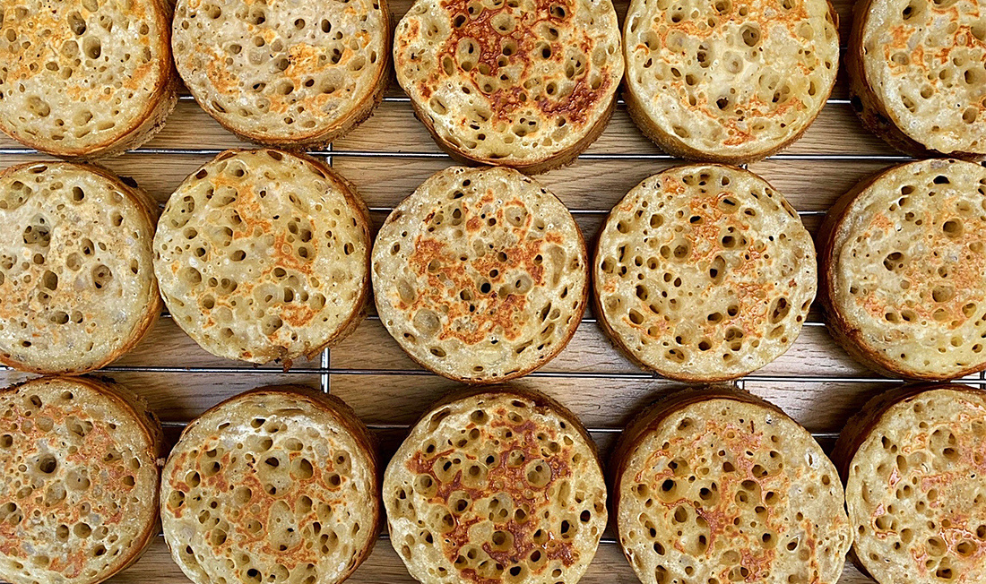




DEAKIN UNIVERSITY
CRUMPETORIUM
Crumpet summer marketing and sales strategy
  Social media and marketing expertise
  Customer personas and target audience
  Differentiation ideas
GRUMPY PANDA
Creating a business plan and strategy
  Boost online sales
  Improve brand awareness
  Increase customer base
CONDIMENTUM
Competitor analysis for mustard as an ingredient
  Key import and exporters
  Freight and logistics
  Competitor analysis
PREPKING
B2B development and growth strategy
  Utilising influencers
  Top down approach
  Consumer base approach

Slide 8





























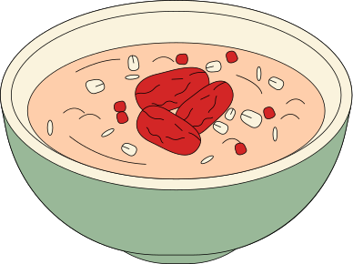


Sausages and meat
Tonic and mixers
IPA
Non-alcoholic spirits
Food supplements
Jam and marmalades
Free from beer
Adult fruit drinks
Smoothies
Spirits
Chocolate
Porridge
Free from cakes
MARKET INSIGHTS

Slide 9


UEA MASTERS
FARMYARD
Value chain analysis
  Increase sales
  Extending distribution beyond Norfolk & Suffolk
  Current customer segmentation
  Key shopper segments to target
  Importance of product to shoppers
  Retail outlets to target
PREPKING
Category management
  Ensure reaching full potential
  Business development decisions
  Category management decisions
  Opportunities for category growth
  Key shopper segments to target

Slide 10

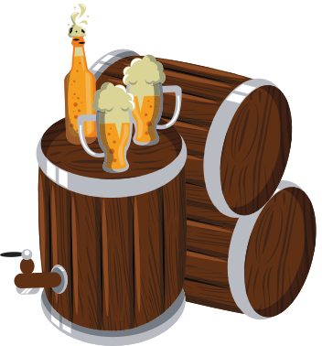





WILDCRAFT
SUSTAINABLE GOODS AT SUSTAINABLE PRICES
The future of the brewing industry
Maximise
profits
Sustainable business values
Growth
strategy
Customer views on retail prices

Slide 11
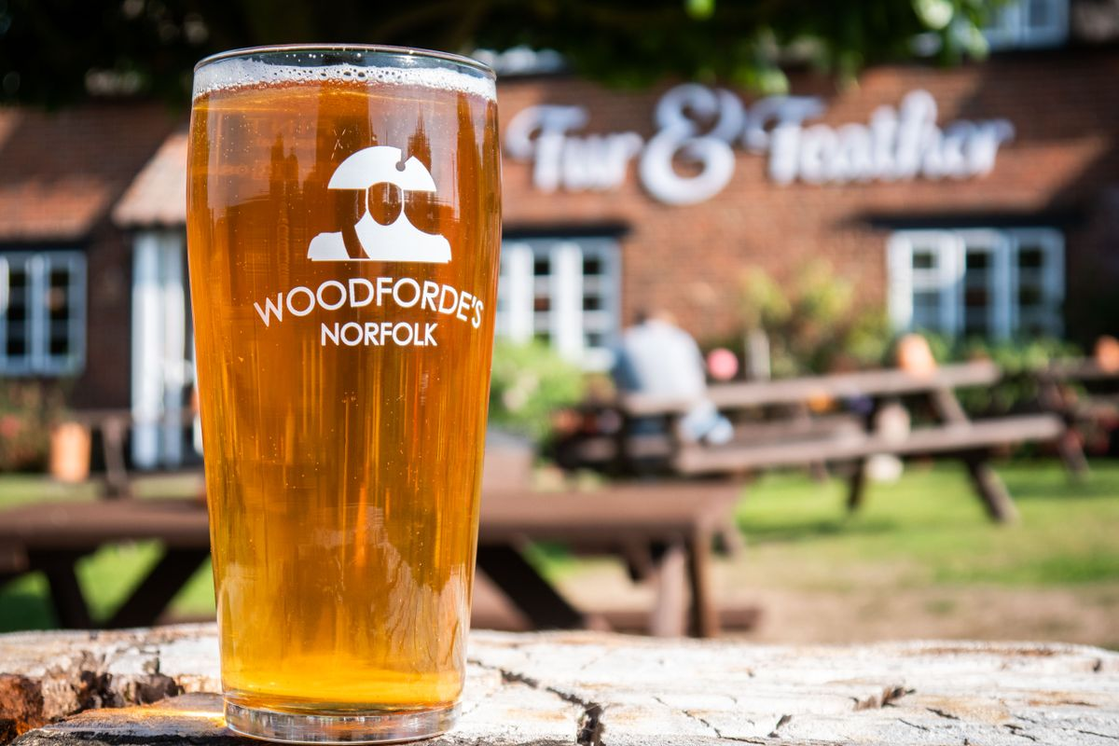



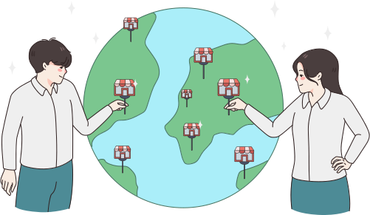

WOODFORDES
HOW CAN WOODFORDES BREWERY CULTIVATE A NATIONAL GROWTH STRATEGY WHILE PRESERVING ITS NORFOLK ROOTS?
The future of the brewing industry
Supermarket strategy
Off-trade experience and competition
Advertising
Expansion of Woodfordes

Slide 12
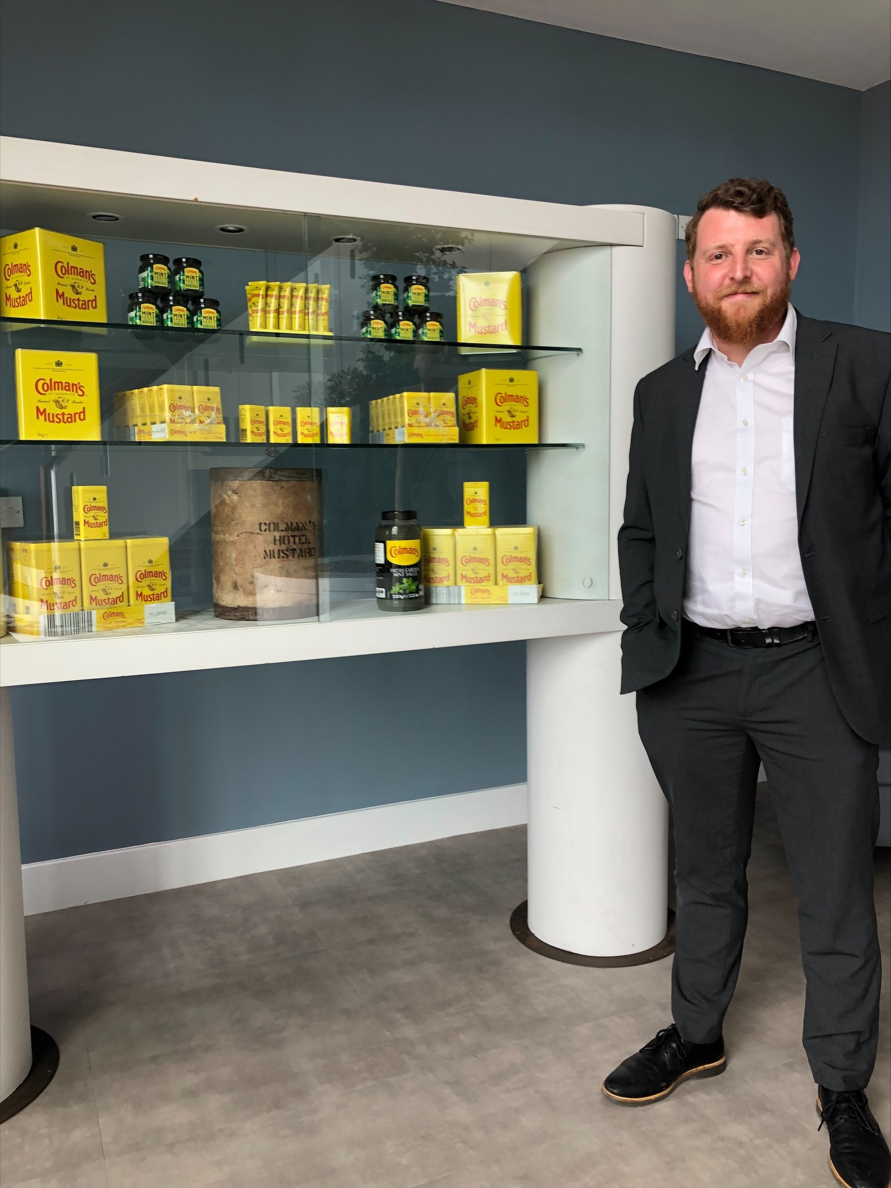





CONDIMENTUM
THE MILLING OF MUSTARD SEED INTO FLOUR - UNDERSTANDING THE PARTICLE SIZE CHANGES THAT OCCUR DURING THE MILLING PROCESS AND HOW THIS AFFECTS THE END PRODUCT QUALITY CHARACTERISTICS
Greater knowledge of products
Improvements to milling process
Reduce mill downtime
Increase productivity
Expansion of customer segmentation

Slide 13



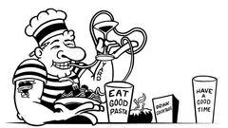
MBA CONSULTANCY
THE UK’S FIRST COMPLETE FERMENTED FOOD SUBSCRIPTION BOX
AI-POWERED INGREDIENTS AND SOLUTIONS
PREMIUM GIN INTERNATIONAL
GROWTH
GROWTH AND EXPANSION OF FROZEN PASTA MEALS

Slide 14
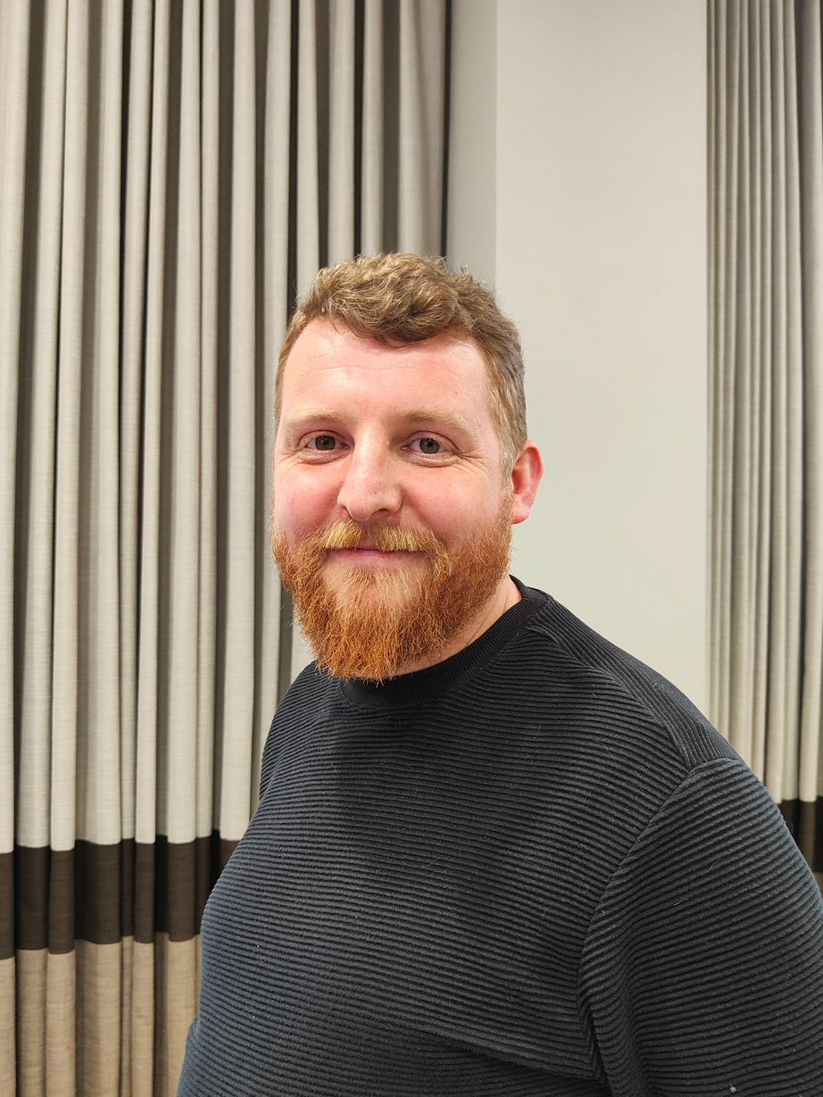
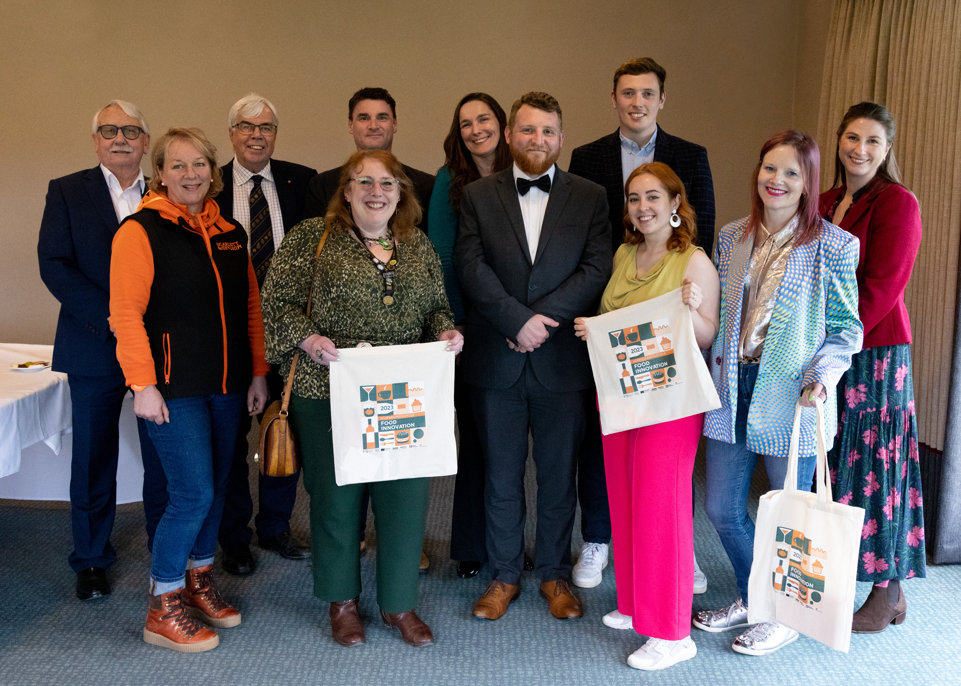





www.foodinnovationbroadland.com
Contact Us
@foodclusterEast
Food Innovation
Cluster
Alex Larter
@foodclustereast
Charlotte Beach
Food Innovation Cluster Manager
Marketing and Events Coordinator
Food Innovation
Cluster
Alexander.Larter
@uea.ac.uk
C.Beach@uea.ac.uk

