Slide 1
Food and drink-related needs/outcomes of older people who use community-based social care
Stacey Rand¹, Lavinia Bertini², Monique Raats³, Alan Dargan¹
Becky Sharp†, Karin Webb & Della Ogunleye§
1 Personal Social Services Research Unit (PSSRU), University of Kent
2 Brighton and Sussex Medical School (BSMS), University of Sussex
3 Food, Consumer Behaviour and Health Research Centre, University of Surrey
† NIHR Applied Research Collaboration, Kent, Surrey and Sussex (ARC KSS)
§ Research Advisors (PPI)

Slide 2
Acknowledgements
This presentation summarises independent research funded by the National Institute for Health and Care Research School for Social Care Research (NIHR SSCR). The views expressed are those of the authors and not necessarily those of the NIHR SSCR, the NIHR or the Department of Health and Social Care.
Images are from the Centre for Better Ageing’s library of age-positive images.
Further information about ASCOT is available here: www.pssru.ac.uk/ascot

Slide 3
Background
An estimated 1.3 million UK older adults, aged 65+, are undernourished
Malnutrition and dehydration are major causes of health deterioration
Older people using social care services (incl. homecare) are at higher risk
Complex inter-related risk factors
How do we understand food and drink-related needs/outcomes…?
Thinking beyond (risk of) malnutrition and dehydration to also consider quality of life
Community-based services play a vital role in supporting people
But their role is relatively underexplored
Notes:
An estimated 1.3 million UK older adults, aged 65+, are undernourished
Malnutrition and dehydration are major causes of health deterioration
People using community social care (incl. homecare) are at particular risk
Complex inter-related risk factors:
Health and care-related needs
Social isolation and loneliness
Accessibility of local area
Transport to/from shops and food outlets
Low or reduced household income
How do we understand food and drink-related needs/outcomes…?
Thinking beyond (risk of) malnutrition and dehydration to consider quality of life… relevant to all of us, but especially people with care and support needs.
Community-based services play a vital role in supporting people
But their role is relatively underexplored…

Slide 4
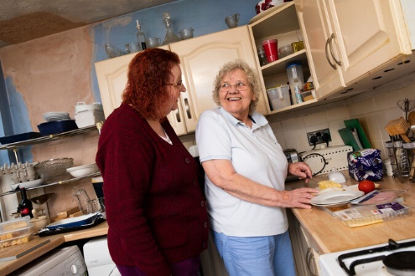
Aims and Objectives
What is already known about food and drink-related needs and outcomes* of older adults using homecare?
What is the profile of and factors related to the food and drink-related needs and outcomes* in England?
* Defined broadly, to include ‘food and drink care-related quality of life’
Notes:
Defined broadly, as ‘food and drink-related quality of life’, i.e. does support with eating & drinking adequately consider personal preferences & psychosocial, cultural, religious/ethical etc. needs – alongside, supporting basic nutrition & hydration.

Slide 5
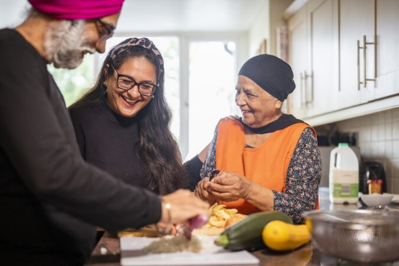
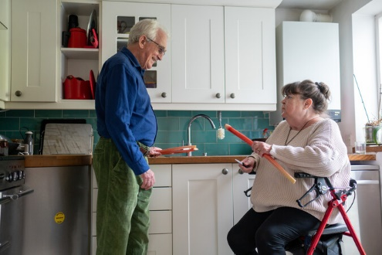
Methods
Scoping literature review
Analysis of the English Adult Social Care Survey (ASCS)
Developing a guide to findings and recommendations

Slide 6
Work Package (WP) 1 - Scoping Literature Review
Objectives
Conduct a systematic search of published works
To gain an overview of the international literature on food and drink-related needs/outcomes of older adults using homecare
What is already known and where are the gaps?
Notes:
Objectives
Conduct a systematic search of published works
To gain an overview of the international literature on food and drink-related needs and outcomes of older adults using homecare
Establish the type and range of methods, measures and theoretical frameworks applied
Identify the conceptual understanding(s) of ‘food and drink-related needs/outcomes’
Identify evidence of effectiveness of direct care, service delivery or policy interventions – where are the gaps?
Identify implications for policy and practice

Slide 7
Work Package (WP) 1 - Scoping Literature Review
Eligibility criteria
Published reports of research studies (journal articles, grey literature)
Published in English language
Published after 2000
Relates to:
Older adults, aged 65 or over…
Using homecare, and…
Food and drink-related needs or outcomes
Including: (mal)nutrition, (de)hydration and/or quality of life

Slide 8
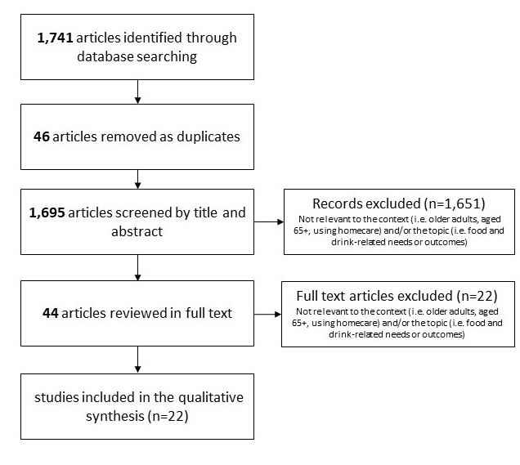
Database searches
Title/abstract review
Full-text review & charting
Qualitative analysis and interpretation
Notes:
Web of Science (Science Citation Index Expanded database, to cover broadly literature published in sciences and social sciences)
Psycinfo (to cover social, behavioural, and health sciences)
SCIE Online (social care-related research briefings, reports, government documents, journal articles, websites)
ProQuest Politics Collection (grey literature)

Slide 9
Work Package (WP) 1 - Scoping Literature Review
Understandings of food and drink needs/outcomes
Narratives around (mal)nutrition → health deterioration → hospitalization
Person-centred care for food/eating and drink/drinking
What is the role of homecare in supporting older adults?
In most studies, the role of homecare was not explicitly considered
Some studies explore person-centred care and the challenges to delivery
Innovations
Combination with other services or assistive technology
Improving or supporting communication between family/unpaid carers, healthcare professionals, homecare and/or other services
Notes:
Acknowledge a challenge of international scoping review – diversity between countries re homecare funding/finance, delivery and legislative or regulatory frameworks.

Slide 10
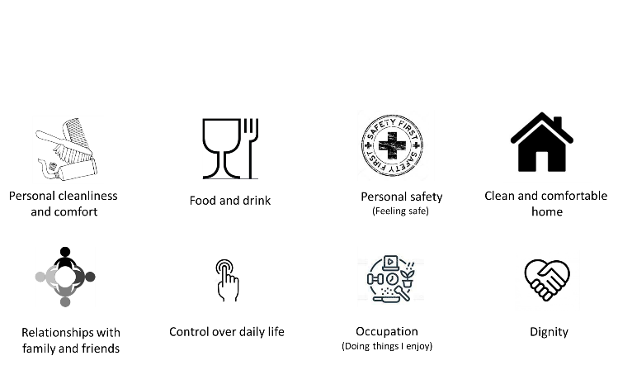
WP2 - Analysis of Adult Social Care Survey Dataset
Annual survey of adults using publicly-managed social care in England
Adult Social Care Outcomes Toolkit (ASCOT)

Slide 11
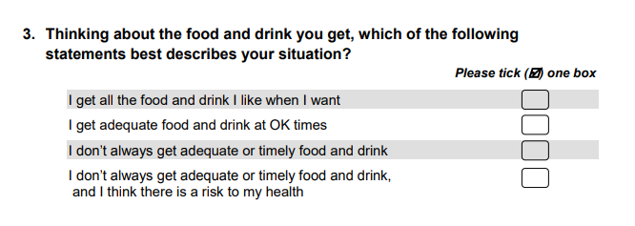
food & drink care-related quality of life
Based on capability approach
(i.e. the ability to do and be, as you wish…)
= Ideal state
= No needs
= Some needs
= High-level needs
Needs met
Unmet
needs

Slide 12
ASCS wave/year | Invited Sample N | Respondent Sample N | Response Rate % | Unmet need N (%)
1. 2010/11 | 67,890 | 29,650 | 43.7% | 1,273 (4.3%)
2. 2011/12 | 63,947 | 28,204 | 44.1% | 1,246 (4.4%)
3. 2012/13 | 68,213 | 28,618 | 42.0% | 1,311 (4.6%)
4. 2013/14 | 71,253 | 29,255 | 41.1% | 1,390 (4.8%)
5. 2014/15 | 72,739 | 28,449 | 39.1% | 1,665 (5.9%)
6. 2015/16 | 73,534 | 28,584 | 38.9% | 1,714 (6.0%)
7. 2016/17 | 73,342 | 27,902 | 38.0% | 1,726 (6.2%)
8. 2017/18 | 70,536 | 23,582 | 33.4% | 1,506 (6.4%)
9. 2018/19 | 76,052 | 25,206 | 33.1% | 1,616 (6.4%)
10. 2019/20 | 77,592 | 23,598 | 30.4% | 1,561 (6.6%)
11. 2020/21 | 9,126 | 2,535 | 27.8% | 147 (5.8%)
12. 2021/22 | 81,474 | 23,193 | 28.5% | 1,879 (8.1%)
TOTAL | 805,698 | 298,776 | 37.1% | 17,034 (5.7%)
An increase in % with unmet needs from 4.3% to 8.1%
Voluntary survey due to pandemic
Decreasing response rate to ASCS

Slide 13
WP2 - Analysis of Adult Social Care Survey Dataset
What are the factors* related to unmet need?
Ethnicity
Sex/gender
Health and care needs (difficulty with everyday activities, anxiety & depression)
Informal help from family & friends
Suitability of home design
Financial contribution towards cost of care
By the person, their family or person & family (combined)
Survey year
Type of local authority
*These are limited by data available in the ASCS dataset or linked data.

Slide 14
 | B | SE | OR
Gender: male | -.115*** | .021 | .891
Ethnicity: categories other than white | .148*** | .030 | 1.160
Local authority †
Unitary | -.014 | .026 | .986
Shire county | -.052 | .027 | .949
Inner London | .202*** | .034 | 1.224
Outer London | .082** | .030 | 1.085
I/ADLs with difficulty | .121*** | .005 | 1.128
Eating and drinking with difficulty | .498*** | .025 | 1.646
Suitability of home †
Meets most needs | .657*** | .024 | 1.929
Meets some needs | 1.429*** | .026 | 4.176
Totally inappropriate | 1.842*** | .040 | 6.310
Informal care / Practical help
Outside home | 1.347*** | .027 | 3.845
Inside and outside home † | .286*** | .047 | 1.332
None | 1.665*** | .033 | 5.283
Privately purchased care (‘top up’) †
Yes, family money | -.047 | .038 | .954
Yes, own & family money | .078 | .058 | 1.081
None | -.164*** | .020 | .849
Response by proxy report | .096** | .030 | 1.101
Preliminary analysis ….
Analysis is still ongoing
† Base category
Local authority - metropolitan Suitability of home - meets all needs
Informal care - inside home
Privately purchased care - own money
** p<0.01
*** p<0.001

Slide 15
 | B | SE | OR
Survey year †
2012 | .008 | .047 | 1.008
2013 | .025 | .046 | 1.025
2014 | .036 | .046 | 1.037
2015 | .136** | .044 | 1.146
2016 | .179*** | .044 | 1.196
2017 | .199*** | .044 | 1.221
2018 | .179*** | .046 | 1.196
2019 | .213*** | .045 | 1.238
2020 | .230*** | .046 | 1.259
2021 | .080 | .107 | 1.084
2022 | .449*** | .044 | 1.567
Constant | -5.300*** | .053 | .005
McFadden’s pseudo r ² |  |  | 12.0%
χ² |  |  | 12,366, df = 29, p<.001
† Base category
Survey year (2011)
** p<0.01
*** p<0.001

Slide 16
WP2 - Analysis of Adult Social Care Survey Dataset
Food and drink care-related QoL (‘outcome’) = care intensity + care quality + functional care needs + individual characteristics
ASCS dataset does not include individual-level care intensity
Estimate of average care intensity per older person using services per LA
From 2015 to 2022 only, due to data availability
Results are similar except….
Ethnicity – no longer significant
Privately purchased care - with own and family money – significant (higher likelihood of unmet need)
Survey year, 2021 – significant (lower likelihood of unmet need) *
Survey year, 2022 – significant (higher likelihood of unmet need)
Average care intensity per person, by LA - significant (lower likelihood of unmet need)
* Survey conducted on a voluntary basis vs mandatory, due to the pandemic.

Slide 17
Summary and Conclusions
Estimated 4% to 8% of older adults living at home using social care have unmet food and drink care-related needs
% increased between 2011 and 2022
Factors related to unmet need….
Survey year (i.e. an increase over time)
Does this reflect wider sector impacts (e.g. workforce shortages, chronic underfunding) or context (e.g. pandemic, cost of living increases)?
Average intensity of homecare per older person in each local authority
This indicates that social care investment ‘works’ overall…
But we are limited by what we can consider in the dataset, so it is hard to say more
Further analysis…
Data linkage – but a challenge with current data collection and reporting
New possibilities based on changes to social care data collection in England…?

Slide 18
WP3 – Brief guide to key findings and Recommendations Development, Dissemination and Implementation
Share preliminary findings from WP1/2:
Identify key stakeholders and reasons for interest
Explore how the findings could be used to inform, engage, influence
Development of a brief guide - summarising key findings and recommendations, tailored to different audiences
Consider contextual issues, in relation to implementation
Facilitate discussion and commitment to further research
Blog post(s)
Project guide and recommendations
On-line event (spring 2024)
Informed by the Knowledge Exchange, Impact and Engagement (KEIE) Plan

Slide 19
Any questions?
s.e.rand@kent.ac.uk
@DrStaceyRand

Slide 20
Food and Care
“Food is loaded with meaning, is grown and cooked by some people for others, who eat it jointly or alone, with all the social specificities this entails – while it is also physical. Living bodies die if they go without it.”
Harbers, Mol, Stollmeyer, 2002,p.207
The language and practices of care are underrepresented in public debates.

Slide 21
Disseminating and implementing the findings
Two questions for you:
Who is the target audience (i.e., who may be interested in this research)?
What terminology would you use to disseminate the findings (i.e., how would you frame the issue)?

Slide 22
Who is the target? Audience/stakeholders
Adult Social Care
Commissioners, providers, care workers
Adults with support needs, using care services
Family and friends
Healthcare professionals
Public Health
Researchers and academics

Slide 23
Framing the issue(s)
Public Health – a focus on ‘healthy eating’; eating and drinking are framed as individual ‘choices’; impact of food poverty… but what about care poverty?
Medicine – ‘Nutrition’ and ‘illness’; eating and drinking are framed as ‘natural processes’.
Social Care – ‘Quality of life’ or supporting a person to live well, i.e., person-centred care; eating and drinking are framed as a ‘task’, i.e., ‘caring’: “wilful and responsive, creative and adaptive, infused by desire and attuned to the circumstances” (Mol, 2021,p.88).

Slide 24
Why is it important?
IMPACT
FUNDS
AWARENESS
INCLUSION

Slide 25
Any questions?
Contact us: Dr Stacey Rand: s.e.rand@kent.ac.uk Dr Lavinia Bertini: L.Bertini@bsms.ac.uk
Project website: www.pssru.ac.uk/foodanddrink/

