Slide 1
The Right to Food and Civic Mission September 2023
Dr Philip Pothen Tilda Ferree
Director of Engagement Food Foundation
Notes:
Introductions : Philip and Tilda

Slide 2
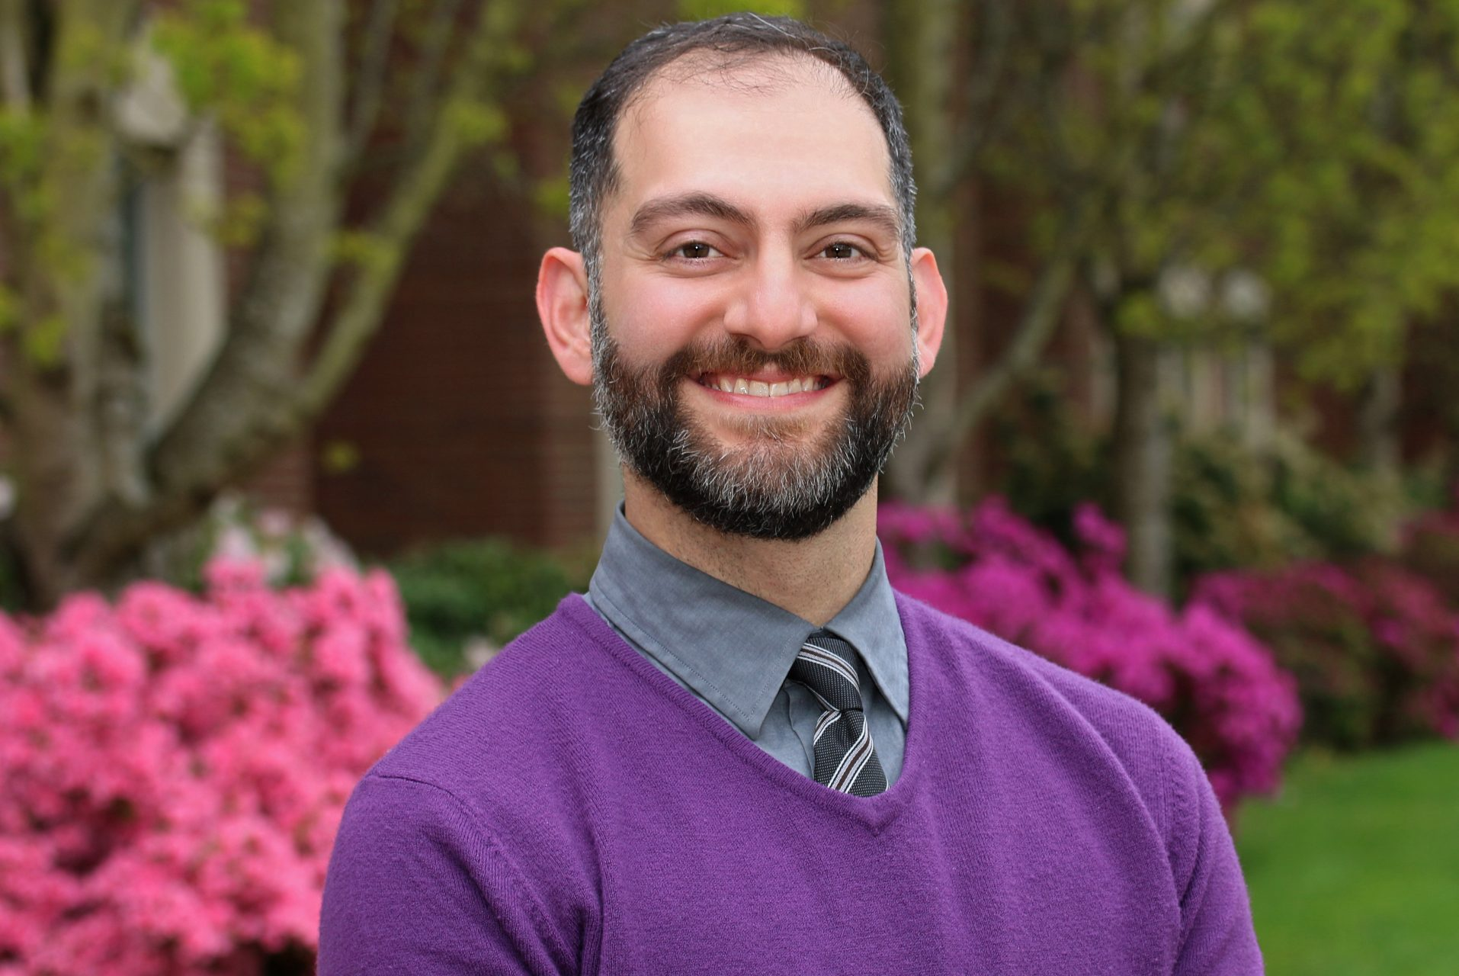
Why a ‘Right to Food’ University?
“Food is not just a commodity, it is the result of a set of practices. It is part of the rhythm of everyday life. We give meaning to life through how and what we eat, who we eat with establishes the bond that create kin and community.”
Michael Fakhri, UN Special Rapporteur on the Right to Food, at University of Kent Centre for Critical International Law, March 2022
The Right to Food is being met when “every man, woman and child, alone or in community with others, have physical and economic access at all times to adequate food or means for its procurement.”
UN Committee on Economic, Social and Cultural Rights (CESCR), General Comment no. 12: The Right to Adequate Food (Art. 11 of the Covenant), 12 May 1999 [para 6].
Notes:
In March 2022, Michael Fakhri, UN Rapporteur for The Right to Food, visited the Centre for Critical International Law at The University of Kent. During his lecture, Michael Fakhri posed the question, “what would a Right to Food University look like?”
This question has inspired The University of Kent, in collaboration with The Food Foundation, to launch a civic mission to establish a Right to Food University.
We are drawing on a legal framework (The Right to Food in international law is articulated in Article 11 of the International Covenant of Economic Social and Cultural Rights (1966). It falls under the general provision of the right to an adequate standard of living: "right of everyone to an adequate standard of living for himself and his family, including adequate food, clothing, housing, and to the continuous improvement of living conditions”) which sets out that food should be available (a stable supply), accessible (people must be able to get and make food in a way that is fair and stable, e.g. through affordable food that is sold, or through access to land to grow food) but crucially “adequate” food should be culturally, ecologically and nutritionally appropriate. What is considered “adequate” will vary across communities and people should have the ability to decide for themselves.
A rights based approach is useful because (points 1 to 5 on the slide)

Slide 3
Why a ‘Right to Food’ University?
We want to move away from a narrative that sees food as a commodity, but as something that is integral to community and a good life.
A rights-based approach puts forward good food as an entitlement, no matter who you are or what your circumstances are.
We want to promote change across the food system, rather than focus on individual responsibility.
We want to ensure a democratic and collaborative process is taken to decide together what good food looks like.
We are joining the “Right to Food” movement that is being taken up by organisations, councils and governments across the country and internationally.
Universities are more than educational institutions – we are also communities where students and staff live, work – and eat – together. How we do that says something very important about who we are, what we are here for and what our values are…
Notes:
In March 2022, Michael Fakhri, UN Rapporteur for The Right to Food, visited the Centre for Critical International Law at The University of Kent. During his lecture, Michael Fakhri posed the question, “what would a Right to Food University look like?”
This question has inspired The University of Kent, in collaboration with The Food Foundation, to launch a civic mission to establish a Right to Food University.
We are drawing on a legal framework (The Right to Food in international law is articulated in Article 11 of the International Covenant of Economic Social and Cultural Rights (1966). It falls under the general provision of the right to an adequate standard of living: "right of everyone to an adequate standard of living for himself and his family, including adequate food, clothing, housing, and to the continuous improvement of living conditions”) which sets out that food should be available (a stable supply), accessible (people must be able to get and make food in a way that is fair and stable, e.g. through affordable food that is sold, or through access to land to grow food) but crucially “adequate” food should be culturally, ecologically and nutritionally appropriate. What is considered “adequate” will vary across communities and people should have the ability to decide for themselves.
A rights based approach is useful because (points 1 to 5 on the slide)

Slide 4
Why should universities promote the Right to Food?
Universities have a civic responsibility and can act as anchors in their communities and regions.
Research and innovation brings new knowledge, insights and real-world application to our understanding of food systems across a wide range of disciplines.
Pathfinders: by sharing learning at a local level, we can create a blueprint for food system change that can be shared across the UK and internationally.
As education institutions, universities can inspire students to become future food activists.
Notes:
Philip – expand and explain in context of University of Kent civic engagement work.
In their commitment to developing new insights and their applications, universities are uniquely placed to understand and therefore to help challenge systemic failings
Universities have involvement across food system levers, including research, business, education, as well as being active food communities.
Tilda – demonstrating what works, and what has limitations at a local level can then inform national policy asks and decision making
Our aim is to pilot projects and track our progress, with the aim of establishing a toolkit and blueprint that is practically useful for other higher education institutions
Universities are also important knowledge hubs, centres for education. We are looking at other awards systems (e.g. Athena Award, Civic Engagement tools) to create a similar model for the right to food.
3) Philip: encouraging students to think about food systems and become advocates for change in the future.

Slide 5
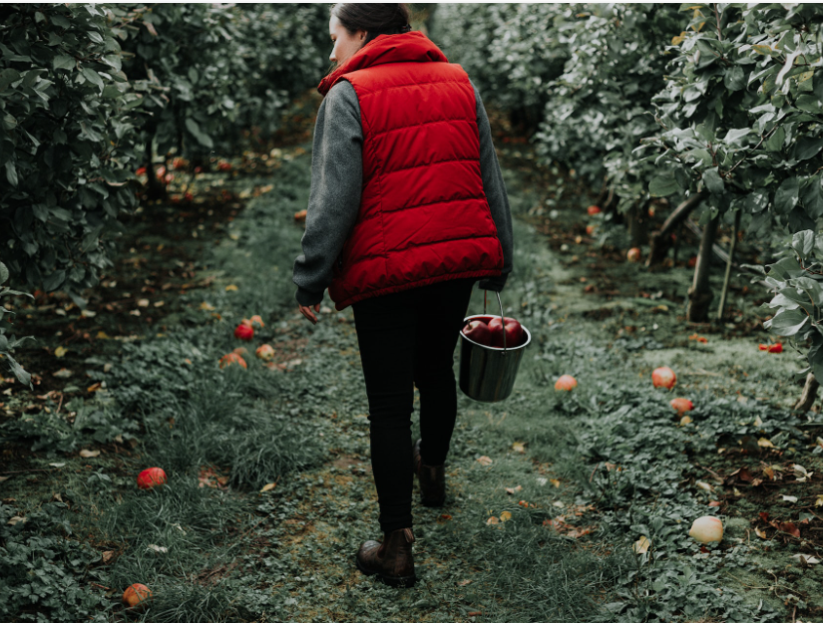
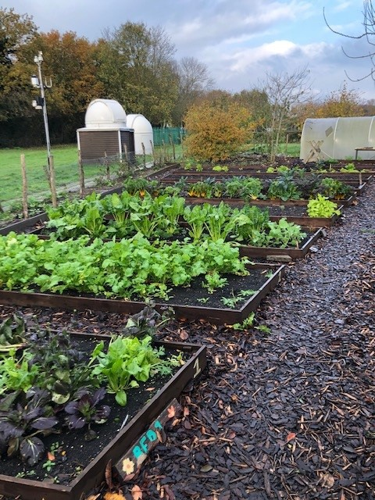
Why the Right to Food at the University of Kent?
We have important research strengths in this area, including work on developing bio-refineries for revalorising food waste for use throughout the food chain; improving food security, and research into regenerative farming practices to reduce environmental impact, etc.
We’re based in the Garden of England, home to over 40% of UK high-value horticultural production and a key gateway to global markets. The UKRI-funded Growing Kent and Medway partnership is helping to shape food production, from handling and distribution processes to producing affordable and nutrient-rich foods.
Our campus is an extraordinary resource – from the Kent Community Oasis Garden and the Diamond Orchard on the southern slopes. The ‘River of Vegetation’ will link these with a rich variety of assets that can be used for learning and teaching, recreation, public engagement and outreach
We are partnering with the Food Foundation, national campaign and advocacy organisation. But we also have important and growing links with local and regional organisations, and growing collaborations, eg gleaning, poverty forum, regional events and engagements, etc.
Notes:
Philip – expand and explain in context of University of Kent civic engagement work.
In their commitment to developing new insights and their applications, universities are uniquely placed to understand and therefore to help challenge systemic failings
Universities have involvement across food system levers, including research, business, education, as well as being active food communities.
Tilda – demonstrating what works, and what has limitations at a local level can then inform national policy asks and decision making
Our aim is to pilot projects and track our progress, with the aim of establishing a toolkit and blueprint that is practically useful for other higher education institutions
Universities are also important knowledge hubs, centres for education. We are looking at other awards systems (e.g. Athena Award, Civic Engagement tools) to create a similar model for the right to food.
3) Philip: encouraging students to think about food systems and become advocates for change in the future.

Slide 6
Notes:
The rationale behind the missions: We have set out a series of missions and objectives, that draw together the way that the University of Kent has influence over the food system currently e.g. through its teaching and research, through its procurement frameworks, through the food it grows and serves on campus (missions 2 and 3), and the potential it has to make a positive impact on the food system regionally and within the higher education sector (missions 1 and 4).
We want to avoid working in silos: like the food system the missions are cross-cutting, aiming to work towards environmental goals and tackle food insecurity. Out audience expands beyond the immediate university community of staff and students, to include the food sector in Kent, and similar anchor institutions.
How we formed these ideas: after the question posed by Michael Fakhri, the missions were socialised and through this process, we narrowed them down and selected missions that played to the current strengths of the university. Some of the timing was fortuitous e.g. The University had recently received Strength in Places funding from UKRI for the Growing Kent and Medway partnership.

Slide 7
Goals:
To host an annual Food Summit, bringing together partners across business, research and civil society to learn more about the Right to Food University mission and provide a platform for collaboration.
Host learning visits about what being a Right to Food University means and how it can be achieved.
Develop a blueprint that inspires and mobilises other universities and organisations in the UK and internationally.

Slide 8
So far…
In February this year we launched the project, making a public commitment to start implementing actions that will support our four missions.
We are keen to support an official visit by the UN special Rapporteur on the Right to Food, to shine a light on the issues of food insecurity and sustainability in the food system in the UK.
We are recording and sharing the progress of the project as it advances, building a narrative and blueprint that we hope will inspire others.

Slide 9
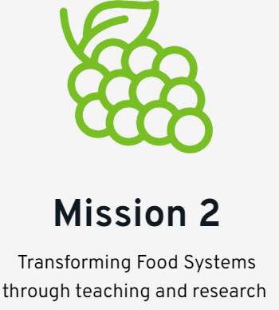
Goals:
Integrate a stronger food focus across the curriculum with a view to embedding, promoting education and research into the role of food within the promotion of human health and a fair society.
To develop training on food security for professional courses, such as social work.
To develop a transdisciplinary course on food systems transformation.
To offer applied learning opportunities for students including study work placements and volunteering opportunities through partnerships with local organisations and businesses.

Slide 10
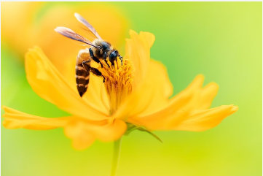
So far…
We have carried out a curriculum audit and begun the process of engaging academics already working in teaching and research on food systems.
Through Growing Kent & Medway, we are supporting sustainability in food businesses.
Researchers are collaborating with farmers on regenerative agriculture, revalorising food waste and engaging our communities in learning activities.

Slide 11
The Right to Food curriculum audit
“Integrate a stronger food focus across the curriculum with a view to embedding, promoting education and research into the role of food within the promotion of human health and a fair society”
Health, Care and Wellbeing
Poverty and inequality
Social Policy, Health Policy including international perspectives
Sustainability
Law – Environmental and Land
Identity and representations of the body – Cultures of Embodiment
Art and Aesthetics of Food
History
Animals and Society
Bio-cultural perspectives
Anthropology
Biogeography/ecology/conservation
Sports Science and Applied Nutrition
Business and Marketing
Food distribution and production
Notes:
Philip – expand and explain in context of University of Kent civic engagement work.
In their commitment to developing new insights and their applications, universities are uniquely placed to understand and therefore to help challenge systemic failings
Universities have involvement across food system levers, including research, business, education, as well as being active food communities.
Tilda – demonstrating what works, and what has limitations at a local level can then inform national policy asks and decision making
Our aim is to pilot projects and track our progress, with the aim of establishing a toolkit and blueprint that is practically useful for other higher education institutions
Universities are also important knowledge hubs, centres for education. We are looking at other awards systems (e.g. Athena Award, Civic Engagement tools) to create a similar model for the right to food.
3) Philip: encouraging students to think about food systems and become advocates for change in the future.

Slide 12
Transforming Food Systems through teaching and research
How is food currently embedded in teaching and research at your institutions or work?
What more could be done to integrate a food focus across the curriculum at universities?
What value can the Right to Food bring to teaching and research?

Slide 13
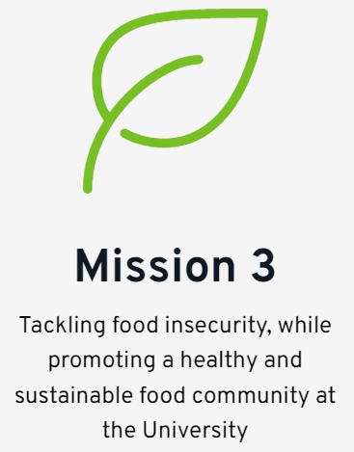
Goals:
To increase free or subsidised food provision, e.g. by developing a social supermarket and community fridges.
To develop and track the progress University’s Sustainable Food Action Plan with the catering and procurement teams.
To turn Medway and Canterbury into ‘Edible Campuses’ setting aside green space for growing and learning about food.

Slide 14
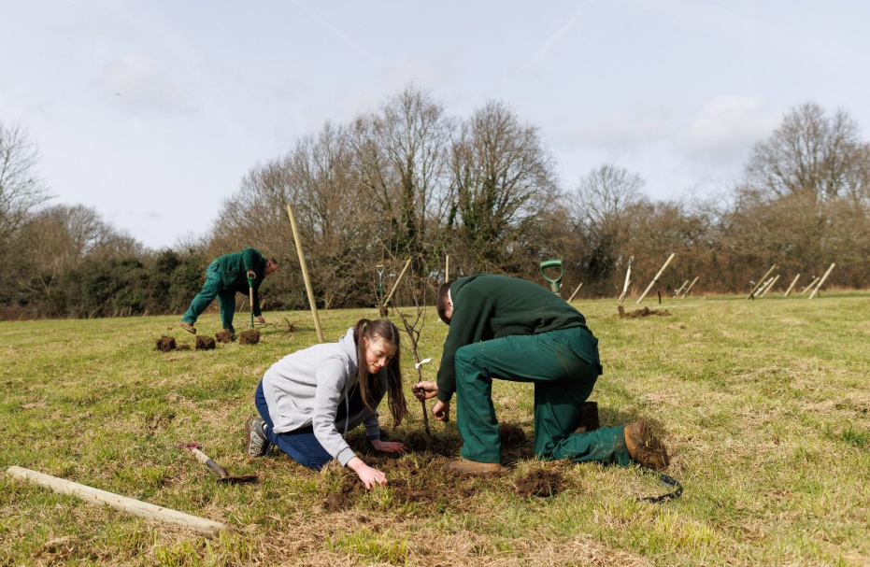
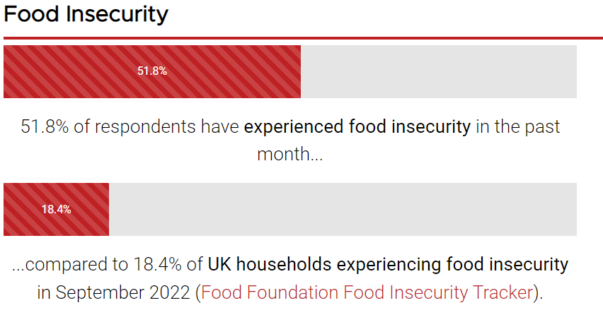
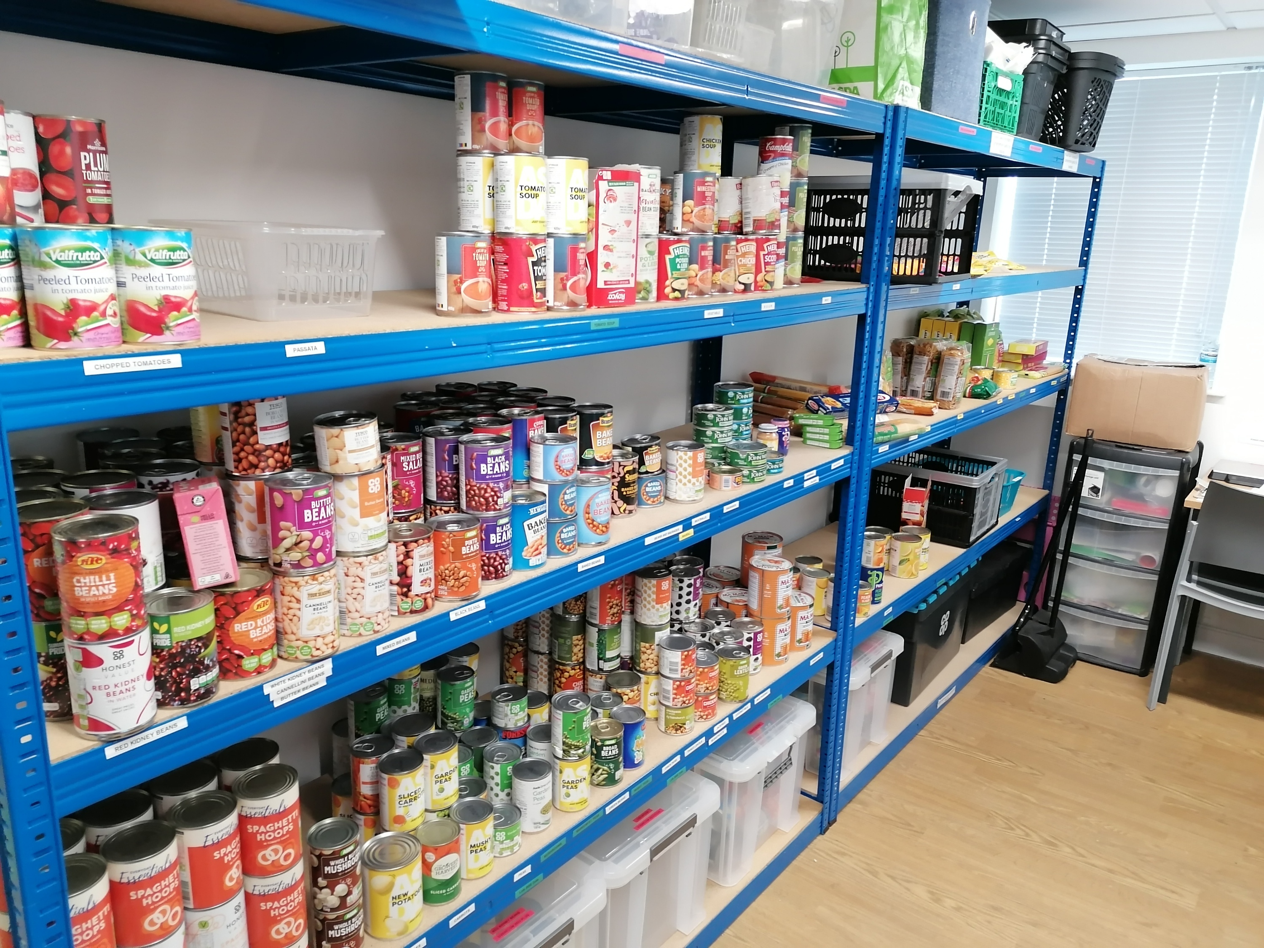
So far…
We have expanded the university’s growing space from Kent Community Oasis Garden, by developing the Jubilee Orchard of over 300 fruit and nut trees on the University’s estate.
We have carried out a cost of living survey among students and staff to understand the scale of food insecurity.
Kent Union have established The Campus Pantry, where students can access free food as well as advice and support.
We are offering subsidised £3 meals for students (£3.60 for staff) at our main outlets.
Notes:
The environment in which people buy food is a major driver of their choices. The specific dietary drivers which are most powerful are price & affordability; marketing & appeal and availability.
We want to make it easier for those on campus to eat healthily and sustainably, to support local producers, reduce waste and support a fair supply chain.

Slide 15
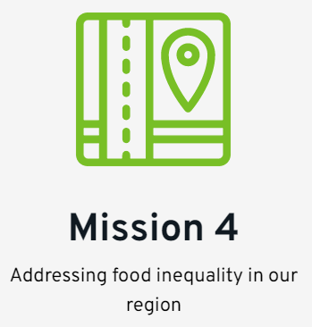
Goals:
We will engage with local authorities, charities, schools, farmers and communities across Kent to develop a plan to tackle food inequality across the county.
The University of Kent will offer space to local food organisations to host events, training, innovation and fundraising, including establishing a Community Kitchen for food entrepreneurs and charities.
We want to offer students opportunities, through placements and volunteering, to support local food charities and organisations tackling food insecurity.

Slide 16
So far…
We have offered kitchen space to a local food charity, so they can continue to provide nutritious meals to families via a network of community fridges.
We have launched a gleaning project, alongside Produced in Kent, Kent Union and the University.
The University has steering group membership on the Kent Food Partnership, which is part of Sustainable Food Places.

Slide 17
National Civic Impact Accelerator
“The NCIA’s vision is to increase the connectivity, momentum, and effectiveness of the HE sector’s civic activities for local societal, economic, and environmental benefit and maximise the contribution universities can make towards addressing societal challenges and responding to policy priorities.”
A two-year, UKRI-funded initiative led by Civic Universities Network, Sheffield Hallam and NCCPE
Kent is one of 12 universities/consortia chosen to be involved, out of 38
The Right to Food was the central pillar of our application
Action learning groups will pool knowledge, insight and intelligence from their work and each university will learn from the others involved
Gather evidence to support decision-making and share with the wider sector
Funding will support activities at important moments of the programme, building an evidence base and seeding innovation
Notes:
The relationship with The Food Foundation came about during the visit of the Special Rapporteur, when he met with The Food Foundation’s young food ambassadors. The Food Foundation is a charity whose mission is to increase access to healthy and sustainable food. We work with national decision makers on policy, with businesses to change practice, and with citizens, engaging them as advocates for food system change. This partnership with the university of kent holds the promise of showing what role anchor institutions can play in changing the local food policy landscape.
The Food Foundation brings links to networks and expertise to the partnership, as well as a conduit for disseminating best practice and influencing national policy. Helping us to understand what the limits are as well of local system influencers, and therefore what needs to happen at a policy level e.g. universities may not have the financial or human resources to effectively implement and enforce food policy initiatives, like dynamic procurement, limited jurisdiction - universities have limited jurisdiction over food systems, for example: implementing consistent measurement and the standardised company reporting, setting environmental and land management criteria for producers, c) address structural inequalities that impact access to healthy food, such as income inequality
2) The steering group has representation from academic staff in natural sciences and social justice, kent business school, the catering and procurement departments, sustainability team kent union, hr and communications.
3) Food starts conversations: we’ve been approached by community organisations interested in collaborating, and actively reached out to partners. The University now sits on the newly formed Kent Food Partnership.
4) Having established our missions and key objectives, we launched in February 2023, making a public commitment to becoming a Right to Food University.

Slide 18
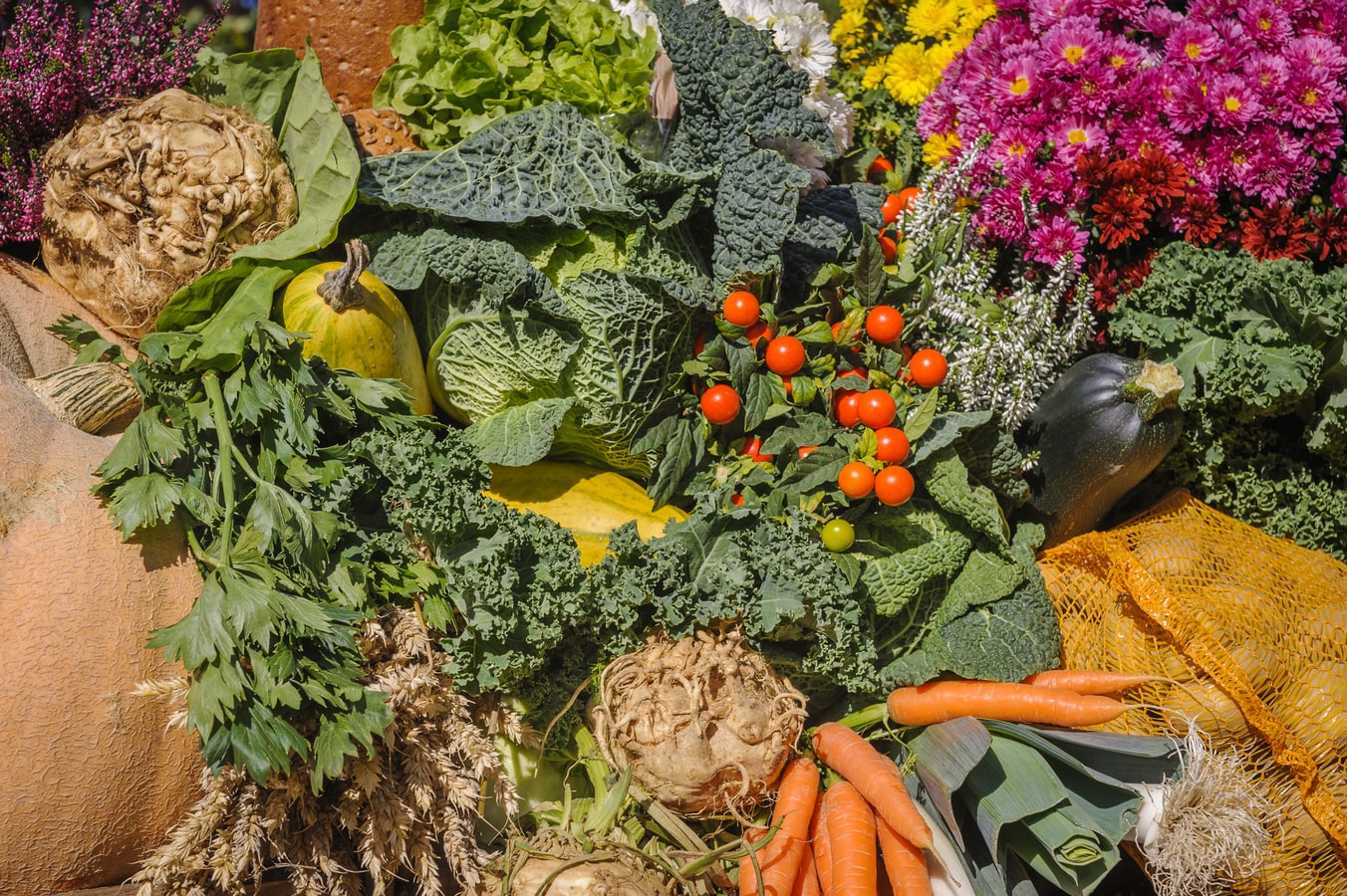
Potential challenges
Maintaining a focus on the whole food system, in the context of the cost of living crisis.
Financial pressures on universities
Time and staff capacity
Monitoring our impact
Engaging certain stakeholders: farmers, schools, colleges, seldom-heard groups.

Slide 19
Plans and next steps
Raising funding to support future plans
Developing a blueprint or model that can be shared with other higher education institutions.
Increasing our engagement, particularly with students, academics and regional stakeholders.
Building a network of interested and engaged universities and sharing the journey of the project.

Slide 20
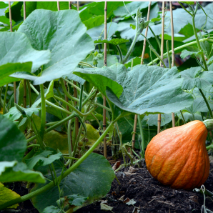
Get involved
Please get in touch to find out more or share ideas, by emailing: righttofood@kent.ac.uk
We’ll be sharing news, updates and blogs on our website: https://www.kent.ac.uk/right-to-food
JISCmail discussion list: right-to-food@jiscmail.ac.uk
We’ll be sending a monthly newsletter on the project’s progress. We want to showcase what other universities are doing too, so please email us with your contributions!

