Slide 1
Beavering away
Using the power of nature to underpin sustainable rural business
Archie Ruggles-Brise
Spains Hall Estate
Finchingfield, Essex. UK
www.spainshallestate.co.uk
spainsestate
spainshallestate
spainshallestate
spainshall

Slide 2
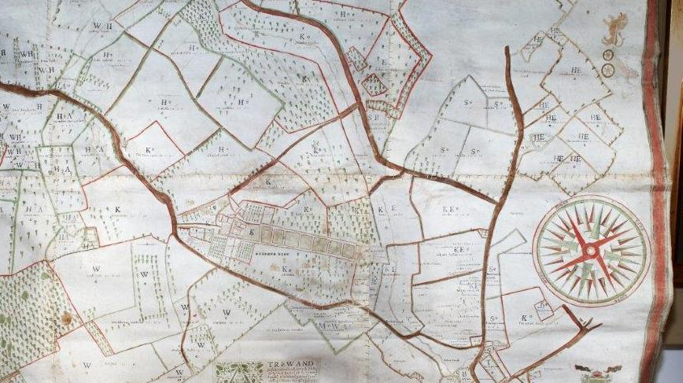
Multi-generational approach
In the same family ownership for over 260 years
11th Generation
Land-based
Food-first approach by default
Currently a predominantly passive rental land model
Is this sustainable?

Slide 3
Current FInancials

Slide 4
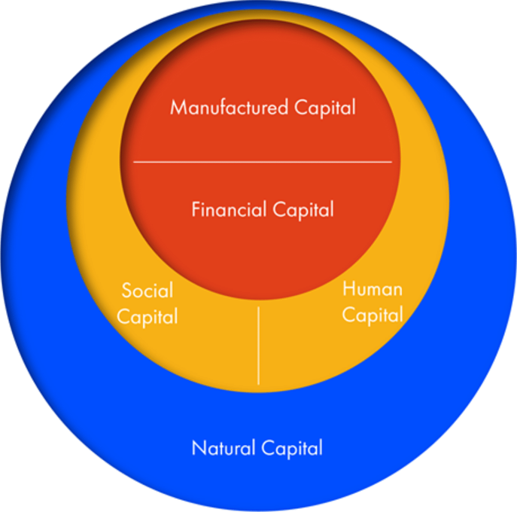
Move towards a Holistic Approach
Systemic change
River Catchment
Conceptual framework
Natural flood management
Problem solving
Nature-based solutions
Lower cost, longer term?
Natural Capital appraisal
Risk + Opportunity

Slide 6
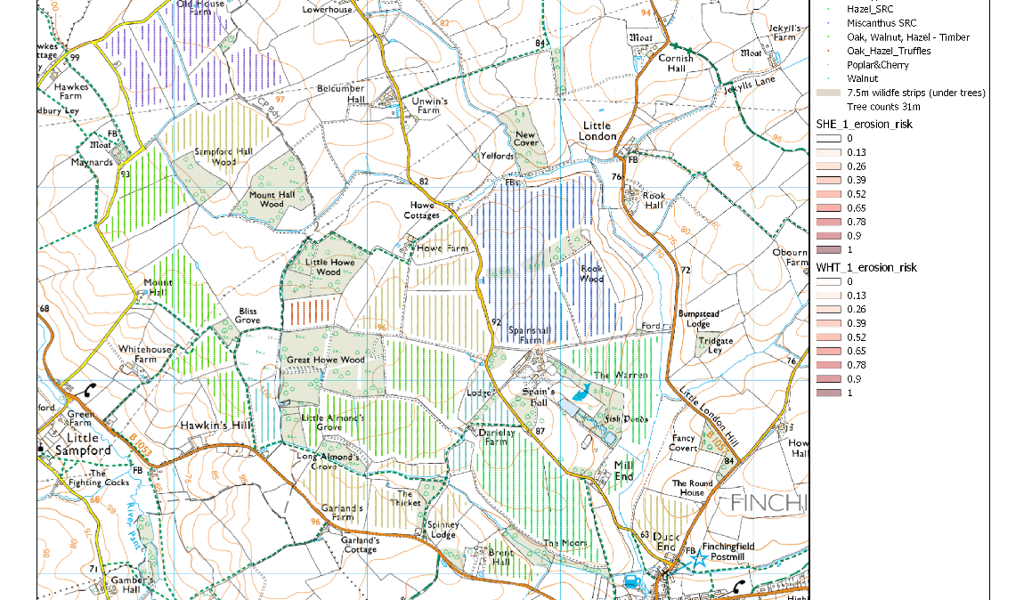
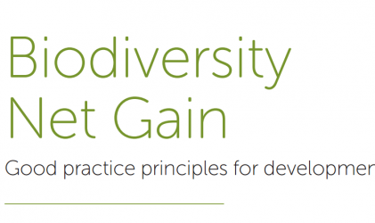
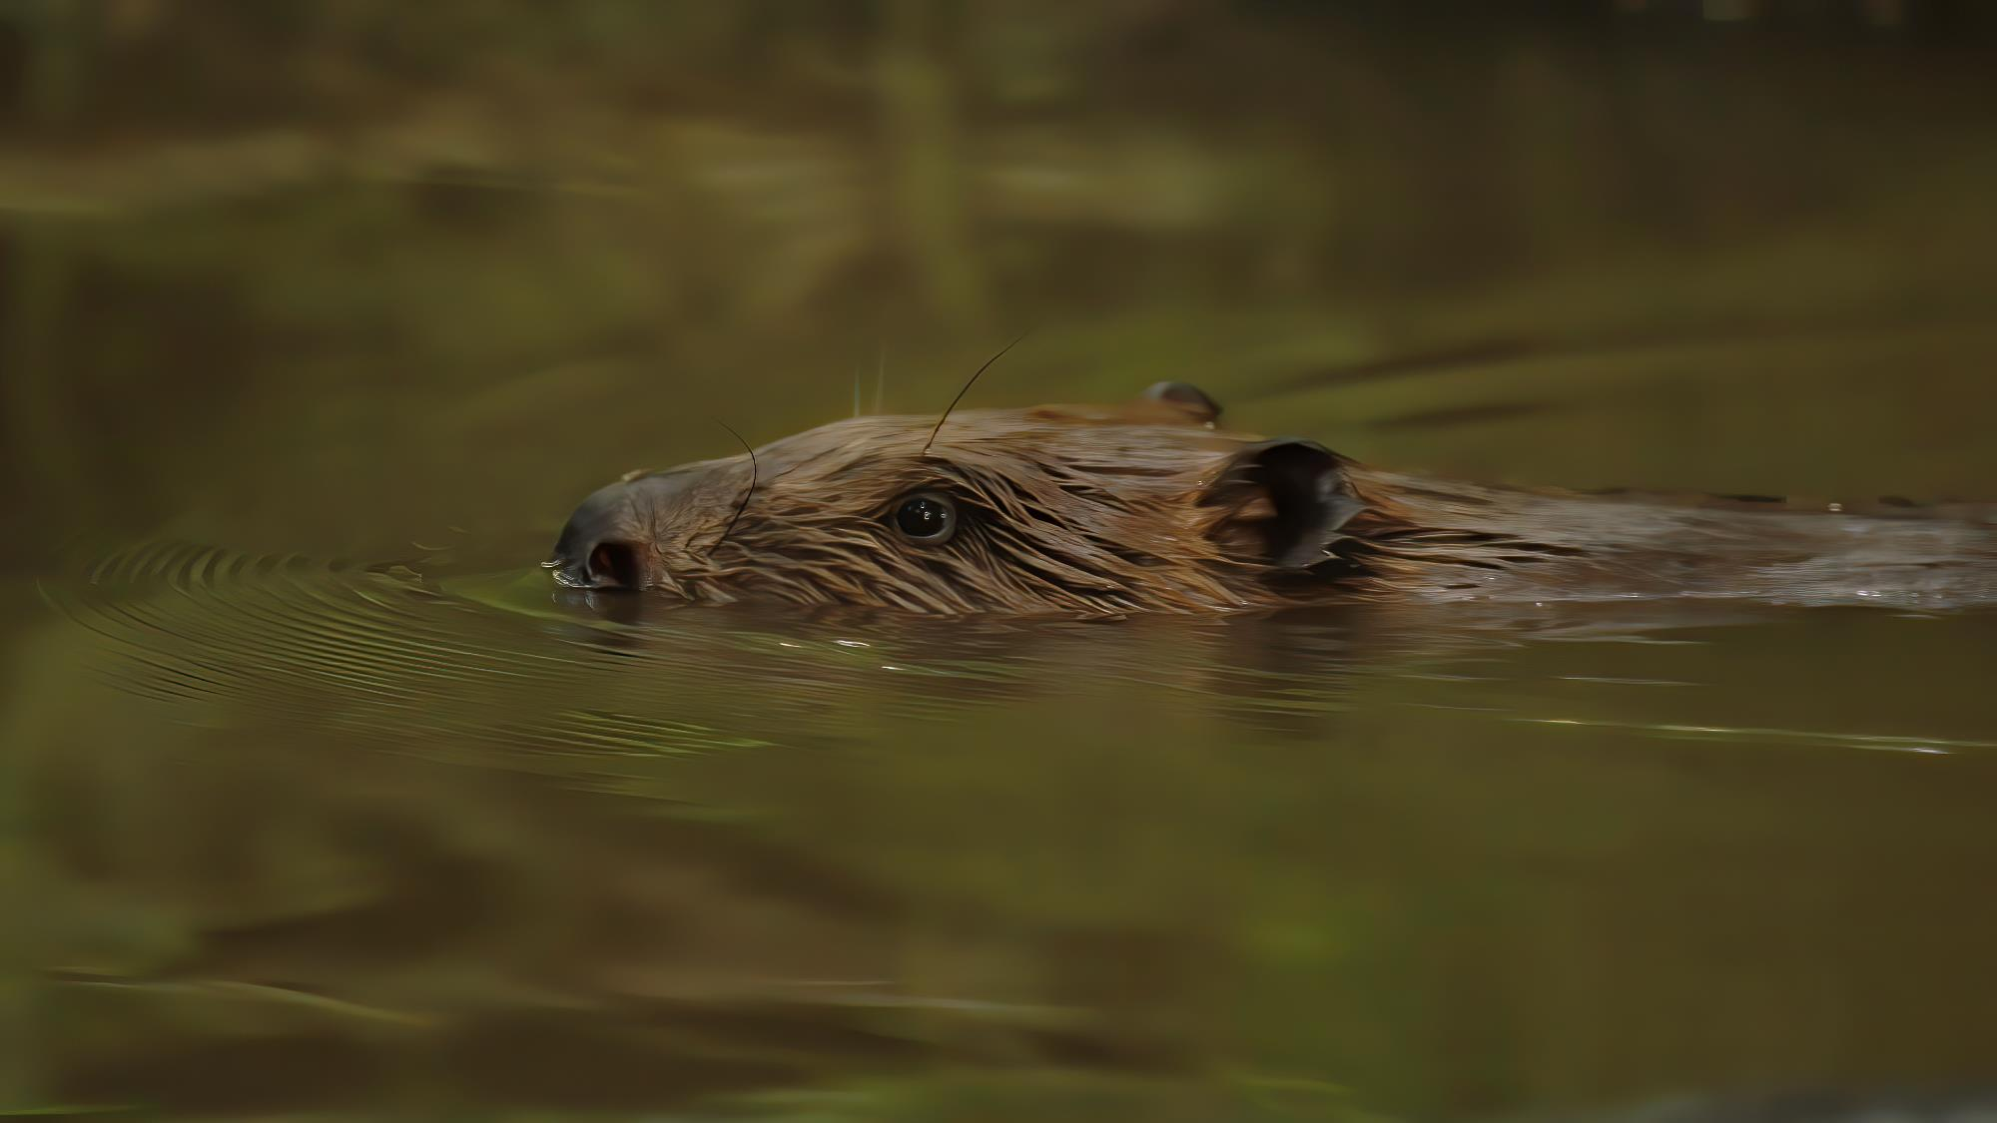
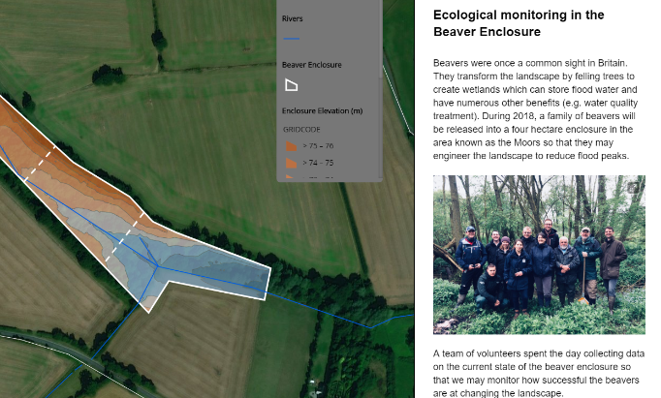
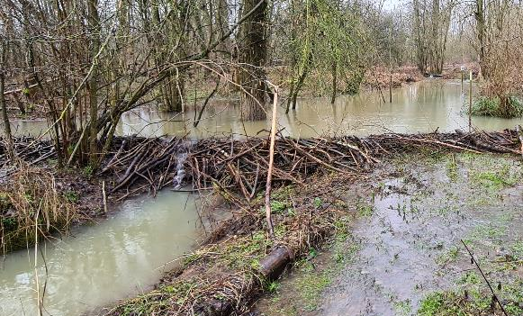
Implementing change
20+ year plan
50+ year vision

