Slide 1
Data, Analysis and Research in MoJ
Ben Hepworth and Sarah Pike
Data and Analytical Services Directorate (DASD)
February 2021

Slide 2
Overview
The Ministry of Justice (MoJ)
Data, analysis and research in MoJ
The Areas of Research Interest (ARI)
Data First
Keeping in touch

Slide 3
The Ministry of Justice
The Ministry of Justice (MoJ) is a major government department, working to protect and advance the principles of justice and deliver a world-class justice system that works for everyone.
Significant, wide-ranging responsibilities across England and Wales, with implications for some of the most vulnerable people in society.
Courts, prisons, probation services, protecting the public, reducing reoffending, children and families, youth justice, legal aid, and much more.
A ministerial department, led by Lord Chancellor and Secretary of State for Justice, the Rt Hon Robert Buckland QC MP, and his ministerial team.
Supported by 34 agencies and public bodies.

Slide 4
Data, analysis and research in MoJ
We work in the Data and Analytical Services Directorate (DASD) at the heart of MoJ.
The DASD vision is to generate greater insights that drive improvements across the justice system to really change lives.
We are a diverse community of (400+) professional analysts from the Government Analytical Professions.
We work with our colleagues in policy/operations/finance/corporate services through the provision, usage, and interrogation of data and evidence to support decision-making.

Slide 5
Data, analysis and research in MoJ
Better analysis. Better delivery.
Analysis Function Strategy 2018–2021, Version 3.0 [GOV.UK]

Slide 6
Data, analysis and research in MoJ
We work in the DASD Evidence and Partnerships Hub. Our vision is to enhance MoJ’s strategic research capabilities by collaborating and partnering with academic experts, research networks and research funders to address our evidence priorities.
Activities we are responsible for include:
Publication and dissemination of the ARI
Knowledge/expertise exchange and brokerage
Events, seminars and workshops
Maintaining an Academic Network
Facilitating secondments and fellowships
Supporting and unlocking funding

Slide 7
Data, analysis and research in MoJ
We need robust research and analysis – whether that is conducted internally, commissioned, or through external collaboration.
We need to understand who, why and how people come into contact with our system and what we can do to improve their experiences and outcomes.
We are committed to enhancing the way data and evidence is used, to shape policy and operational decisions and drive improvements to justice outcomes.
The Areas of Research Interest (ARI) publication reflects this: it will be used as the basis for ongoing conversations, collaboration and challenge with experts in academia, research organisations and funding bodies.
Our aim is to increase the available evidence against our priorities, enhance our combined strategic research capabilities, and reinforce the impact of evidence at all stages of policy and operational development and evaluation.

Slide 8
Areas of Research Interest

Slide 9
The Areas of Research Interest (ARI)
The Areas of Research Interest (ARI) initiative is a cross-government undertaking, promoted and facilitated by the Government Office for Science and Government Chief Scientific Adviser.
Followed the 2015 Nurse Review of UK Research Councils recommendations to achieve:
A more strategic approach to departmental research and development programmes
A more sophisticated dialogue with academia
Documents that set out the most important research questions facing each department
Aims to align scientific and research evidence within government policy and operational decision-making.
Highlights key research questions and evidence gaps that could be filled by external research.
MoJ published its first ARI in 2018 and updated this in December 2020 – it can be found on GOV.UK along with the ARIs of other government departments.

Slide 10
The Areas of Research Interest (ARI)
Themes and questions developed through a comprehensive assessment of the department’s evidence needs, in consultation with our internal partners and colleagues in partner agencies.
Summarises MoJ’s evidence needs over the next three-to-five years, aligned with the department’s strategic objectives for the justice system. A high-level narrative frames each of these objectives, along with a more detailed set of research questions.
Some areas of interest remain similar to our first ARI publication in 2018, reflecting long-standing and complex evidence needs; others are new or have heightened significance against the current social and political context.
Not an exhaustive or definitive list of research questions, nor are they listed in any order of priority.
We aren’t the experts in any area.

Slide 11
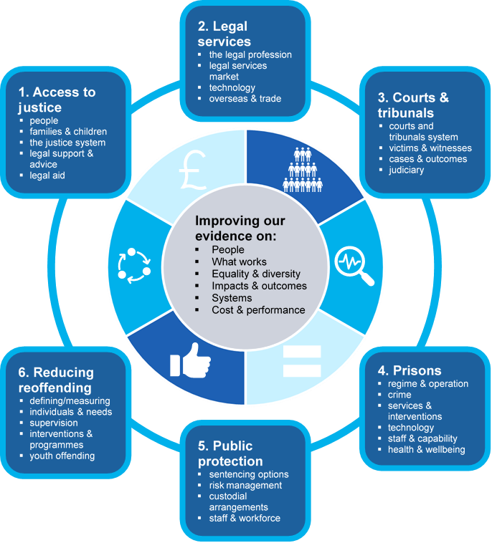
IMPROVING
JUSTICE
OUTCOMES
through innovative research, data, and analysis

Slide 12
1. Access to justice
people
families & children
the justice system
legal support & advice
legal aid
We want to improve the way people are supported in their interactions with the justice system, to target timely and efficient resolutions that lead to positive and sustainable outcomes for all parties involved.

Slide 13
1. Access to justice: example questions
People
What are people’s experiences of dealing with justice problems? How can they be supported to access and navigate the justice system, enforce their rights, and achieve the best outcomes?
Families and children
What are the long-term impacts on children’s developmental outcomes because of placements made under public law orders in care proceedings? Including care orders, placement orders, and special guardianship orders?
Legal aid
How do geographical and demographic factors affect legal aid awareness and uptake? How does legal aid uptake vary by eligibility?
The justice system
How can we better understand drivers of demand in the justice system, so that we support early problem resolution where appropriate, whilst ensuring the formal justice system is accessible to those who need it?
Legal support and advice
How do we improve legal awareness and capability in the population, so that people are able to identify they have a legal problem and seek appropriate help?

Slide 14
2. Legal services
the legal profession
legal services market
technology
overseas & trade
We want to create the conditions for the UK’s legal services sector to flourish by developing a sustainable, efficient and effective system. This includes securing legal services market access overseas, growing the UK’s market share, and enhancing the international competitiveness and attractiveness of the legal sector.

Slide 15
2. Legal services: example questions
The legal profession
Why do recruitment, career progression and pathways, and retention within the legal profession, vary by protected characteristics, socio-economic and socio-demographic background?
The legal services market
What works to promote and maintain competitiveness within the legal services market and ensure individuals can access quality services at a fair and accessible price, whilst growing the sector overall?
Technology
How much specialist technological (LawTech) investment and adoption takes place in the legal sector? How does this differ by the type and size of legal firm or organisation, and for what services and outputs?
Overseas and trade
What are the legal activities of UK firms and legal professionals that are permanently established in non-EU, overseas and emerging markets?

Slide 16
3. Courts & tribunals
courts and tribunals system
victims & witnesses
cases & outcomes
judiciary
We want to modernise the procedures and infrastructure of our courts and tribunals, leading an effective, efficient and coordinated justice system across all the civil, criminal and family justice jurisdictions.

Slide 17
3. Courts and tribunals: example questions
The courts and tribunals system
How do individuals in the courts and tribunals system vary by, for example, protected characteristics, socio-economic or socio-demographic background? How do these characteristics compare across jurisdiction and case type?
Victims and witnesses
What are the needs and experiences of victims, defence witnesses, and those in distressing civil, family, or tribunal cases? How does this vary by protected characteristics, socio-economic or socio-demographic background and jurisdiction?
Cases and outcomes
What are the reasons for case attrition and what works to avoid it, for different case types? What are the impacts of case attrition on victims, particularly for serious violence and sexual abuse cases?
The judiciary
What are the career pathways and recruitment journeys into the judiciary? How do protected characteristics and social mobility affect recruitment?

Slide 18
4. Prisons
regime & operation
crime
services & interventions
technology
staff & capability
health & wellbeing
We want to provide decent, safe and secure accommodation that supports individuals in their rehabilitation. We want to reduce levels of violence and self-harm and develop the evidence on what structures and interventions can help improve outcomes for individuals in prison.

Slide 19
4. Prisons: example questions
Prison regime and operation
How effective are different prison types, categories and functions, such as reception, training and resettlement, in meeting their core objectives?
Services and interventions
How can services and therapeutic interventions, such as training, peer and family relationship support, and drug and addiction services, improve post-release outcomes?
Technology
How effective are different types of technology across the estate in ensuring prisons are safe, secure, fair, inclusive and productive?
Crime
How does intra-prison crime manifest and what are the associated costs?
Staff and capability
What is the optimal workforce model – in terms of staff volumes, diversity, specialisms and experience levels – to ensure the right level of support?
Health and wellbeing
What works to reduce levels of self-harm and self-inflicted death in prisons, for different individuals and groups? How can mentoring, peer support and staff relationships help in reducing self-harm?

Slide 20
5. Public protection
sentencing options
risk management
custodial arrangements
staff & workforce
We want to build confidence and trust in a system that upholds public protection and creates the conditions for individual rehabilitation. We want to better support the probation service in using evidence-based decision-making.

Slide 21
5. Public protection: example questions
Sentencing options, including alternatives to custody
What factors affect the likelihood of different groups receiving different sentences, including custodial, community or other court disposal sentences? How do sentencing recommendations vary by the availability of different options?
Risk management
What works to effectively manage risk and ensure public protection for individuals convicted of serious violent and sexual offences?
Custody and custodial arrangements
What is the impact of home detention curfew, in advance of custodial sentence completion, on individual outcomes and risk to public protection? How can home detention curfew be improved?
Staff and workforce
How can we better understand the future demand and needs of our workforce – including learning and development needs – to ensure effective workload management, particularly in relation to serious and high-risk cases?

Slide 22
6. Reducing reoffending
defining/measuring
individual & needs
supervision
interventions & programmes
youth offending
We want to address the causes of reoffending using personalised evidence, live data, and digital services to better target and sequence interventions. To do this we need to build the evidence base that can inform the development of more holistic measures than ‘proven reoffending’, factoring in a broader range of outcomes.

Slide 23
6. Reducing reoffending: example questions
Defining and measuring reoffending
How accurate is the proven reoffending rate and how does it vary by different groups?
Individuals and needs
What are the risks, needs, protective and promotive factors of different groups? Particularly those with multiple disadvantage, or multiple complex needs?
Supervision and environment
What works to build and sustain positive relationships between staff and individuals under supervision? How does staff diversity impact on relationships with individuals?
Interventions and programmes
What works to reduce reoffending for different groups? For example, those with mental health problems, or those repeatedly convicted of low-level offences?
Youth offending and reoffending
How can we identify children that are at risk of offending at an early stage? How can we prevent the transmission of intergenerational offending to children and young people in families with a history of offending?

Slide 24
Cross-cutting themes
equality and diversity
health and wellbeing
intersectionality
space and place
pathways and outcomes
relationships and trust
perceptions
The overarching themes that structure this ARI are closely linked, with several questions and issues that cut across them. Some extend beyond MoJ and reflect the interests of other government departments. We want to encourage research that is tangential across multiple objectives and outcomes, to develop a holistic approach to analysis that supports policy and operational decision-making.

Slide 25
Cross cutting themes: example questions
Equality and diversity
How do protected characteristics and socio-demographic differences impact upon interactions with the justice system?
How can we better understand and account for population-level differences, experiences and inequalities in our policies, particularly for Black, Asian and Minority Ethnic (BAME) individuals?
Intersectionality
How do multiple sources of disadvantage combine and reinforce over an individual’s time within the justice system?
Pathways and outcomes
How do individuals within the justice system move through it, interacting with multiple (often disparate) agencies, services, interventions and policies? How we can develop, target, sequence, and measure the outcomes of, interventions and support?

Slide 26
Research methods
operational research methods
data science/ML/AI
experimentation/evaluation
social research methods
statistical techniques
behavioural science
data mapping and linking
Multi-disciplinary methodologies and approaches are essential to improving the evidence base and unlocking new insights. We want to build our internal capability to apply cutting-edge analytical and research methodologies. We are keen to engage with researchers across a range of disciplines, to explore how innovative methods could be applied to justice research.

Slide 27
Research methods
Data science, machine learning, and artificial intelligence: algorithmic decision-support and decision-making; NLP, feature extraction, textual analysis; AI transparency/accountability/fairness/‘explainability’.
Experimentation, implementation, and evaluation: evaluation approaches and randomised control trials; pre- and quasi-experimental methods; theory-based evaluation and value-for-money evaluation.
Social research methods: qualitative research and ethnographic methods; advances in ‘big qual’ methodology; quantitative social research methods such as sequence and cluster analysis.
Operational research: simulation, agent-based modelling and hybrid modelling methods: optimisation methods; forecasting techniques; resource modelling, and performance frameworks.
Statistical techniques: analysing and interrogating administrative and other data, particularly missing information, low frequencies and counts, and approaches to data linkage.
Data mapping and linking: improving the quality and use of administrative data through developments in cutting-edge data linking methodologies – which brings us to Data First…

Slide 28
Data First

Slide 29
Data First
Ambitious data-linking programme led by MoJ and funded by ADR UK (Administrative Data Research UK)/ESRC.
Unlock the potential of the wealth of data already created by MoJ, by linking administrative datasets from across the justice system and beyond.
Enabling accredited researchers, across government and academia to access anonymised, research-ready datasets in an ethical and responsible way.
By working in partnership with academics to facilitate research in the justice space, we will create a sustainable body of knowledge on justice system users and their needs, pathways and outcomes across public services.

Slide 30
Data First
Linking criminal, family and civil justice administrative datasets can build a picture of the characteristics of justice system users and their interactions with the courts, prisons and probation services.
Understanding these characteristics, patterns of frequent use, and common transitions between different services, can help develop our understanding of ‘what works’ to improve experiences and outcomes and inform the development of policies and services.
The project is designed to facilitate links with our research and academic partners; by working in collaboration, we will identify priority areas for analysis to make best use of the data.
Linking MoJ data with that of other government departments is intended to develop our understanding of how justice system users interact with other public services. This will enable further insight into how social, economic and educational backgrounds can influence their pathways and outcomes.

Slide 31
Internal Linking
Improving the quality and potential of MoJ datasets by linking criminal, civil and family justice data
Mapping
Understanding the scope, breadth and quality of data we hold by creating data catalogues
External Linking
Broadening the potential of MoJ data by linking data across other government departments
Data
First
Research
Developing a sustainable body of evidence from linked data to enhance strategic research capacities and inform policy
Sharing Lessons Learnt
Sharing experiences and lessons learnt from this pioneering project across government and academia
Sharing
Making linked data accessible for researchers across and outside government via DEA accredited processors

Slide 32
Data First
Data sharing timeline
June 2020
Magistrates’ court defendant case level dataset
MoJ-DfE dataset
Aug. 2020
Crown Court defendant case level dataset
Sept. 2020
Linkage of the criminal court datasets
Feb. 2021
Prisoner custodial journey dataset
2021
Linkage of criminal courts, prisons and probation datasets
Family justice dataset
2022
Linkage of criminal, civil and family justice datasets

Slide 33
Keeping in touch
Join our Academic Network (we will be in touch in March) and look out for opportunities to get involved with our engagement programme – seminars, workshops, knowledge exchange events.
Areas of Research Interest: https://www.gov.uk/government/publications/ministry-of-justice-areas-of-research-interest-2020
Data First: https://www.gov.uk/guidance/ministry-of-justice-data-first
Drop us an email if you have research findings that addresses any of our ARI questions, are submitting a research funding proposal that is likely to generate such findings, or have questions about Data First that aren’t answered on the above page:
researchsupport@justice.gov.uk
datafirst@justice.gov.uk

